Slide 1
FFRDC Business Operations and Management
Presented By: Stephen Davis, Contracting Officer
Chief, Management Operations and Support Branch
Notes:
For a more accessible version of this file or to request additional information about the images contained in this PowerPoint presentation, please contact: the FNCLR Acquisition Team @ FNLCR_ACQ@mail.nih.gov.

Slide 2
Operating an FFRDC
The FFRDC operator, in order to discharge its responsibilities, has access beyond that which is common to the normal contractual relationship
Access to privileged Government: information, systems, installations, equipment, real property
It is not the Government’s intent that this access be used to compete with the private sector. However, some work may be performed under certain circumstances
The Economy Act, or other applicable legislation; when the work is not otherwise available from the private sector
Notes:
*****PLACE SPEAKER NOTES HERE:

Slide 3
Operating an FFRDC
Operated, managed, or administered by an autonomous organization or as an identifiably separate operating unit of a parent organization
Required to operate in the public interest, free from organizational conflict of interest, and to disclose its affairs (as an FFRDC) to the primary sponsor
Must be adaptable with the ability to respond to emerging needs and anticipate future critical issues
Must have quick response capabilities to offer short-term assistance to meet urgent and high-priority requirements
The NCI FFRDC is a Government Owned-Contractor Operated facility
Notes:
*****PLACE SPEAKER NOTES HERE:

Slide 4
Government Owned-Contractor Operated (GOCO)
The Government:
Provides the oversight
Provides the infrastructure
Provides the systems
Provides the equipment
Provides the property
The Contractor:
Operates the facility
Utilizes in-place systems
Performs/manages the work
Ensures required licenses, certifications and accreditations are maintained.
Notes:
*****PLACE SPEAKER NOTES HERE:

Slide 5
Business Management
The operator manages and administer a system of internal controls for all business and administrative operations
Implements business processes which are risk-based, cross-functional, cost effective, optimize and streamline operations, increase efficiency, and enhance productivity
Maintain electronic business/information systems for organizational operations and for activities involving general purpose data collection, data processing, and report generation.
Notes:
*****PLACE SPEAKER NOTES HERE:

Slide 6
Financial Management
Maintain and operate an electronic financial management system
Integrated accounting system suitable to capture, record, and report financial activities in a timely manner
Budgeting system which identifies all resource requirements needed to accomplish projected work
Internal financial control system for tracking and expenditure of funds obligated under the contract
Disbursements system for both employee payroll and other supplier payments
Notes:
*****PLACE SPEAKER NOTES HERE:

Slide 7
Additional Management Responsibilities
Property Management - Manage over 30,000 pieces of accountable Government owned property ensuring accountability, proper safeguard, and disposition
Acquisition Services and Purchasing Management - Responsible for establishing and administering:
Subcontracts, leases, consultant agreements, purchase orders, maintenance service agreements, etc.
Human Resources Management - All HR functions for operator’s staff
Internal Audits - establish, maintain, and routinely execute audits, reviews, and appraisals
Notes:
*****PLACE SPEAKER NOTES HERE:

Slide 8
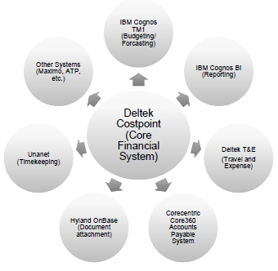
FNLCR Core Business Systems

Slide 9
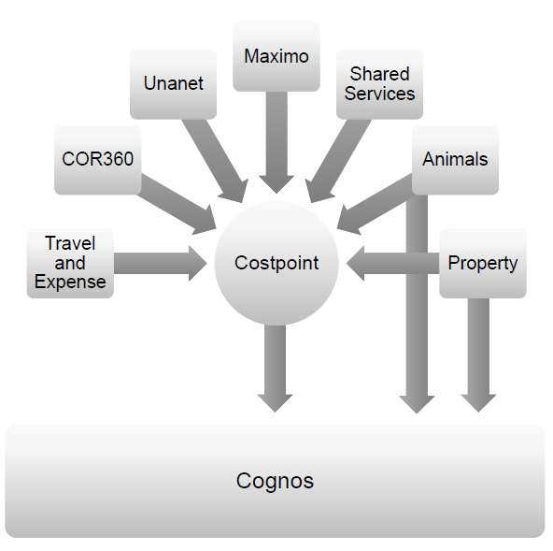
FNLCR Core Business Systems
Notes:
*****PLACE SPEAKER NOTES HERE:

