Slide 1
NCI Office of the Director
Presented By: Kristin Komschlies, Ph.D.
Notes:
For a more accessible version of this file or to request additional information about the images contained in this PowerPoint presentation, please contact: the FNCLR Acquisition Team @ FNLCR_ACQ@mail.nih.gov

Slide 2
Facilities Overview
Notes:
*****PLACE SPEAKER NOTES HERE:

Slide 3
FFRDC Managed Facilities: NCI at Frederick Facilities and FNLCR Leased Facilities
Advanced Technology Research Facility (ATRF)
NCI at Frederick
NCI at Frederick
Notes:
NCI at Frederick Facilities are government owned facilities which we will be touring today.
We will also be touring the Advanced Technology Research Facility which one of the Frederick National Laboratory for Cancer Research (FNLCR) Leased Facilities.

Slide 4
FFRDC Managed: NCI at Frederick Facilities
Located within the perimeter fence of Ft. Detrick
Property of the NCI/NIH
Maintained and operated by the FFRDC Contractor

Slide 5
FFRDC Managed: NCI at Frederick Facilities
Transferred from DoD 1970’s
68 acres
1.3 million GSF
100 buildings
53% are > 45 years old
5% are < 10 years old
16% are trailers/leased
77% are single story

Slide 6
FFRDC Managed: NCI at Frederick Facilities – Space Distribution
1.3 Million GSF
833,000 SF Laboratory
203,000 SF Administrative
80,000 SF Vivarium
10,000 SF Repository
106,000 SF Infrastructure
Boiler/Chiller Plants
Warehousing
Storage
Industrial shops

Slide 7
FFRDC Managed: NCI at Frederick Facilities Utilities Provided by the US Army Garrison
Utilities
Electric infrastructure and electricity
Water infrastructure and water
Sewer infrastructure and waste water
Depend upon the US Army Garrison for repair of utilities

Slide 8
FFRDC Managed: NCI at Frederick Facilities -- Amenities
Auditorium and Conference Center
Conference Rooms
Scientific Library
Cafeteria
Occupational Health Facility

Slide 9
FFRDC/FNLCR Leased Facilities
On-campus Leased Facilities
4 Modular buildings
18,220 SF
8,520 SF Laboratory
9,700 SF Administrative
Off-campus Leased Facilities
6 Buildings
543,000 GSF
374,000 SF Laboratory/cGMP
149,000 SF Administrative
20,000 SF Biospecimen repository
Notes:
On-campus leased facilities are located at the NCI at Frederick.
Off-campus leased facilities are located in the Frederick/I-270 corridor area.

Slide 10
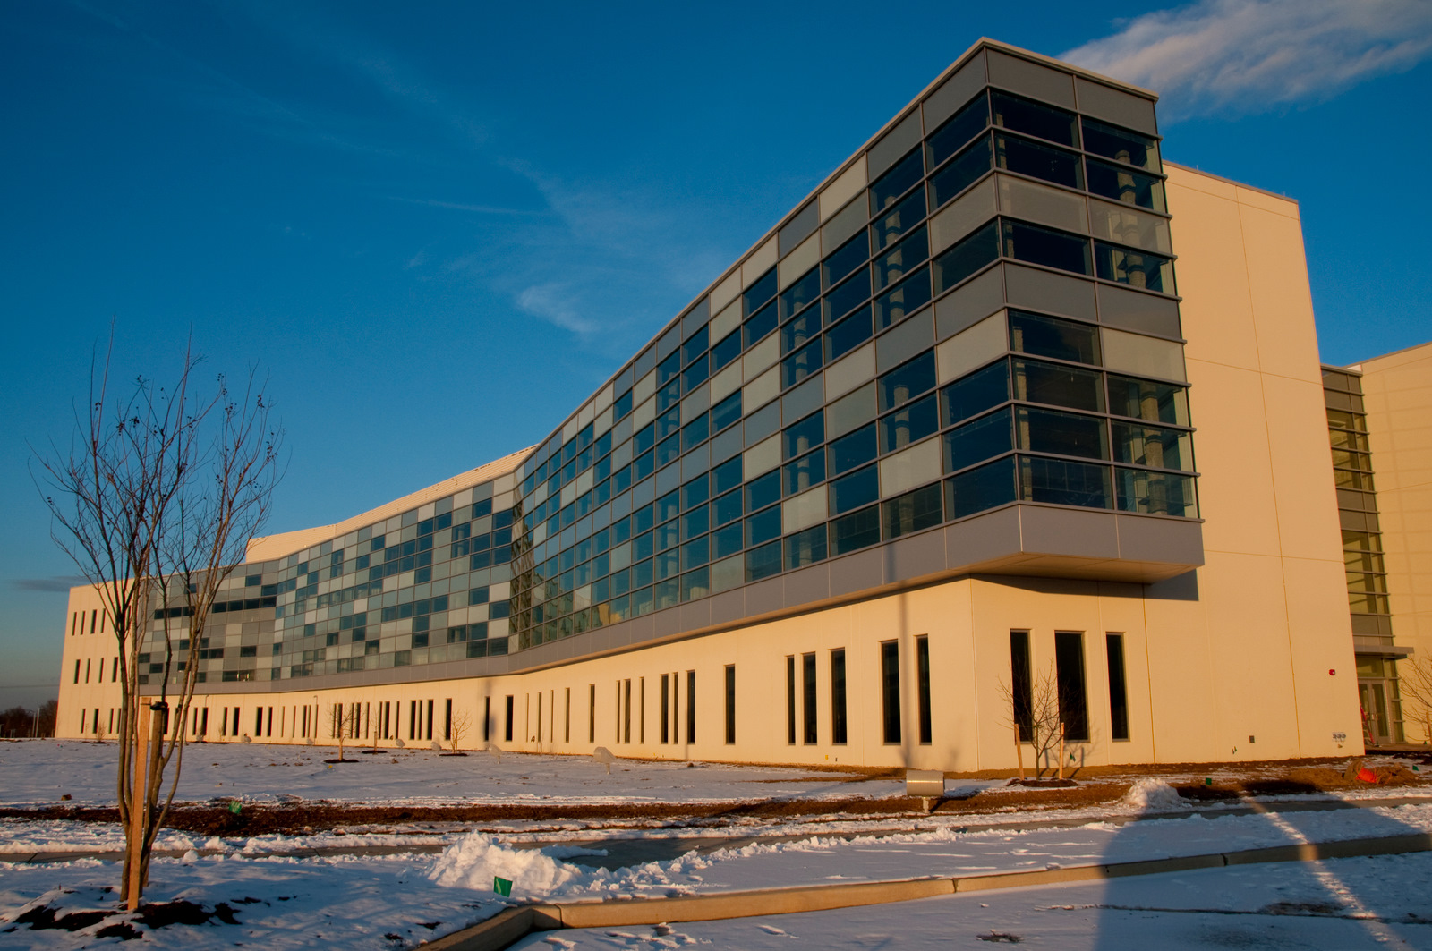
Advanced Technology Research Facility (ATRF)
FNLCR Leased 330,000 SF building
On 32 acres dedicated to the NCI
Part of the 177 acre Riverside Research Park
Building shell was completed in 2010
Fit-out completed and occupied in 2012
Notes:
The ATRF is the largest building leased by the FNLCR.

Slide 11
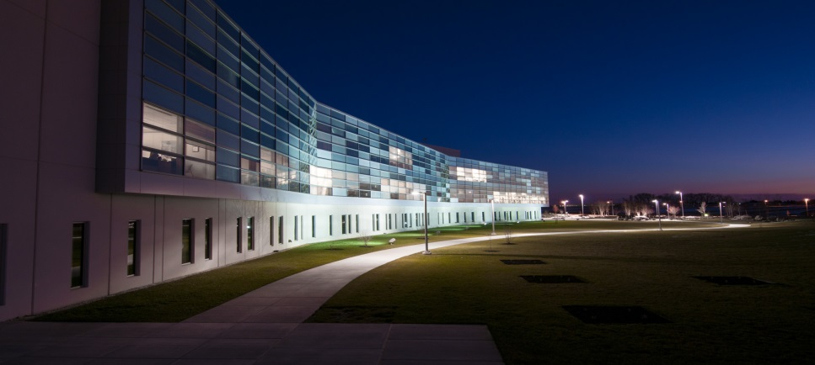
Advanced Technology Research Facility (ATRF)
Types of Space
103,000 SF Laboratory
80,000 SF cGMP/Lab
60,000 SF Administrative
90,000 SF Infrastructure
Amenities
Auditorium and Conference Center
Grab N’ Go Lunch Area
Gym
Scientific Library Satellite
Occupational Health Satellite

Slide 12
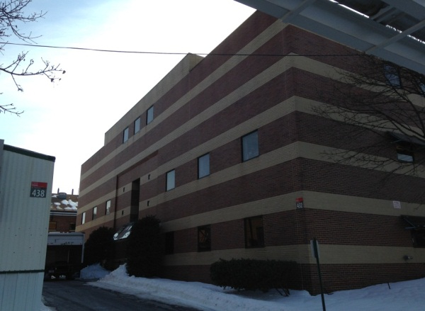
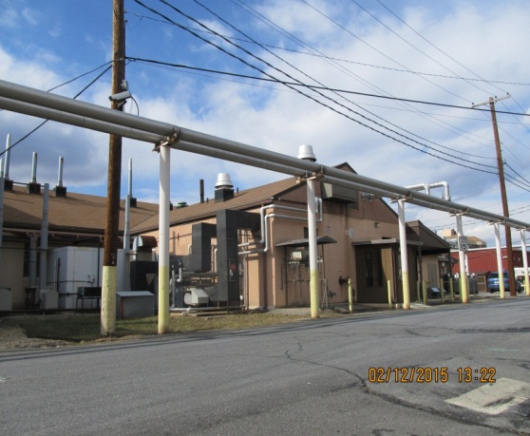
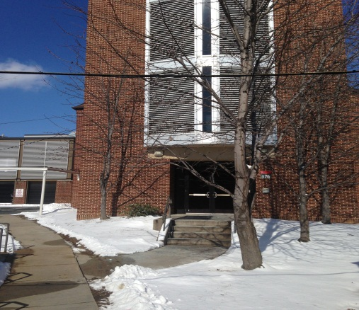
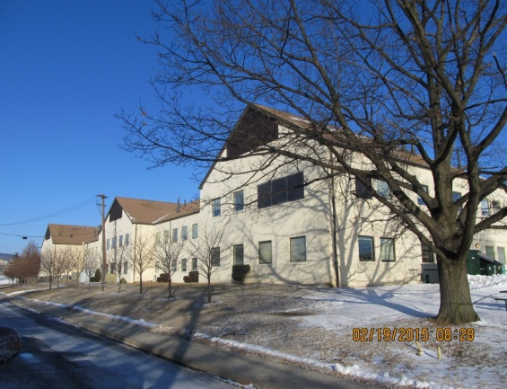
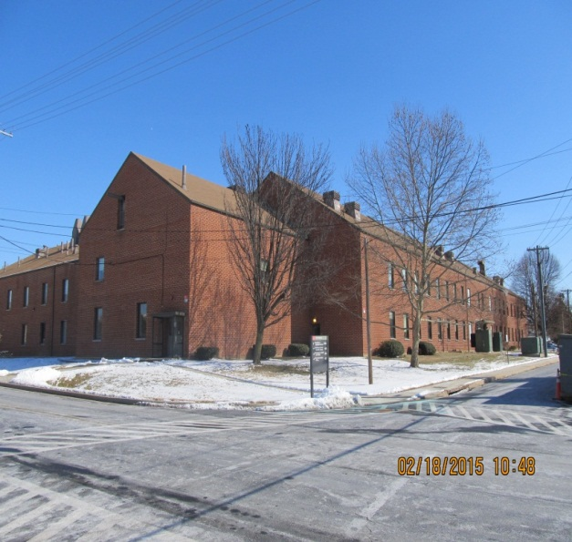
FFRDC Managed: NCI at Frederick -- Typical Buildings

Slide 13
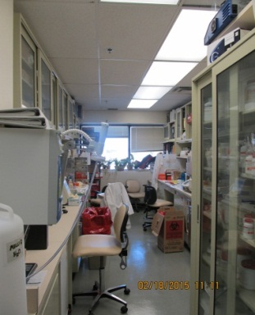
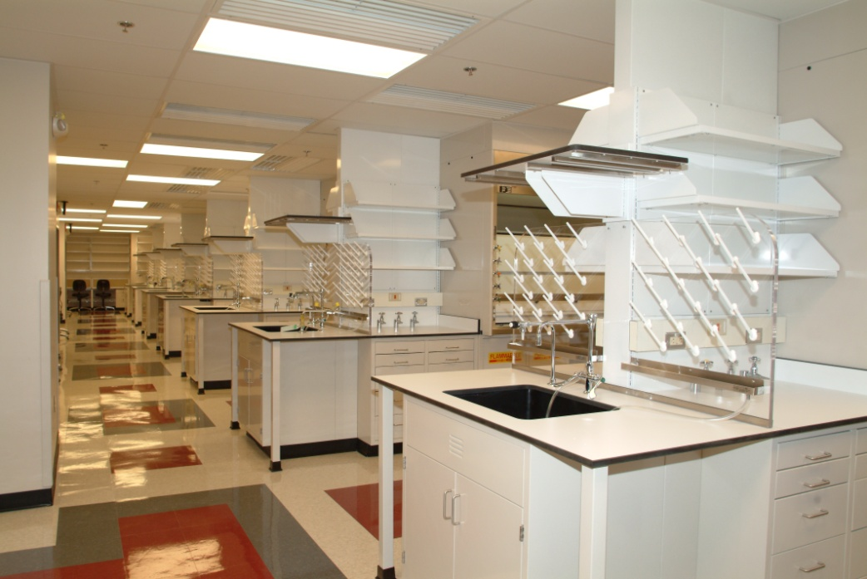
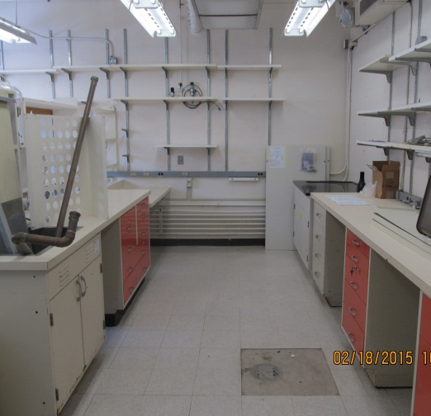
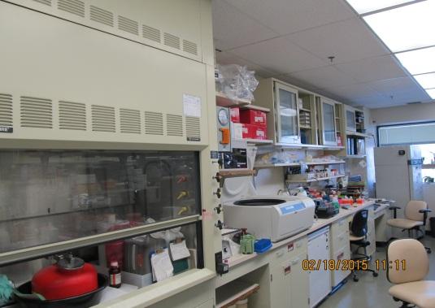
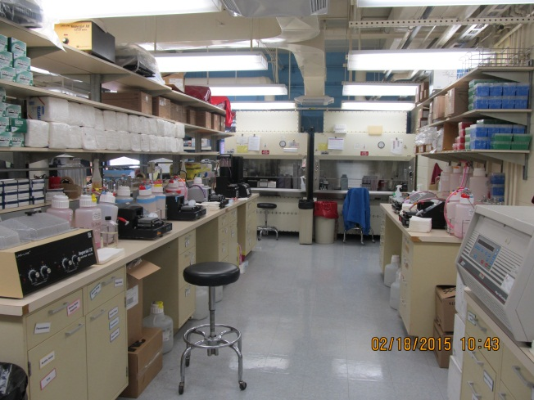
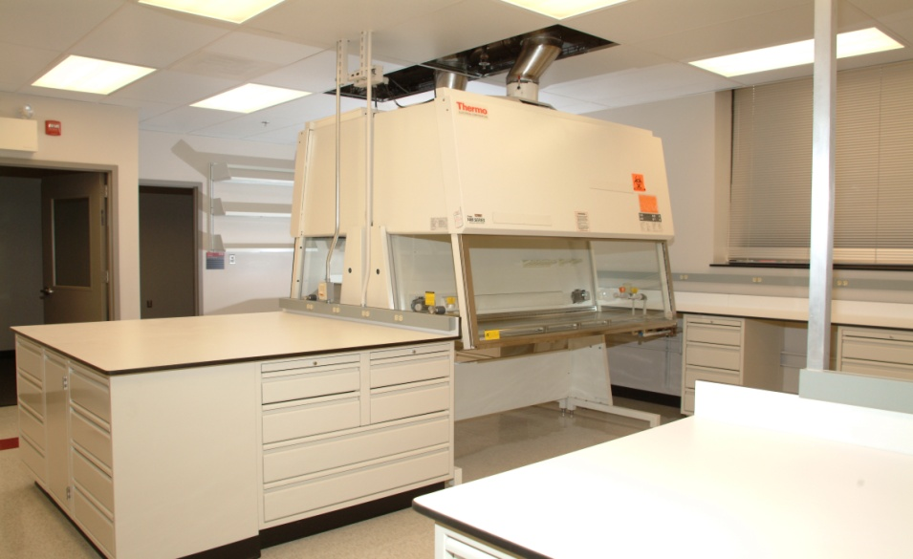
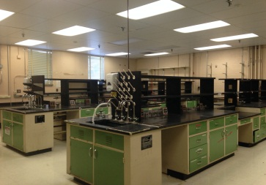
FFRDC Managed: NCI at Frederick -- Typical Laboratories

Slide 14
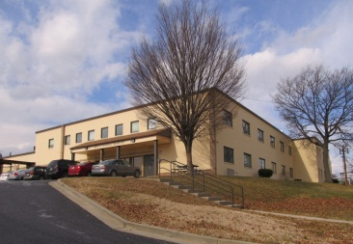
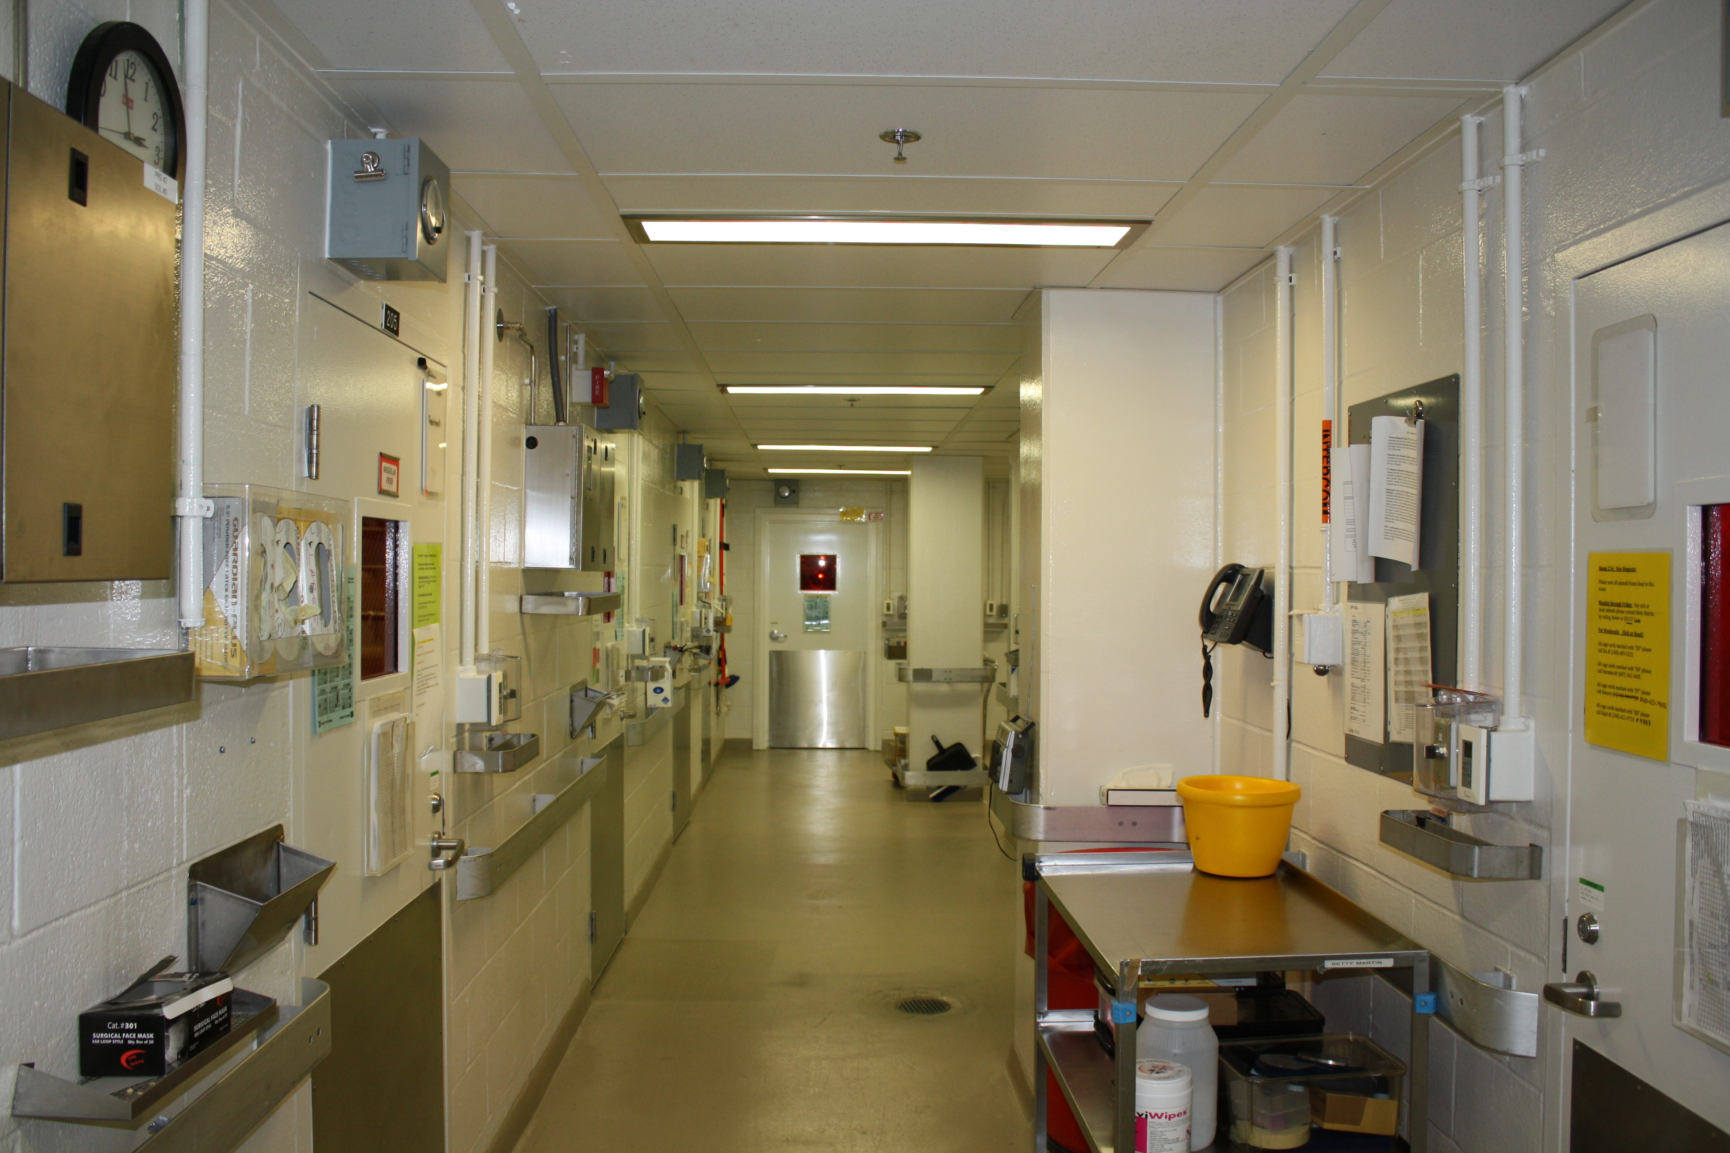
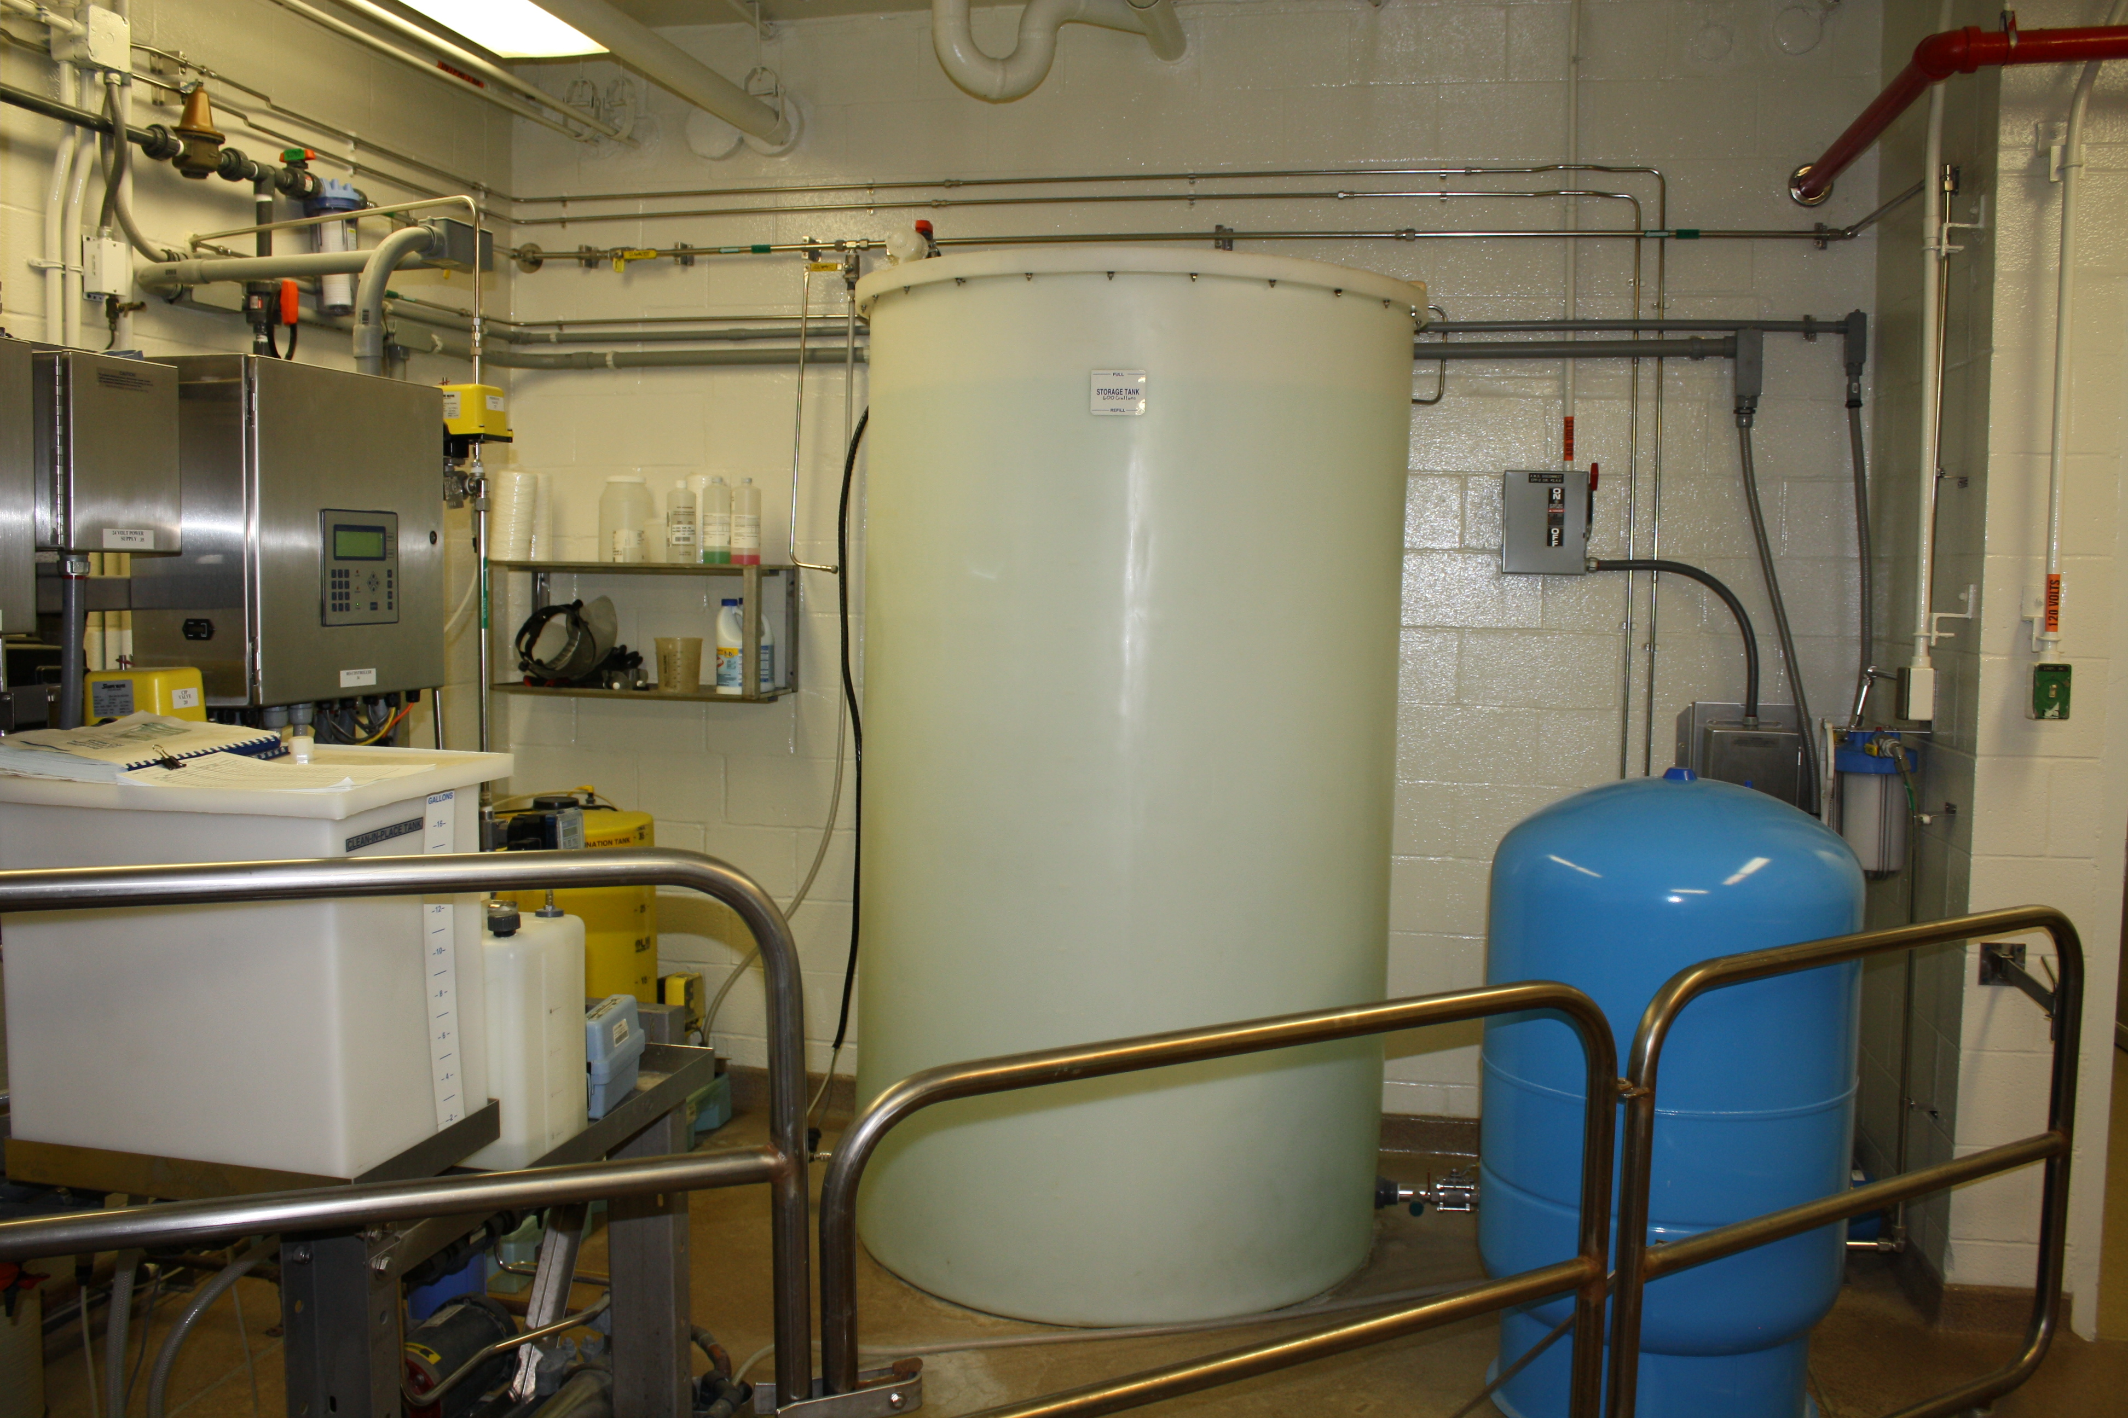
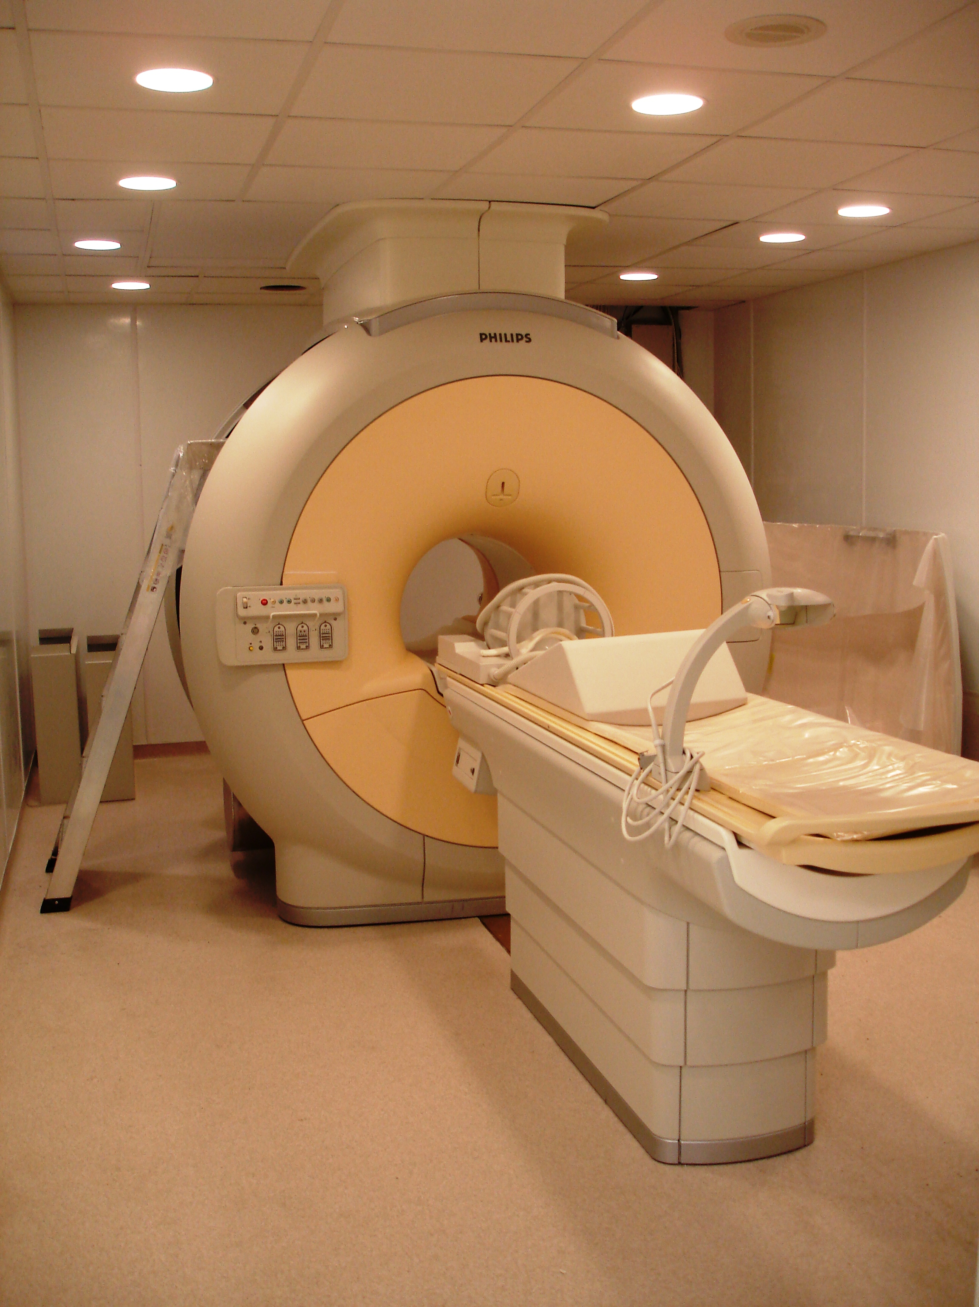
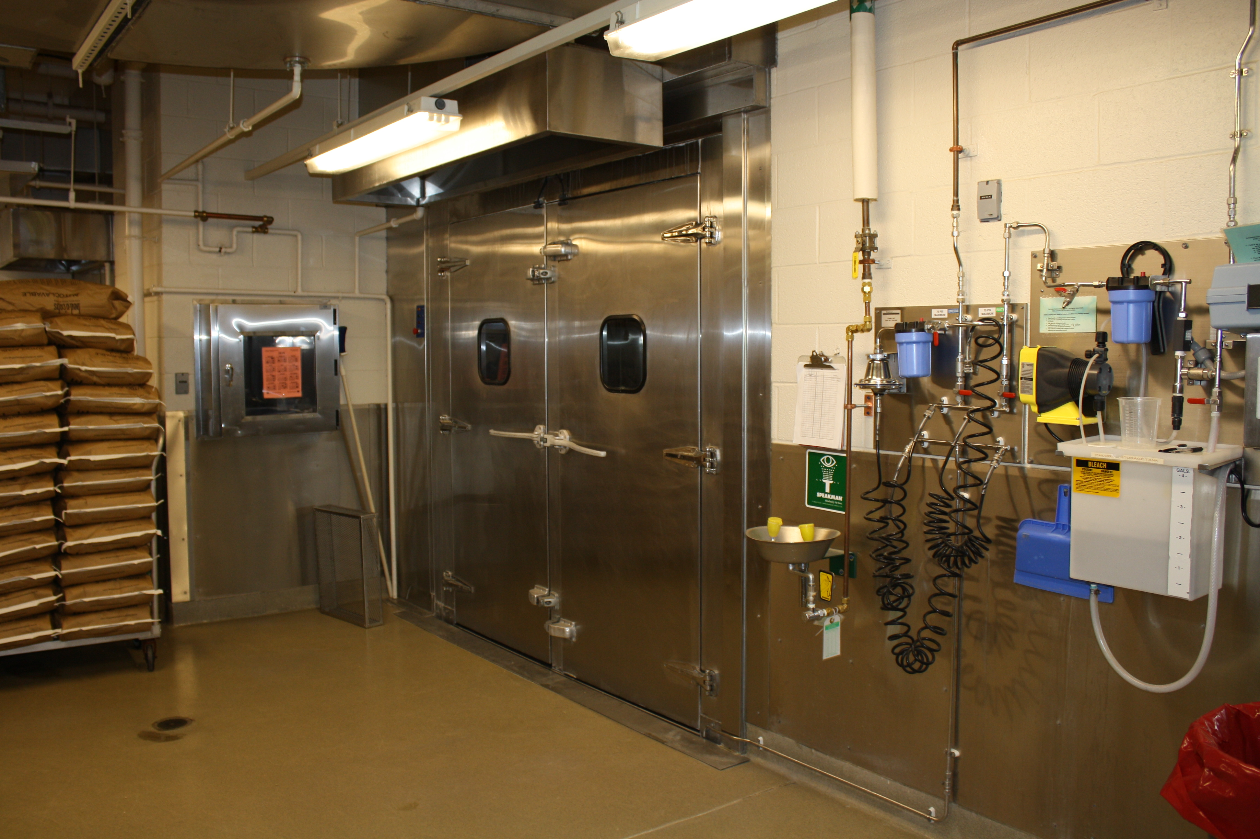
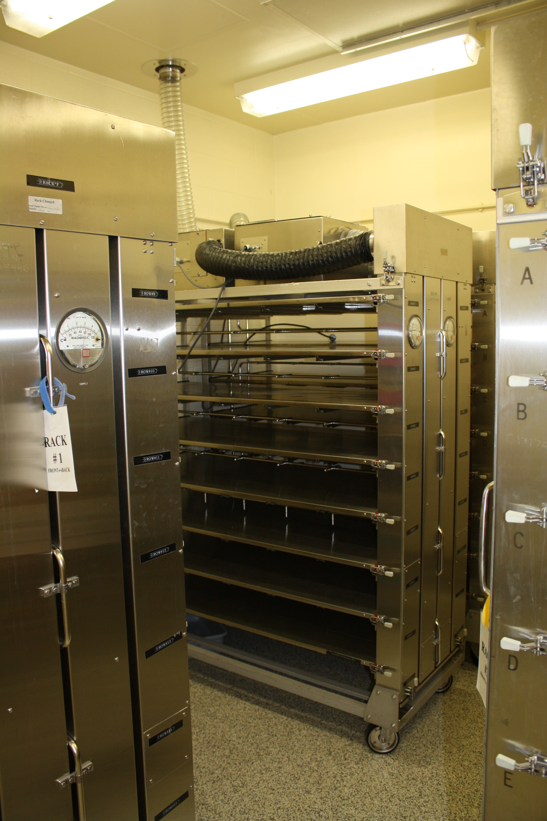
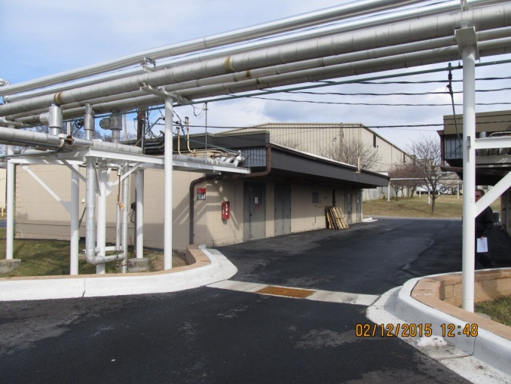
FFRDC Managed: NCI at Frederick -- Animal Facilities

Slide 15
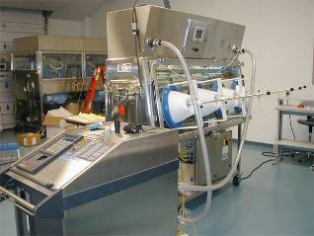
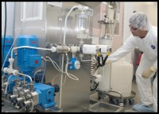
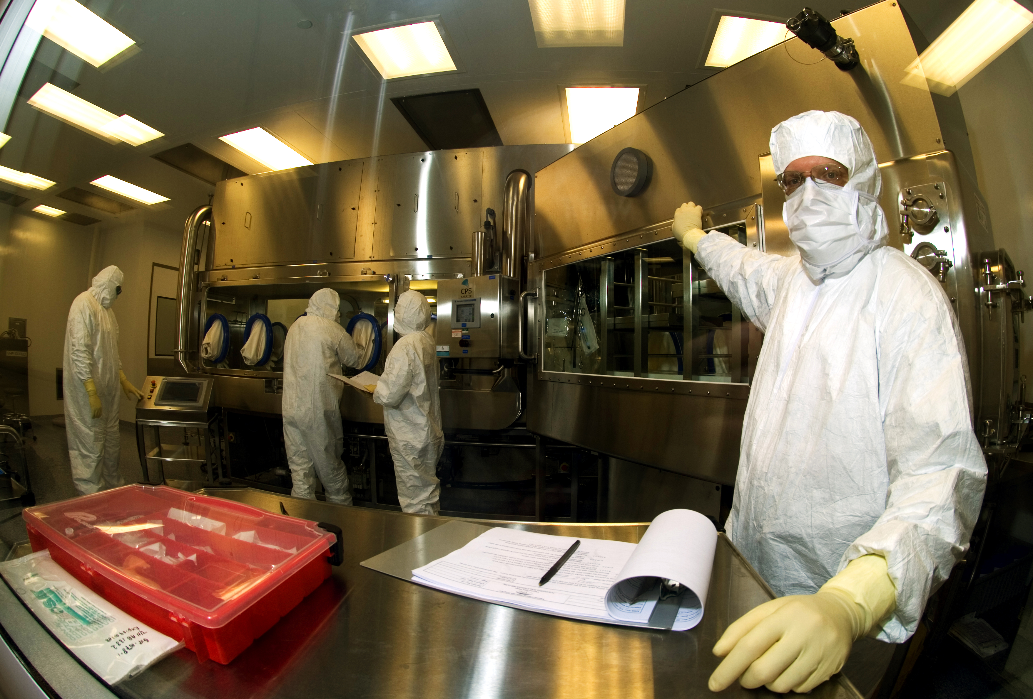
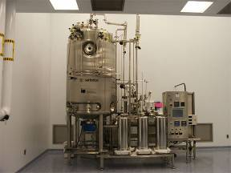
FFRDC/FNLCR Leased cGMP Facilities
Notes:
There are two FNLCR leased facilities – one located at the ATRF (support to NCI) and the other at a building (support to NIAID) in the Frederick area.

Slide 16
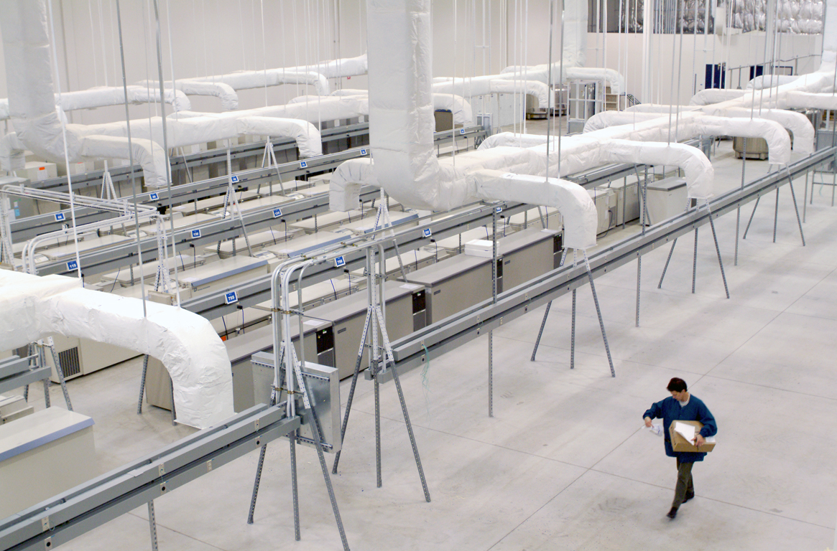
FFRDC Managed/Leased: Biospecimen Repository Facilities
Notes:
There are Biospecimen repositories located at the NCI at Frederick and a leased facility in the Frederick area.

Slide 17
Today at the FFRDC Managed: NCI at Frederick Facilities
Travel to the NCI at Frederick via shuttle
Enter Ft. Detrick through Army gate
Pass through Army property enroute to the NCI at Frederick
Perimeter tour at the NCI at Frederick via shuttle to observe points-of-interest
Tour of laboratories in Building 560
Return to the ATRF

Slide 18
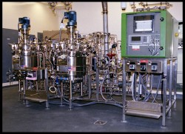
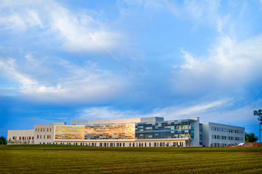
Today at the Advanced Technology Research Facility
Information Tables
Looping Slide Show of Facilities Pictures
Tours of Three Areas:
Laboratories
Data Center
Biopharmaceutical Development Program (cGMP)

