Slide 1
Division of Cancer Biology
Presented By: Dan Gallahan, PhD
Deputy Director
Notes:
For a more accessible version of this file or to request additional information about the images contained in this PowerPoint presentation, please contact: the FNCLR Acquisition Team @ FNLCR_ACQ@mail.nih.gov.

Slide 2
Overview of Mission and Purpose
Notes:
*****PLACE SPEAKER NOTES HERE:

Slide 3
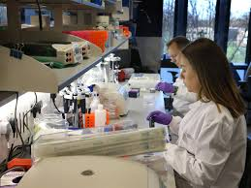
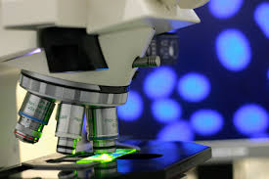
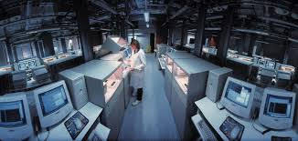
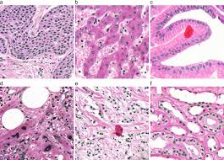
Division of Cancer Biology
Our Mission:
To ensure continuity and stability in basic cancer research while encouraging and facilitating the emergence of new ideas, concepts, technologies and possibilities
Through a broad portfolio of Investigator initiated research and specialized NCI programs
Notes:
The DCB is primarily an extramural Division supporting investigators and institutions out side NIH.
Basic cancer research covering a broad range of scientific topics
Most of the grants are investigator initiated, some requested funding opportunities on topics of immediate importance (RFA, PA)

Slide 4
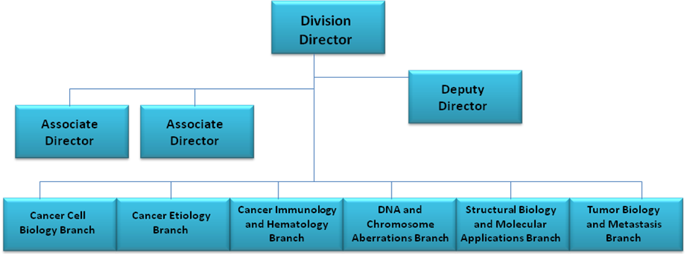
Branches:
Cancer Cell Biology Branch (CCBB)
Cancer Etiology Branch (CEB)
Cancer Immunology and Hematology Branch (CIHB)
DNA and Chromosomal Aberrations Branch (DCAB)
Structural Biology and Molecular Applications Branch (SBMAB)
Tumor Biology and Metastasis Branch (TBMB)
Notes:
The administrative structure of our division mirrors our scientific areas of interest.
Branches scientific portfolios are fluid adopting and anticipating new and changing scientific directions.
Individual program directors within branches manage individual grants and to a much lessor extent contracts

Slide 5
Overview of Scientific Work
Notes:
*****PLACE SPEAKER NOTES HERE:

Slide 6
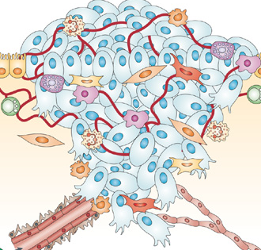
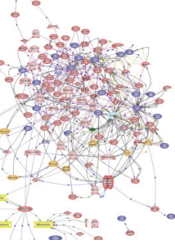
Understanding Cancer
Physiological Systems
Environment
Cellular Interactions
Signaling Networks
Genomic Alterations
Initiation-> Progression-> Metastasis->Regression-> Resurgence

Slide 7
DCB Scientific Breadth
Cancer Genetics
Cell Cycle, Growth and Cell Death
Cellular Metabolism (Signal Transduction)
DNA/Chromosomal Alterations
Endocrinology and Hormonal Carcinogenesis
Cancer Immunology and Inflammation
Etiological Agents
Gene Expression
Research Application and Resources
Biophysical/Molecular Interactions
Tumor Models
AIDS-Associated Cancers
Stem Cells
Cancer Genomics
Systems Biology and Computational Biology

Slide 8
Special NCI Programs managed by DCB
Tumor Micro-Environment Network (TMEN)
Cancer Systems Biology Consortium (CSBC)
Physical Science Oncology Network (PS-ON)
Oncology Models Forum
GM/CA X-ray Beamline
Barrett’s Esophagus Translational Research Network (BETRNet)
Chernobyl Tissue Bank (CTB)
The International Registry of Werner Syndrome
NIH MHC Tetramer Program
Notes:
This reflects solicited research projects using various funding mechanisms.
Many are consortium activities utilizing linking together investigators and resources to work collectively on problems.

Slide 9
Examples of Special Activities Conducted through FNLCR
3 Representative efforts

Slide 10
NCI Mouse Repository
Program Overview
The NCI Mouse Repository is a DCB-funded resource for maintenance and propagation of mouse cancer models and distribution of strains, as well as the micro RNA resource throughout the scientific community.
Mouse strains are maintained as live colonies or cryoarchived
The entire collection of genetically engineered miRNA mESC lines has been available for distribution through the NCI Mouse Repository since 07/11/13 (for domestic distribution only). Validation data for each miRNA is listed on the corresponding “ES cell Details” page.
Protocols utilized in the generation, care, manipulation, and use of the miR ESC clones are provided in the protocol section. Orders for miR expressing clones may be submitted online. Limited availability.
Annual NCI Mouse Repository Distribution Volume as of 08/15/15*

Slide 11
Physical Science Oncology Network (PSON) Cell Lines Physical Characterization Project
High Content Cellular Characterization of Physical-Based Properties of PS-OC Cell Line Panel
30 cell lines: breast, colorectal, glioma, lung, melanoma, ovarian, pancreatic, prostate
Measurements: stiffness, contractile energy, motility, proliferation, area, volume, nuclear volume, axial ratio, shape factor
7 different substrates:
200 pascal HA gels coated with Fibronectin or Collagen 1
500 pascal polyacrylamide gels coated with Fibronectin or Collagen 1
30 kilopascal polyacrylamide gels coated with Fibronectin or Collagen 1
Glass
Data management and dissemination

Slide 12
DREAM Challenge Support: A crowd sourcing project
Based on a NCI-DREAM Challenge to accurately predict drug sensitivity in breast cancer using computational algorithms
Reward for top-performer: A Model Refinement & Software Development Contract
Make Sole source awards based on the initial competition
Manage diverse approaches and institution
Ensure useful and validated product for the NCI and the research community
2 Subcontracts awarded
Texas Tech (Evaluating how model performance changes with incorporation of additional data sets (CCLE) being investigated
UT Southwestern (Began curation process of 2 gene expression data sources (GEO data (Lymphoma) and LINCS data (colon cancer)) to normalize the data to a single standard)

