Slide 1
NCI’s Division of Cancer Epidemiology and Genetics
Neil E Caporaso, Chief, Genetic Epidemiology Branch
Allan Hildesheim, Chief, Immunoepidemioloy and Infectious Disease Branch
Notes:
For a more accessible version of this file or to request additional information about the images contained in this PowerPoint presentation, please contact: the FNCLR Acquisition Team @ FNLCR_ACQ@mail.nih.gov.

Slide 2
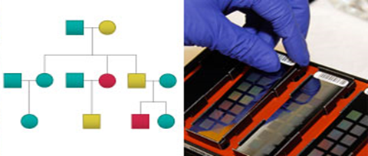
DCEG: Mission and Purpose
Identify environmental and genetic causes of cancer in populations
High impact, high quality, value-added research
National and international in scope
Strategic partners in molecular epidemiology in NCI and beyond
Notes:
The Division of Cancer Epidemiology and Genetics conducts…

Slide 3
National Cancer Institute
Intramural
Divisions
Extramural Divisions
DCEG
CCR
9 Branches/
Laboratory
57 Branches/
Laboratories/Programs
Notes:
We are an Intramural Division- along with CCR.

Slide 4
Office of the Director
Stephen J. Chanock, M.D.
Director
Epidemiology and
Biostatistics Program
Human Genetics
Program
Hormonal and Reproductive
Epidemiology
Biostatistics
Genetic
Epidemiology
Clinical
Genetics
Infections and Immunoepidemiology
Nutritional
Epidemiology
Laboratory
of
Translational Genomics
Occupational and Environmental
Epidemiology
Radiation
Epidemiology
Notes:
The Branches show the breath and range of DCEG studies
Which include an environmental program (6 B)
and a Genetics program with 3 units (2 Branches and a lab).
I am BC of GEB and Allan Hildesheim is from the Environmental side- IIB.
The LTC……………………
The Cancer Genomics Lab…………

Slide 5
Multi-disciplinary Research Teams
Epidemiologists
Physicians
Oncologists
Geneticists
Biostatisticians
Health physicists
Toxicologists
Industrial hygienists
Genetic counselors
Clinical nurses
Post-bac, pre-doc, post-doc fellows
Notes:
DCEG scientists encompass a range of disciplines from…

Slide 6
DCEG Collaborate Across NCI
Center for Global Health
Center for Research on Cancer Health Disparities
Division of Cancer Control and Population Sciences
Center for Cancer Research
DCEG
Division of Cancer Biology
Division of Cancer Treatment and Diagnosis
Division of Cancer Prevention
Center for Cancer Genomics
Notes:
A key feature of DCEG is that we are widely collaborative- since we engage scientists of widely different disciplines,
To conduct a range of studies in human populations…

Slide 7
Collaborations Around the World
Notes:
in settings around the world

Slide 8
DCEG Research Directly Improves Public Health
Identify genetic and environmental causes of cancer in populations
Provide data used by regulatory agencies to set safety standards
Water, gasoline, workplace safety, safer farming
Inform clinical practice guidelines
Cancer susceptibility syndromes, second cancers
Preventive interventions
Safer CT scans, benefits of physical activity, efficacy of HPV vaccine
Methods Development
Notes:
Our work with a central goal of identifying G and E causes of cancer….
Has important public health implications such as….

Slide 9
DCEG Core Resources
(across the FNLCR Contract)
Cancer Genomics Research Laboratory
DESL
HPV Immunology Laboratory
Hormone Laboratory
Biorepository
*Leidos
Notes:
A major trend in epidemiology has been the INTEGRATION of GENETICS
and BIOMAKERS into population studies, often referred to as MOLECULAR or INTEGRATIVE Epidemiology
Since a large and increasing proportion of DCEG studies incorporate biomarkers
we necessarily work hand-in-hand with laboratory-based scientists to conduct these studies.
This slide shows 5 major contract-supported entities that have been intimate partners in DCEG studies

Slide 10
Cancer Genomics Research Laboratory (CGR)
Core Services
+
Collaboration
+
Innovation
GWAS & Follow up
Biotechnology
Genotyping
+
Candidate Gene Studies
+
Sequencing
Genomics
Regional/ Exome/ Genome Sequencing
Computing Support
Computational Methods
Data Sharing
Data Analysis
> 600 Publications
Statistical Methods
CGR conducts scientific research in support of DCEG investigators via genomic and analytical resources across a variety of applications.
Notes:
The first is the Cancer Genomics Research laboratory
CGR provides a range of services……………………
Built a program from start to finish (including sample handling, preparation and pre-genetic analyses)
CGR has produced over 700 reports with data as an indication of the breadth and depth of biological insights generated by the integrated programs within DCEG
Development/technology is a strong suit- built to assess and decide when to move technologies into the pipeline and when to sunset technologies
(multiple ABI, Sequenome, STRs for Linkage, various robots/capture assays)

Slide 11
Cancer Genomics Research Laboratory (CGR)
 | FY12 Count | FY13 Count | FY14 Count
Samples Extracted | 1,979* | 2,910 | 6,185
Samples Staged/Handled | 26,994 | 26,091 | 37,204
TaqMan Assays Developed | 218 | 307 | 109
Single-plex Genotypes Generated | 736,456 | 646,644 | 180,365
Multi-plex Genotypes Generated | 20,931,817,536 | 32,669,408,992 | 32,256,365,288
Samples Sequenced (Exome) | 637 | 1,019 | 3,037
Projects Completed | 213 | 287 | 220
*Data not tracked most of FY12
Notes:
The scale of this work is large.

Slide 12
Milestones
2001 2002 2004 2006 2008 2010 2012 2014 & beyond
Whole Genome
Sequencing
Candidate SNP
Functional Data
Genome-wide
association
studies
Population-based
Population-based
Sequencing
Exome
Sequencing
Families
Candidate Genes
Biological Plausibility
Genetic Markers
Candidate Pathway
Biological Plausibility
Regional Sequencing
GWAS & Linkage
Basic Functional
follow-up
Notes:
This resource is not static- the laboratory has developed different capabilities over time as new technologies emerge
and are developed to address questions in the population.
As this diagram suggests, it is safe to assume that the new technologies will continue to emerge and find their
Role in population studies. From our perspective, mechanistic and animal model work is important- but the gold
Standard is demonstration of effects in large human population studies…

Slide 13
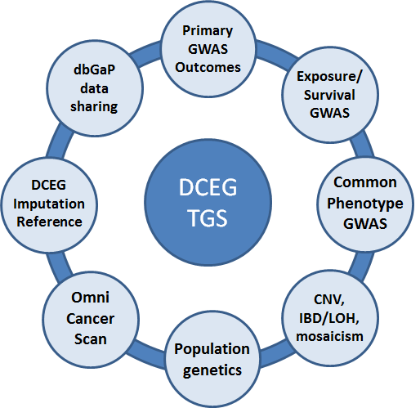
DCEG Total GWAS Set (TGS)
Master database of over 135,000 Illumina whole-genome SNP array results
Notes:
As one example of how the bioinformatics, genomics, epidemiological data and data management capabilities of this group have come together-
A DCEG TGS or Total Genome Set including data from diverse studies has been created and will be used to conduct large scale
Metanalyses across different cancers and populations.

Slide 14
DESL (DNA Extraction and Staging Laboratory)
Receipt and shipment of materials from/to collaborators around the world
DNA extraction from liquid biospecimens
Nucleic acid quantitation by absorbance, fluorescence, amplification
Aliquoting tasks for plasma and serum
Normalization and staging of DNA for future work
Plating of samples for projects at CGR (run-ready) and elsewhere
Coordination with the Biorepository and other DCEG Contractors
Notes:
DESL is
This group receives, processes samples- extracts, quantitates and QCs DNA for genetic analyses.
This complex set of operations involves aliquotting, tracking, plating and coordination with other contractors

Slide 15
DESL Staging Pipeline Workflow
Extraction
DESL Sample Staging Pipeline
Sample Receipt
Volume
Check
LabChip DS
(OD Quant.)
dsDNA Fluorescent Quant.
Staging (normalization & REMPing)
DNA Profiling
Notes:
This graphic depicts the coordination involved in some of these operations-
Sample receipt, various quality checks, DNA quantity and quality determinations
Are performed and data is organized, stored, and distributed

Slide 16
HPV Immunology Laboratory Goals/Objectives
Immune Responses to HPV Vaccination
Neutralization potential
Type-specific antibody levels and avidity
Cross-neutralizing/protective antibodies
Applied to specimens obtained from participants in large, community-based randomized trials
Define Inflammation Markers Predictive of Cancer Risk
Luminex-based multiplex marker panels (>70 markers)
Applied to specimens obtained from extensively annotated individuals from large population cohorts
Notes:
Another area of support has been the HPV Immunology Lab…

Slide 17
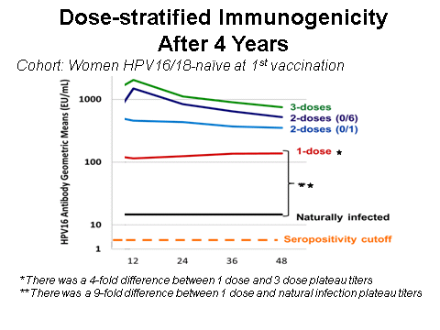
<3 Doses of HPV-16/18 Vaccine is Effective and Induces Durable Antibody Responses Costa Rica HPV-16/18 Vaccine Trial
Safaeian (DCEG), … , and Pinto (FNL). CPR 2013
Kreimer et al. JNCI 2011
Notes:
Just as a quick example, this has made important studies possible such as:
an evaluation of antibody response parameters after 1 , 2 or 3 doses of vaccine over time

Slide 18
Summary of Multiplex Immune Panel (MIP) Studies within Large Epidemiological Cohorts
Cancer Site | Study Size | Discovery (N) | Replication (N)
Lung | ~2,250 | √ | √
NHL | ~1,200 | √ | √
Ovary | ~300 | √ | O
Gallbladder | ~250 | √ | O
Colon | ~1,100 | √ | P
Endometrium | ~600 | √ | P
Stomach | ~1,000 | O | P
Cervix | ~400 | O
√ = Completed; O = Ongoing; P = Planned
Notes:
MIP studies in large epidemiological cohorts have demonstrated association of key
Inflammatory markers (such as CRP) in various cancers and followed with replication studies

Slide 19
Hormone Unit
A unit of the Laboratory of Proteomics and Applied Technologies
15 estrogen metabolite panel
Optimized for urine, serum and plasma
Recently developed serum assays
11 androgen metabolite panel
7 progesterone metabolites and precursors
Extensive methodologic investment
Emphasis on technology transfer
Notes:
A hormone laboratory has developed assays for key hormones
Of great interest in studies of breast, prostate, endometrial and other
Cancer with known or suspected hormonal dependencies

Slide 20
The DCEG Biorepository
is part of the Central Repository at FNLCR
> 10.3 million biospecimens (of ~15M total inventory at the CR)
Most stored at central repository in Frederick, MD
Over 100 different material types from population studies
Serum
Plasma
DNA
Whole blood
RBC
Buffy CT
Buccal
Urine
Tissue
Notes:
To conduct large scale studies, DCEG studies involve biospecimen collections that include DNA or other analytes.
As new technologies emerge- they are validated and used to query carefully selected groups from defined populations to address important questions.
Over 2/3’s of DCEGs 15 million biospecimens are housed in the FNL central repository in Ferederick Maryland

Slide 21
Overview of Scientific Work
Notes:
*****PLACE SPEAKER NOTES HERE:

Slide 22
CGR Co-authored Publications Per Year
* Nature Genetics, Science, Nature, JAMA, Blood, JNCI, PLoS genetics, NEJM, HMG, PNAS, AJHG
Notes:
I’ve mentioned the types of resources DCEG has benefited from in the past-
I want to also highlight the high quality and number of scientific
Publications that have emerged from this contract and the associated collaborative work.
As I mentioned, DCEG studies are critically dependent on laboratory support.
This slide shows CGR publications, including a significant proportion in high impact journals…

Slide 23
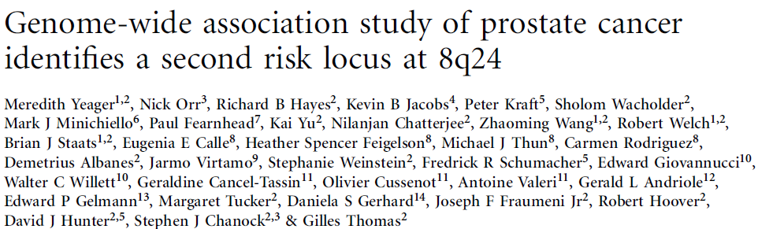
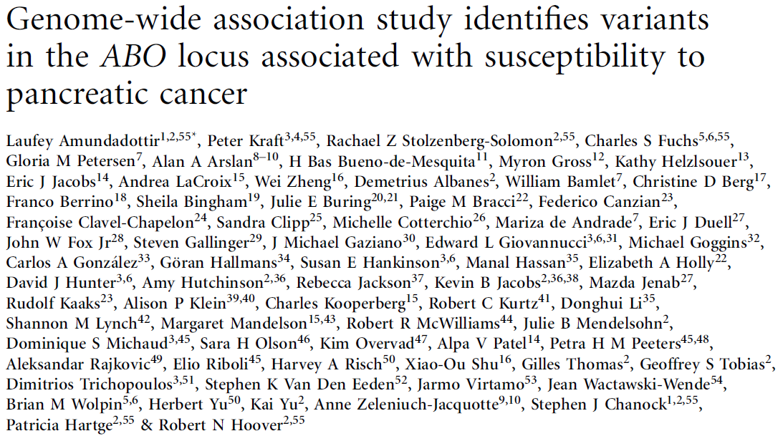
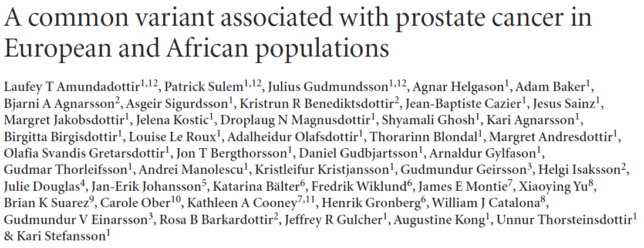
High Impact Studies of Cancer Etiology
Notes:
Studies that have resulted in high impact publications often involve CGR personnel in integral roles and in 2 of the examples above- CGR are 1st authors.
This is not surprising at all given the increasing emphasis on multidisciplinary team science and the close working relationships in these complex projects

Slide 24
Innovation: Research & Development
2007
2008
2009
2010
2011
2012
2013
DME
Regional Sequencing: 454 and PGM
Gene Deletion
Dynamic Arrays
Access Arrays
Exome Sequencing: Illumina
Methylation Seq
PGM Variant Follow-up
PGM Exome Sequencing
WGA, FFPE Infinium
2.5M/5.0M beta
Telomere length
Whole Gen Seq
RNA-Seq
Notes:
As different technologies emerge- they must be piloted, scaled up to production, and eventually sun setted.
This slide shows a few examples of that ongoing process

Slide 25
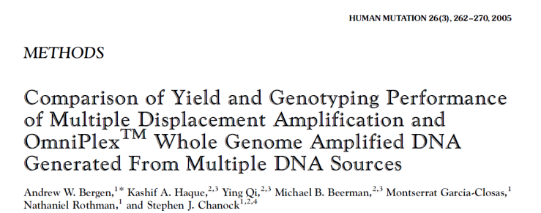
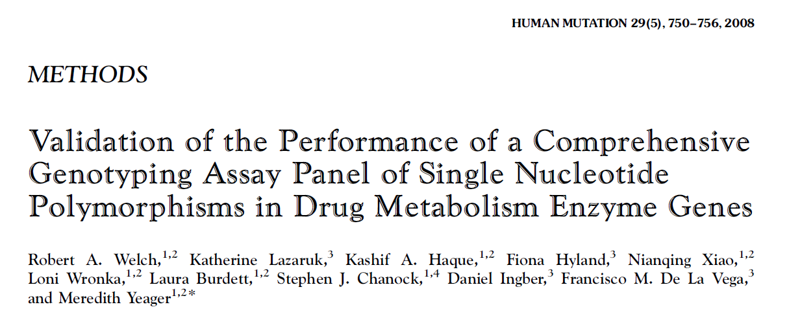
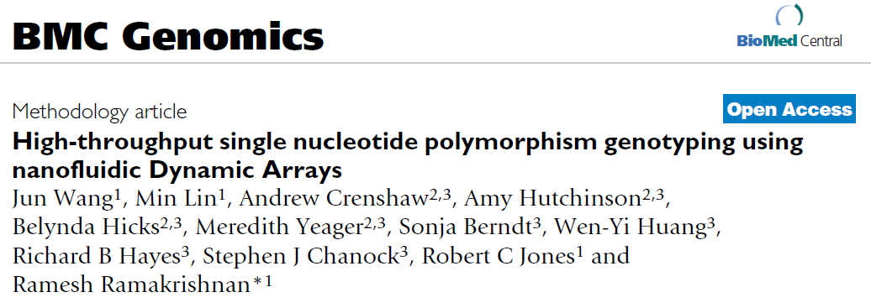
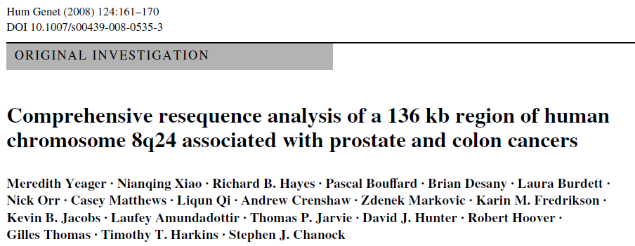
Notes:
And publications involving METHODS development that accompanies this process,

Slide 26
Bioinformatic Innovation
Analytical and Bioinformatic Expertise
Close collaboration from inception to publication
Studies
Methodology
Software development & dissemination (open-source)
Systematic data sharing
Integrative analysis across studies & data types
Notes:
The development of biostatistical and informatics expertise also involves close collaboration

Slide 27
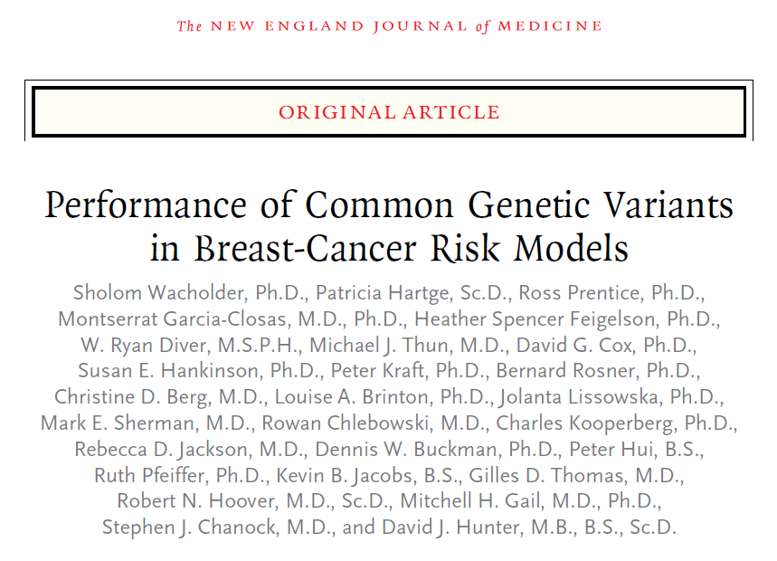
Notes:
And here again, there are many publications with the biostatistics branch as we together seeks to develop and apply novel statistical approaches to ‘big data’
Many rich collaborations have emerged in the interface of statistics, bioinformatics, and laboratory methods

Slide 28
High Impact Studies of Cancer Etiology
2015
Prediction of breast cancer risk based on profiling with common genetic variants
Occupational exposure to diesel engine exhaust and alterations in lymphocyte subsets
Association between donor leukocyte telomere length and survival after unrelated allogeneic hematopoietic cell transplantation for severe aplastic anemia.
Two susceptibility loci identified for prostate cancer aggressiveness
Characterization of large structural genetic mosaicism in human autosomes
Prediagnostic sex steroid hormones in relation to male breast cancer risk
Identification of novel genetic markers of breast cancer survival
Association between regular aspirin use and circulating markers of inflammation: A study within the Prostate, Lung, Colorectal, and Ovarian Cancer Screening Trial
Germline TP53 variants and susceptibility to osteosarcoma
Efficacy of fewer than three doses of an HPV-16/18 AS04-adjuvanted vaccine: Combined analysis of data from the Costa Rica Vaccine and PATRICIA trials
Incidence of solid tumours among pesticide applicators exposed to the organophosphate insecticide diazinon in the Agricultural Health Study: An updated analysis
Association of aflatoxin with gallbladder cancer in Chile
Identification of six new susceptibility loci for invasive epithelial ovarian cancer.
Mortality and cancer in relation to ABO blood group phenotypes in the Golestan Cohort Study
Multiple biopsies and detection of cervical cancer precursors at colposcopy

Slide 29
Notes:
Thank you
I’ve tried to emphasize the large scope and scale of the contract resource
AND
the how our strong working relationship over time has resulted in
a highly productive scientific output.

