Slide 1
Division of Cancer Treatment and Diagnosis
Presented By: Michael Difilippantonio, Ph.D.
October 1, 2015
Notes:
For a more accessible version of this file or to request additional information about the images contained in this PowerPoint presentation, please contact: the FNCLR Acquisition Team @ FNLCR_ACQ@mail.nih.gov.

Slide 2
Overview of Mission and Purpose
Notes:
*****PLACE SPEAKER NOTES HERE:

Slide 3
Overview of Mission and Purpose
  To improve the lives of cancer patients by enabling the scientific transition from basic research to advanced clinical studies of cancer diagnostics and therapeutics.
Notes:
*****PLACE SPEAKER NOTES HERE:

Slide 4
Overview of Scientific Work
Notes:
*****PLACE SPEAKER NOTES HERE:

Slide 5
Overview of Scientific Work
Overview of current and/or past programs / activities
Specific current and/or past high visibility projects / programs / activities executed through the FNLCR
Notes:
*****PLACE SPEAKER NOTES HERE:

Slide 6
Overview of Scientific Work
Overview of current and/or past programs / activities
Specific current and/or past high visibility projects / programs / activities executed through the FNLCR
Notes:
*****PLACE SPEAKER NOTES HERE:

Slide 7
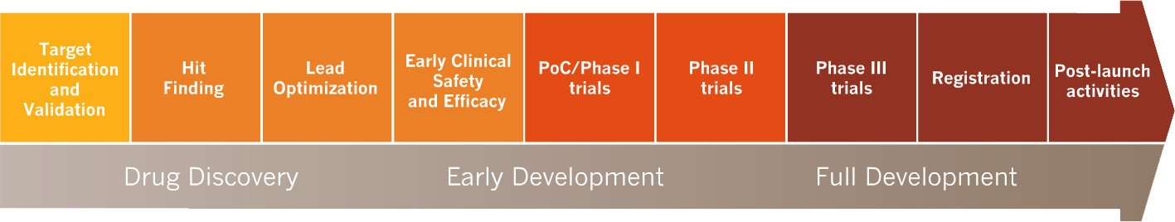
Role of FNLCR in NCI Therapeutics Development Program
Biopharmaceutical Development & New Animal Models
Small Animal Imaging & Imaging Drug Development
Natural Products &
Medicinal Chemistry
Pharmacodynamics
Genomic Characterization
High risk targets
Investigational imaging agents
Investigational drugs, biologics, natural products
Unmet medical needs (rare cancers, pediatric tumors)
Academic & Biotech & Pharma projects
Targets
Therapeutics
Notes:
*****PLACE SPEAKER NOTES HERE:

Slide 8
Therapeutics Discovered / Developed by DCTD/NCI from Preclinical Stage Approved by FDA Past 15 Years
Year | Agents | Role of NCI | Mechanism of Support
2015 | Dinutuximab (ch14.18 ab) | Produced antibody; conducted pivotal trials | FNLCR biologics facility; NCI cooperative grant
2010 | Sipuleucel (Provenge®) | Oversaw production | National Cooperative Drug Discovery Grant
2010 | Eribulin | Natural product discovery; screening; formulation of clinical product; animal efficacy testing; clinical candidate selection; first-in-human trial | FNLCR labs; Analytical, Formulation, PK, Toxicology contracts; RO1 grant; U01 grant
2009 | Pralatrexate | RAID project; NCI produced GMP bulk drug | GMP quality bulk drug production contract
2009 | Romidepsin (Depsipeptide) | Developed safe human dosing schedule in large animals; PK and Tox; produced drug for clinical trials; conducted first-in-human trials in NIH CC | FNLCR animal facilities; Pharmacology, Toxicology, Drug Production contracts
2004 | Cetuximab | Produced first lots for imaging and chimeric clones | Contracts; Cooperative Drug Discovery Grant
2004 | 5-Azacytidine | Pre-clinical molecular pharmacology; produced pre-clinical and clinical drug supply; conducted pivotal trial | FNLCR Labs; Contracts; U01 Grants
2003 | Bortezomib | Extensive analog screening; MOA and PD studies; PK & Tox; clinical formulation | FNLCR Labs; Formulation, PK, Toxicology contracts
2000 | Temozolomide | Scale up synthesis and clinical formulation | Bulk drug and Formulation contracts
Notes:
*****PLACE SPEAKER NOTES HERE:

Slide 9
Overview of Scientific Work
Overview of current and/or past programs / activities
Specific current / past high visibility projects / programs / activities executed through the FNLCR
Notes:
*****PLACE SPEAKER NOTES HERE:

Slide 10

NCI Experimental Therapeutics (NExT) Program:
Role of FNLCR in NCI Pipeline
HTS & CBC
Med.Chem. & Agent Comparison
Efficacy Testing
& New Models
Biologics Development
Drug Supply &
Repository
Regulatory
Support
Proof of Mechanism PD
Molecular Toxicology
Imaging
Drugs
Molecular
Tumor Characterization
Natural
Products
Combination Screening
Phase 0/1
Trials
= Conducted at or by FNLCR

Slide 11
NCI Experimental Therapeutics (NExT) Program:
Role of FNLCR in NCI Pipeline
HTS & CBC
Med.Chem. & Agent Comparison
Efficacy Testing
& New Models
Biologics Development
Drug Supply &
Repository
Regulatory
Support
Proof of Mechanism PD
Molecular Toxicology
Imaging
Drugs
Molecular
Tumor Characterization
Natural
Products
Combination Screening
Phase 0/1
Trials
= Conducted at or by FNLCR

Slide 12
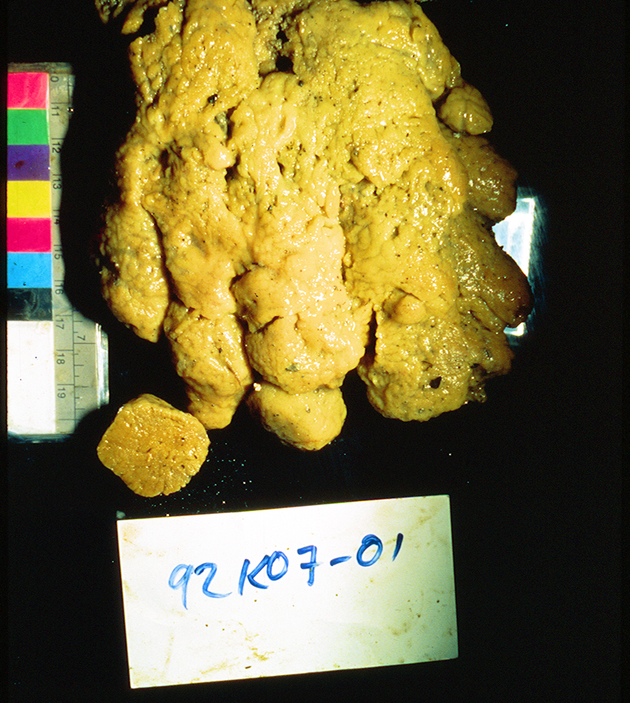
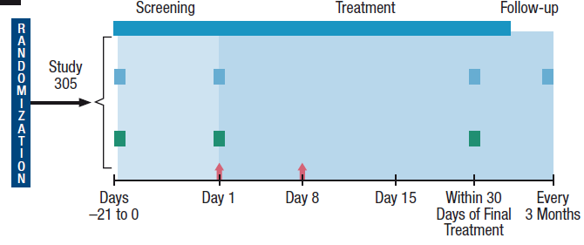
Eribulin: Halichondrin B Analogue Improves Survival in Taxane-Resistant Metastatic Breast Cancer
Development
Mechanism of Action
Unique binding to microtubular ends; abnormal spindles cannot pass the metaphase checkpoint. Mol. Pharmacol. 70: 1866, 2006
Characterization of lead molecules
NCI first-in-human trial
40 pts; weekly X 3 q 4 wks
5 PR: 2 lung, breast,
melanoma, bladder
FDA Approved for Metastatic Breast Cancer (11/2010)
Eisai: MBC OS 3 mo

Slide 13
NCI Experimental Therapeutics (NExT) Program:
Role of FNLCR in NCI Pipeline
HTS & CBC
Med.Chem. & Agent Comparison
Efficacy Testing
& New Models
Biologics Development
Drug Supply &
Repository
Regulatory
Support
Proof of Mechanism PD
Molecular Toxicology
Imaging
Drugs
Molecular
Tumor Characterization
Natural
Products
Combination Screening
Phase 0/1
Trials
= Conducted at or by FNLCR

Slide 14
15 Years of BDP Products from Extramural Research
47 products into clinical trials
14 products in commercial development
1 product currently in FDA/EMA review for licensure
1 product approved

Slide 15
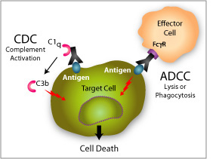
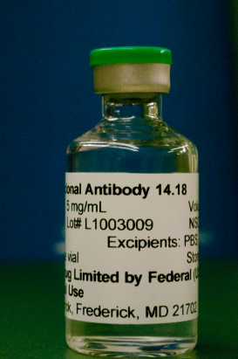
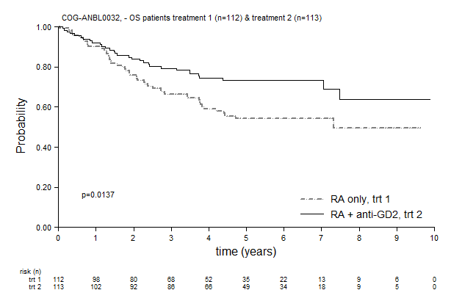
Ch14.18 Monoclonal Antibody Targeting GD2 Improves Survival in High Risk Neuroblastoma
  Ch14.18, a monoclonal antibody discovered at Scripps Institute, targets GD2 on most human melanomas, neuroblastomas, some sarcomas, gliomas, and small cell lung cancers.
  Ch14.18 kills by Complement and Antibody-Directed Cellular Cytotoxicity (ADCC) using NK and granulocyte cells boosted with IL-2 and GM-CSF.
  FNLCR’s BDP manufactured Ch14.18 for the Phase III trial of 1,000 patients in USA, Canada, and Australia.
  Childrens Oncology Group pivotal Phase III clinical trial showed survival benefit in high-risk neuroblastoma. Ch14.18 has become the Standard of Treatment.
  Commercial partner took over manufacturing under CRADA and Ch14.18 was approved by FDA March, 2015.
P = 0.0137
Overall Survival

Slide 16
NCI Experimental Therapeutics (NExT) Program:
Role of FNLCR in NCI Pipeline
HTS & CBC
Med.Chem. & Agent Comparison
Efficacy Testing
& New Models
Biologics Development
Drug Supply &
Repository
Regulatory
Support
Proof of Mechanism PD
Molecular Toxicology
Imaging
Drugs
Molecular
Tumor Characterization
Natural
Products
Combination Screening
Phase 0/1
Trials
= Conducted at or by FNLCR

Slide 17
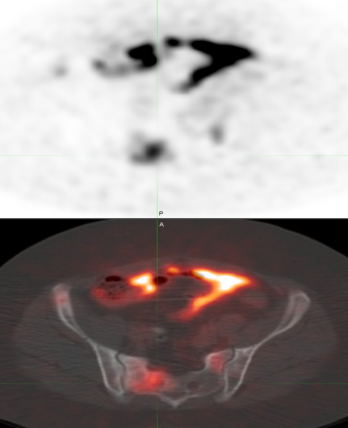
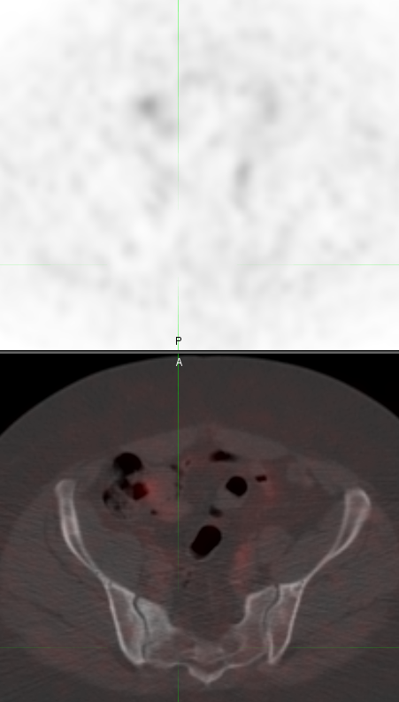
Molecular imaging agents for therapeutic drug development
Develop imaging assay in tandem with early drug development
Most agents are short-lived PET or SPECT radiotracers –unique issues including very limited support for imaging drug development in commercial sector (no ‘blockbuster’ market)
Imaging for non-invasive in vivo PK/PD
¹⁸F-Estradiol for NCI Clinical Center Trial
SUV 8.6
SUV 1.5
Day 6
Baseline

