Slide 1
NCI Office of the Director
Presented By: Kristin Komschlies, Ph.D.
Notes:
For a more accessible version of this file or to request additional information about the images contained in this PowerPoint presentation, please contact: the FNCLR Acquisition Team @ FNLCR_ACQ@mail.nih.gov.

Slide 2
Scientific Programs Overview
Notes:
*****PLACE SPEAKER NOTES HERE:

Slide 3
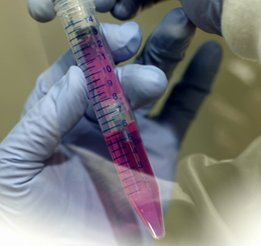
The NCI’s FFRDC – Purpose
To provide a unique biomedical resource for the development of new technologies and the translation of basic science discoveries into novel agents for the prevention, diagnosis & treatment of cancer, AIDS and other diseases

Slide 4
The NCI’s FFRDC – Overview
NCI’s presence was established in the early 1970’s by President Nixon - converting some of Fort Detrick’s biodefense laboratories into “a leading center for cancer research.”
It is a Government-owned Contractor-operated facility.
Approximately 1800 contract staff.
The contractor entity is termed the Frederick National Laboratory for Cancer Research (FNLCR).
In 1975 the FNLCR was designated as a Federally Funded Research and Development Center (FFRDC).
Up to 30% of the financial support for an FFRDC can come from sources other than the sponsoring agency

Slide 5
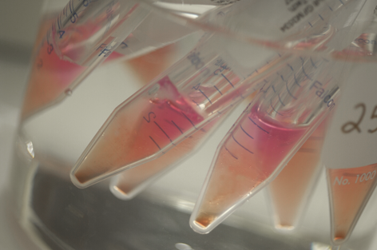
42 Government Research Centers Share the FFRDC Designation
Argonne National Lab (DoE)
Lawrence Livermore National Lab (DoE)
Los Alamos National Lab (DoE)
Brookhaven National Lab (DoE)
Oak Ridge National Lab (DoE)
National Defense Research Institute (DoD)
Jet Propulsion Lab (NASA)
FNLCR is the only FFRDC in the nation dedicated solely to biomedical research

Slide 6
FFRDC Defined
“Federally Funded Research and Development Centers (FFRDCs) means activities that are sponsored under a broad charter by a Government Agency (or agencies) for the purpose of performing, analyzing, integrating, supporting, and/or managing basic or applied research and/or development, and that receive 70% or more of their financial support from the Government.”
(1) A long-term relationship is contemplated;
(2) Most or all of the facilities are owned or funded by the government; and,
The FFRDC has access to government data, employees, and facilities beyond that common in a normal contractual relationship.
(FAR 2.101)

Slide 7
FNLCR – A Unique National Resource
As an FFRDC, the FNLCR provides the NCI with a unique resource to achieve:
Flexibility
Rapid Response
Increased Efficiency

Slide 8
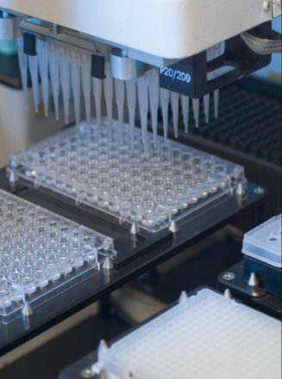
FNLCR – A Unique National Resource
Meeting the most urgent biomedical research needs of the nation, including:
The NCI
Other NIH institutes
Other government agencies
Extramural investigators
NCI corporate partners

Slide 9
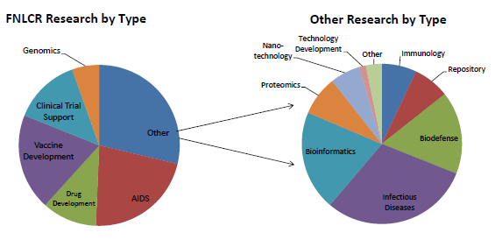
FNLCR – Distribution of Scientific Effort
FNLCR Research by Type
“Other” -- Expanded

Slide 10
FNLCR – Regional Research Support
15
NCI at Frederick
83
Advanced Technology Research Facility
Clinical Monitoring
€
Biospecimen Repository
70
Baltimore
Vaccine Pilot Plant
270
Advanced Technology Center
Bioinformatics
95
NCI Campus at Bethesda
Clinical Trials Support
D.C.

Slide 11
FNLCR – National Research Support
33 States and the District of Columbia
States with research efforts managed/supported by FNLCR Staff

Slide 12
FNLCR – Global Research Support
Countries with research efforts managed/supported by FNLCR staff

Slide 13
FNLCR – Areas of Research/Research Support
Basic Research
Animal Models
Molecular Technologies
Genotyping
Proteomics
Protein Expression
Drug Discovery
Molecular Target Screening
Nanotechnology Characterization
Imaging
Vaccine Production
Biopharmaceutical Development
Toxicology Pharmacology
Clinical Trial Support
Biomedical Computing
Repository Services

Slide 14
FNLCR: Meeting the Needs of the Nation
During the last several years the FNLCR along with its Government counterparts:
Published over 4000 peer-reviewed research articles
Filed >200 invention reports, executed >1500 Material Transfer Agreements and 30 Collaborative Research and Development Agreements with numerous universities and industry collaborators
Cited by The Scientist as a top ten “Best Places to Work” for U.S. research institutions

Slide 15
FNLCR: Meeting the Needs of the Nation (cont.)
During the past several years the FNLCR:
Provided basic and clinical research services to many of the 28 NIH institutes, centers, and NIH-OD
Provided advanced technology expertise and support to the NIH, DoD (e.g. USAMRIID, USACHEHR, USUHS, USAMRICD), DHS, FDA, CDC and USDA
Produced nearly 80 lots of 21 novel biopharmaceutical products and vaccines through two cGMP manufacturing programs
Supported over 350 NIH-sponsored clinical trials to test innovative treatments for cancer and AIDS/infectious diseases
Acquired or stored over 6 million clinical samples in support of cancer and infectious disease clinical trials worldwide
Provided advanced biomedical computing expertise and support every year to over 1,800 users from one of the world’s largest computer resources dedicated to biomedical research.

