Slide 1
Center for Biomedical Informatics and Information Technology (CBIIT)
Presented By: Anthony Kerlavage and Jose Galvez
Notes:
For a more accessible version of this file or to request additional information about the images contained in this PowerPoint presentation, please contact: the FNCLR Acquisition Team @ FNLCR_ACQ@mail.nih.gov.

Slide 2
Overview of Mission and Purpose
Notes:
*****PLACE SPEAKER NOTES HERE:

Slide 3
Overview of CBIIT’s Mission and Purpose
CBIIT collaborates across NCI to plan, provide, and coordinate technology, standards, and scientific computing in support of the NCI mission to speed discovery, facilitate open science, and progress towards precision treatment in cancer care and a learning healthcare system.
As a provider of informatics capabilities (such as scientific computing, semantics, collaboration platforms, translational tools, and tools for data integration and analysis), CBIIT supports NCI's intramural staff in performing their research.
CBIIT also collaborates with the larger cancer research community to help define and advocate for the informatics required to progress the science of discovery and the treatment of cancer patients.
Notes:
*****PLACE SPEAKER NOTES HERE:

Slide 4
Overview of Scientific Work
Notes:
*****PLACE SPEAKER NOTES HERE:

Slide 5
Overview of Scientific Programs and FNLCR Support
Services Provided
  Project Management
  Business Analysis
  Software & Database Development
  Quality Assurance (QA)
  Metadata Curation
  Protocol Abstraction
  Operations & Maintenance (O&M)
Programs Supported (Examples)
  Enterprise Vocabulary Services
  Cancer Data Standards Registry and Repository
  NCI-Molecular Analysis for Therapy Choice
  Clinical Trials Reporting Program
  Imaging Informatics
Notes:
*****PLACE SPEAKER NOTES HERE:

Slide 6
Enterprise Vocabulary Services (EVS)

Slide 7
Enterprise Vocabulary Services (EVS) - Purpose
Provides terminology and ontology services to support NCI's basic and clinical research efforts.
Create and promote best-practice, science-based, responsive terminology/ontology resources to collect, code, and analyze data for clinical trials, basic research, and other activities.
Support metadata, models, value sets, and mappings to structure meanings and make them interoperable between NCI and other semantic infrastructures.
Partner and harmonize with other NIH Institutes/Centers, agencies, SDOs, and researchers to build shared standards for global research and care.
Promote open access, open source content and tools to lower barriers, share burdens, and build shared resources.
Notes:
For more information, see: https://wiki.nci.nih.gov/display/EVS/EVS+Use+and+Collaborations

Slide 8
Overview of FNLCR Work
FNLCR is responsible for development and maintenance work on most EVS terminology software, used by NCI and other systems with many thousands of users:
  LexEVS Terminology Server is a software suite to load, publish, and access vocabulary and ontology resources, with Java and REST APIs (with Mayo Clinic).
  EVS Terminology Browsers help researchers and others code and interpret biomedical data.
  NCI Protégé editing software extends Stanford University's Protégé tool for editing NCI Thesaurus and other terminology and ontologies.
Responsibilities include project management, development, O&M, QA, working closely with federal project leads and staff.
Notes:
*****PLACE SPEAKER NOTES HERE:

Slide 9
Cancer Data Standards Registry and Repository (caDSR)

Slide 10
Cancer Data Standards Repository (caDSR) - Purpose
caDSR is a metadata repository and registry that provides data standards, tools, and services to define and share the meaning and syntax of data, and aid in standardized creation, interpretation, and use.
Provide metadata content services and tools to create, manage, and share common data elements (CDEs) and case report forms
Provide public access via browsers and APIs to common data elements and case report forms
Work with collaborators on metadata curation and harmonization
Provide training, expert guidance and best practices for curation and governance.
Promote open access, open source content and tools to lower barriers, share burdens, and build shared resources.
Notes:
*****PLACE SPEAKER NOTES HERE:

Slide 11
Overview of FNLCR Work
FNLCR is responsible for development and maintenance work on the suite of caDSR software tools, used by NCI, collaborators and other systems such as Clinical Data Management Systems. Main tools are:
    CDE Browser
    CDE Curation Tool
    Form Builder
    CDE Admin Tool
    Sentinel Tool
    caDSR APIs
  Responsibilities include project management, development, O&M, QA.
Notes:
*****PLACE SPEAKER NOTES HERE:

Slide 12
Molecular Analysis for Therapy Choice (MATCH)

Slide 13
NCI-MATCH Purpose
Develop and implement a sophisticated precision medicine workflow and treatment assignment system to support the MATCH Trial
Utilize Agile and DevOps Development Methodologies
System Details:
  Tracks patients through trial workflow
  Enforces trial constraints
  Performs mutation-of-interest filtering
  Performs algorithm-based, rules engine-driven treatment assignment
  Provides automated reporting, data analytics, and data visualization
Notes:
Link to NCI-MATCH Trial details: http://www.cancer.gov/about-cancer/treatment/clinical-trials/nci-supported/nci-match

Slide 14
NCI-MATCH Overview of FNLCR Work
FNLCR manages NCI-MATCH Operations, including:
  Cross-organizational stakeholder management and coordination
  Maintaining multiple systems integrations
    High-availability and redundancy Service Level Agreement (SLA)
  Implementing new study treatment arms and study amendments
    Reiterative system validation
  Use of cutting-edge technologies and approaches considered standard
  Bioinformatics expertise required
  Ability to implement complex logic for treatment assignment
Notes:
*****PLACE SPEAKER NOTES HERE:

Slide 15
Clinical Trials Reporting Program (CTRP)

Slide 16
CTRP - Purpose
Developed in response to 2005 National Cancer Advisory Board Clinical Trials Working Group (CTWG) mandate to:
  Establish “a comprehensive database containing regularly-updated information on all NCI-funded clinical trials”
  Give NCI a complete picture of NCI-supported cancer trials, to enable funding prioritization
  Improve patient accrual by allowing clinicians to identify relevant trials
Need for CTRP was further emphasized in the 2010 Institute of Medicine (IOM) report “A National Cancer Clinical Trials System for the 21st Century: Reinvigorating the NCI Cooperative Group Program”
  Report described the need for “a robust, standardized, and accessible clinical trials infrastructure” including “a complete database of active and planned trials”

Slide 17
CTRP Functionality
Trial Registration
  Web application and web services
Trial scientific abstraction
  Indexing and biomarker abstraction
Accrual management
Facilitates compliance with FDA Amendments Act (FDAAA) through support of ClinicalTrials.gov trial submission
Partnering with major CTMS vendors to simplify accrual reporting
Data publically available via Cancer.gov search portal
Reporting

Slide 18
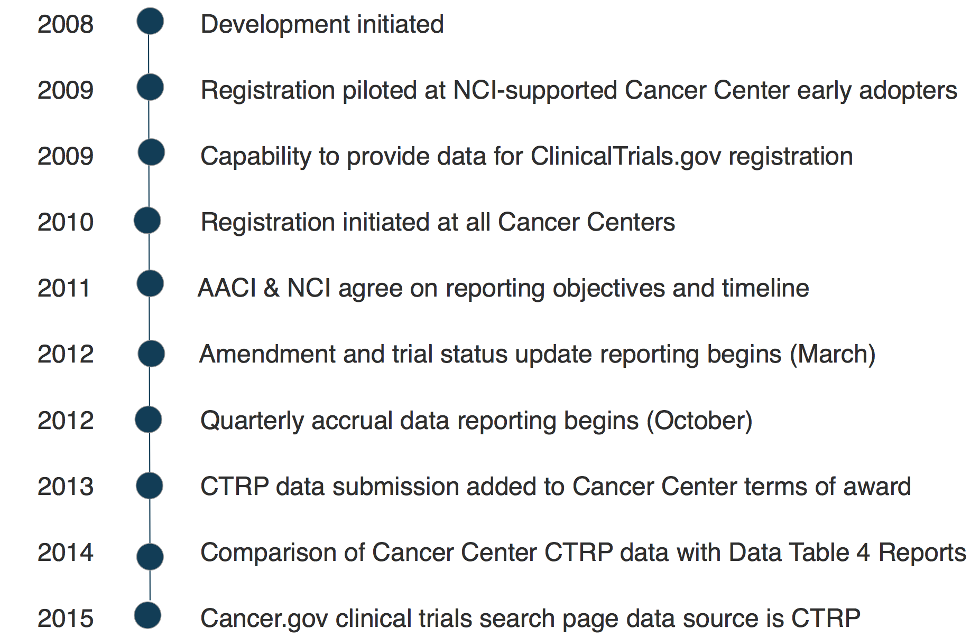
CTRP Timeline

Slide 19
CTRP Overview of FNLCR Work
FNLCR provides:
Database and application development and maintenance
    Maintain web application as well as web services
Registration of all interventional trials open to accrual after Jan. 1, 2009
Coordination with NCI designated Cancer Centers
Curation and protocol abstraction
  Clinical Trials Reporting Office (CTRO) established in 2009
    Contract abstractors
    Assist in the registration process
    Perform scientific protocol abstraction
      Disease indexing
      Biomarker indexing

Slide 20
Imaging Informatics and the National Biomedical Imaging Archive (NBIA)

Slide 21
Imaging Informatics – Purpose & History
Facilitate the development of tools and standards to improve interoperability and functionality available to the cancer imaging community, within and outside NCI.
FNLCR has supported the development of DICOM¹-based tools and applications for image archiving, annotation and markup for support of the Cancer Imaging Program (CIP), the Quantitative Imaging Network (QIN), and The Cancer Imaging Archive (TCIA).
  Development support for NBIA, AIM², Middleware, AVT³, and XIP⁴ has been executed through the FNLCR over the past decade.
  Stakeholder management and support for collaboration across organizations within NCI
Notes:
¹DICOM: Digital Imaging and Communications in Medicine – standard for distributing, viewing, and sharing digital images (http://dicom.nema.org/)
²Annotation and Image Markup – standard for marking up clinical images to provide/share additional information (https://wiki.nci.nih.gov/display/AIM/Annotation+and+Image+Markup+-+AIM)
3AVT: Algorithm Validation Toolkit
4XIP: Extensible Imaging Platform – open-source platform for the development of imaging tools (http://www.openxip.org/)

Slide 22
Imaging Informatics - Overview of FNLCR Work (1)
FNLCR provides project management support for The Clinical and Translational Imaging Informatics Project (CTIIP), cross-NCI project
  Project working to harmonize and create interoperability across informatics capabilities for clinical imaging, digital pathology, and co-clinical trials
  Goal is to progress towards clinical decision support for Precision Medicine
CTIIP has multiple pilot capabilities under development; contracts managed by FNLCR
  Viewing / sharing of digital pathology images
  MICCIA/Open Pilot Challenges
  Co-Clinical Trials data and trial simulation
  Development of DICOM-based Small Animal Imaging standard
Notes:
¹DICOM: Digital Imaging and Communications in Medicine – standard for distributing, viewing, and sharing digital images (http://dicom.nema.org/)
²Annotation and Image Markup – standard for marking up clinical images to provide/share additional information (https://wiki.nci.nih.gov/display/AIM/Annotation+and+Image+Markup+-+AIM)
3AVT: Algorithm Validation Toolkit
4XIP: Extensible Imaging Platform – open-source platform for the development of imaging tools (http://www.openxip.org/)

Slide 23
Imaging Informatics - Overview of FNLCR Work (2)
NBIA activities in support of The Cancer Imaging Archive (TCIA)
  FNLCR manages ongoing NBIA Operations & Maintenance
    NBIA has been in development and parallel operations and maintenance over the past decade.
    The NCI CIP uses multiple instances of NBIA for TCIA at Washington University
Components of CTIIP are dependent on NBIA
Notes:
*****PLACE SPEAKER NOTES HERE:

