Slide 1
Center for Cancer Research
Presented By: Joel Schneider, Ph.D.
Notes:
For a more accessible version of this file or to request additional information about the images contained in this PowerPoint presentation, please contact: the FNCLR Acquisition Team @ FNLCR_ACQ@mail.nih.gov.

Slide 2
Overview

Slide 3
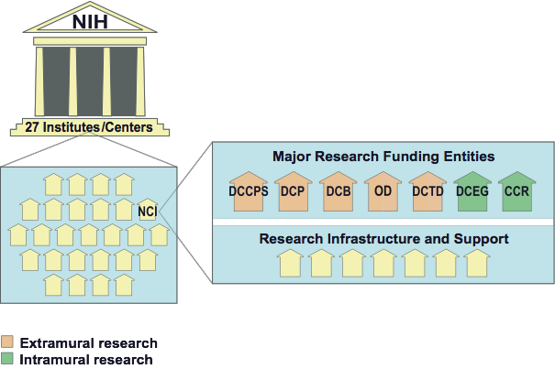
NIH and NCI Structure
The NCI supports its mission through a combination of extramural funding (grants) and intramural (on-site) research
Notes:
THIS SLIDE IS ANIMATED TO CIRCLE CCR
NIH is made up of 27 Institutes and Centers. NCI is one of these 27 Institutes.
The NCI supports its mission through a combination of extramural funding (grants) and intramural (on-site) research.
The Center for Cancer Research (CCR) is part of NCI’s intramural program.

Slide 4
CCR is the Basic and Clinical Research Arm of NCI’s Intramural Program
National Cancer Institute
Intramural Divisions
Extramural Divisions
Division of Cancer Epidemiology and Genetics
Division of Cancer Treatment and Diagnosis
Division of Cancer Control and Population Sciences
Division of Cancer Prevention
Division of Cancer Biology
Office of Centers, Training, and Resources
70% PIs based in Bethesda
30% PIs based in Frederick
Center to Reduce Cancer Health Disparities
Notes:
CCR is the Basic and Clinical Research Arm of NCI’s Intramural Program
70% of CCR Principle Investigators are based in Bethesda and 30% of CCR Principle Investigators are based in Frederick.
The FNLCR contract facilitates research activities on both campuses. Bethesda this is mainly embedded nursing support, while in Frederick this is embedded technical support and some PI groups. CCR staff in both locations send samples to the contractor-run cores in Frederick.

Slide 5
CCR Vision
Integrate basic, translational, and clinical research to make cancer preventable, curable, or chronically manageable.
HIV/AIDS
6%
Notes:
THIS SLIDE IS ANIMATED
The Vision of the CCR is to Integrate basic, translational, and clinical research to make cancer preventable, curable, or chronically manageable.
Research conducted in the CCR is equally split between basic research and clinical/translational research.
And it is important to note that roughly 6% of our research focuses on HIV/AIDS.

Slide 6
Distinctive Attributes of CCR’s Mission
Sustained support for investigator-driven high-risk, high-impact research
Highly interactive, interdisciplinary culture for basic and clinical scientists:
generation of new knowledge
efficient bench to bedside to bench translation
development of new technologies
focus on rare cancers and underserved patient populations
Largest effort in the NIH Clinical Research Center which is world’s largest cancer-focused clinical research center
The FFRDC facilitates many of our activities

Slide 7
Research Overview

Slide 8
Interdisciplinary Strengths of CCR’s Research Portfolio
Notes:
This chart shows our current research portfolio.
Cancer Biology (33%)
Immunology (14%)
Chromosome Biology/Epigenetics (11%)
Chemistry/Structural Biology (11%)
Cell and Development Biology (11%)
HIV/Cancer virology (8%)
Molecular biochemistry/microbiology (7%)
Genetics and genomics (5%)

Slide 9
Interdisciplinary Strengths of CCR’s Research Portfolio
The FNLCR Contract Provides:
Embedded support for basic, translational and clinical research
State-of-the-art laboratory animal services, including genetically modified mouse models
Dedicated laboratories with advanced technologies in protein chemistry, genomics, and imaging
Translational
Clinical
Basic
Animal Models
Technology
Notes:
THIS SLIDE IS ANIMATED: TEXT ON RIGHT APPEARS
The contract adds several essential elements to facilitate our research in the areas of basic, clinical, and translational research as well as in technology and animal resources.

Slide 10
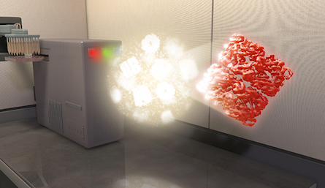
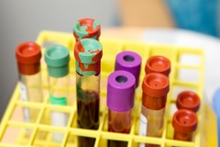
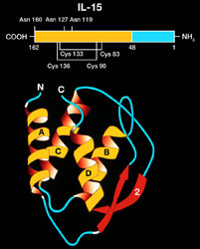
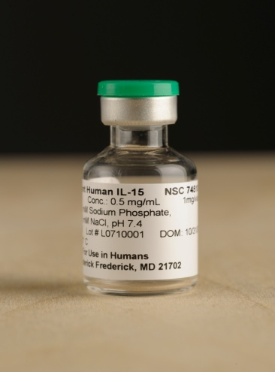
Past and Ongoing FNLCR Contract-Enabled Research
Animal Models
Preclinical models
Microbiome/germfree mice
Advanced Technologies
Microscopy (optical and EM)
Sequencing
Protein chemistry
Protein production
Clinical Trials
Planning and implementation
CLIA certified specimen processing and testing
Translational
Drug Development
cGMP production
Notes:
Here are a few examples of past and ongoing contract enabled research, including contractor-led and contractor-supported efforts.
Clinical Laboratory Improvement Amendments (CLIA)

Slide 11
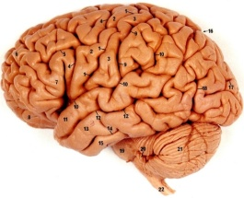
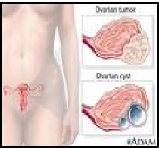
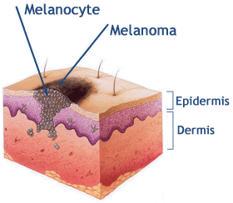
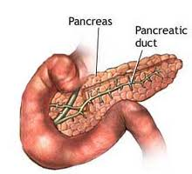
Animal Models:
Developing Preclinical Models
Model Type
Lung Adeno/
Squamous Carcinoma
Center for Advanced Preclinical Research
Glioblastoma
Serous Ovarian Carcinoma
Melanoma
Pancreatic Ductal
Adenocarcinoma
Notes:
An example of the contract facilitating our needs with regards to animal models can be demonstrated via our Center for Advanced Preclinical Research (CAPR) program.
We have developed several preclinical models in: Lung adeno/squamous carcinoma, glioblastoma, serous ovarian carcinoma, melanoma, and pancreatic ductal adenocarinoma.

Slide 12
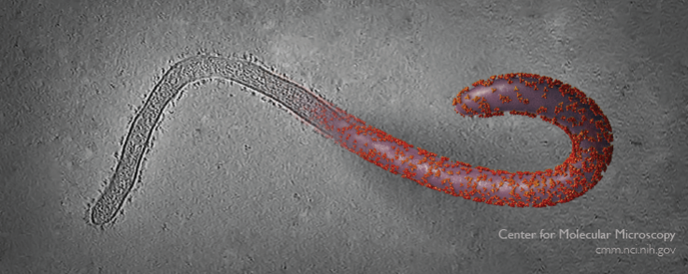
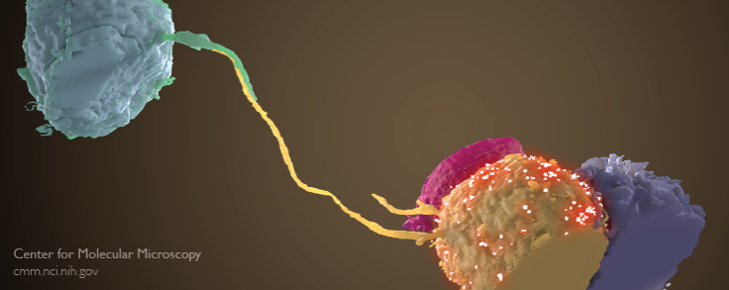
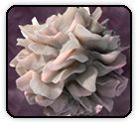
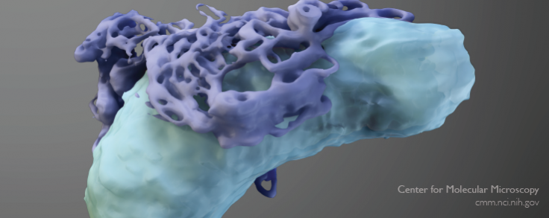
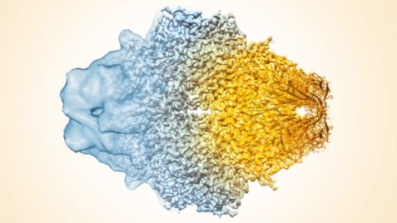
Technology Development: Center of Molecular Microscopy
The Center for Molecular Microscopy is conducting high-level research using breakthrough technologies and methods for biological 3D electron microscopy and expanding the capabilities of these methods for high-resolution structures of molecules, cells and tissues.
EBOLA
HIV virological synapse
Dendritic Cell
Mitochondrion with
endoplasmic reticulum
Beta-galactosidase
Notes:
An example of a newly develop technology resource is our Center of Molecular Microscopy.
This new resource will be instrumental in moving our structural biology research to the next level and well as broaden our efforts in precision medicine.
The CMM is conducting high-level research using breakthrough technologies and methods for biological 3D electron microscopy and expanding the capabilities of these methods for high-resolution structures of molecules, cells and tissues.
Some of the recent advances made using this technology are shown here, demonstrating the enormous potential in this field.

Slide 13
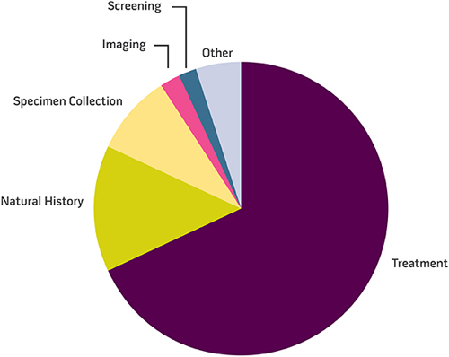
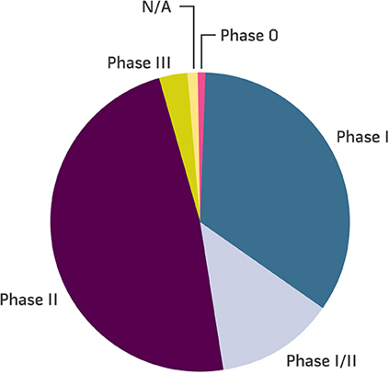
Clinical Support: CCR Clinical Trials
Types of Clinical Trials
Treatment Trials by Phase
Focused on
early phase
Currently, 55% of the ongoing trials in CCR are supported via the contract
Notes:
The contract is very important to our clinical research.
In the CCR we conduct a number of trials, mostly studying different or combinations of treatments. Most of these treatment trials are early phase trials.
Currently, 55% of the ongoing trials in CCR are supported via the contract though the provision of clinical staff and assays for clinical monitoring.

Slide 14
Translational Efforts: Drug Development
Immunotherapy
In 2007, IL-15 and IL-7 were two of the top 5 agents selected for development during the at NCI’s Immunotherapy Agent Workshop
The contractor clinically manufactured both of these agents according to cGMP regulations and made them available to the intramural and extramural community
Both are being used in several investigational studies for cancer therapy
First clinical trials of IL-15 for the treatment of patients with metastatic malignant melanoma and metastatic renal cell cancer
First clinical trials of IL-7 in humans
Notes:
An example of our translational efforts can be seen in our drug development collaborations.
Immunotherapy is a major research area in the CCR.
In 2007….
Current Good Manufacturing Practice (CGMP)

Slide 15
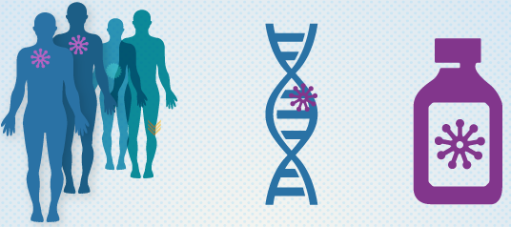
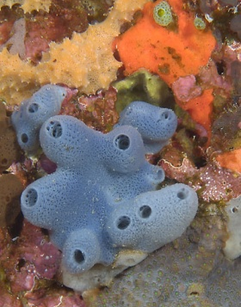
Areas of Special Emphasis
Precision Medicine and Prevention
Cell-based Therapies
The Human Microbiome
NCI Natural Products Discovery Initiative
Notes:
These are some areas of special emphasis within the CCR portfolio and examples of how the FNLCR contract supports these efforts.
Precision Medicine and Prevention: contractor support is used for sequencing patient samples, metabolomics, and clinical support
Cell-based Therapies: contractor support is used for advanced cell culture and clinical support
The Human Microbiome: FNLCR contract provides a state-of-the-art germ-free animal facility, sequencing identification of microbes, and bioinformatics analysis
NCI Natural Products Discovery Initiative: FNLCR contract provides embedded chemistry technical support

