Slide 1
Center for Strategic Scientific Initiatives (CSSI)
Presented By: Michelle Berny-Lang
Notes:
For a more accessible version of this file or to request additional information about the images contained in this PowerPoint presentation, please contact: the FNCLR Acquisition Team @ FNLCR_ACQ@mail.nih.gov.

Slide 2
Overview of Mission and Purpose
Notes:
*****PLACE SPEAKER NOTES HERE:

Slide 3
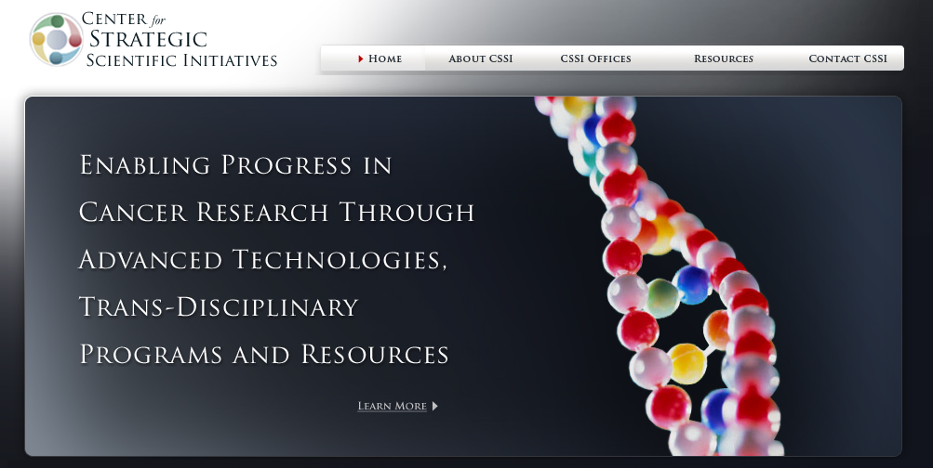
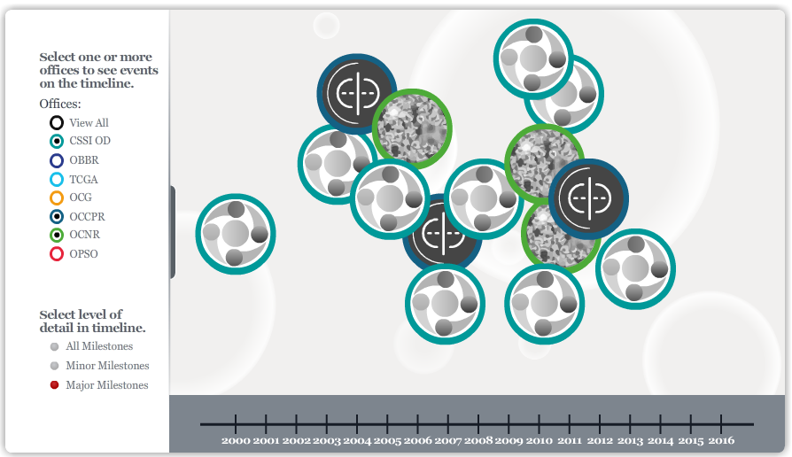
Center for Strategic Scientific Initiatives (CSSI) Overview
cssi.cancer.gov
CSSI Office of the Director
  Office of Cancer Nanotechnology Research (OCNR)
  Office of Cancer Clinical Proteomics Research (OCCPR)
Notes:
--I’m here to introduce the Center for Strategic Scientific Initiatives (CSSI). The center is an operating entity of the NCI’s Office of the Director and was formally established in 2003 as a strategic focus for innovative programs that range from exploratory pilot programs to the development of national resources that serve the overall cancer research community. CSSI adheres to a basic set of principles that define each program, including extensive conversations with the extramural community; mile-stone driven plans; trans-disciplinary team science; and publically available, broadly accessible, multi-dimensional data.
--Please visit our website for more information, including an interactive timeline highlighting milestones and key events from past and present programs.
--Since its inception, CSSI has undertaken a number of initiatives that have contributed to addressing major barriers and opportunities in cancer research, focused on areas such as genomics, biospecimens, and physical sciences. The Center is currently comprised of two offices: the Office of Cancer Nanotechnology Research (OCNR) and the Office of Cancer Clinical Proteomics Research (OCCPR).

Slide 4







CSSI Programs
Program | Grants |  | Cooperative Agreements | Contracts | FFRDC |  | Interagency Collaborations (Co-fund/joint pilot programs)
 | Research | Training |  |  | Resource | R&D Subs
 | ✓
 | ✓
 | ✓ | ✓ | ✓ |  | ✓ | ✓ | ✓
 | ✓ | ✓ | ✓ | ✓ | ✓ | ✓ | ✓
Notes:
--Across CSSI, we currently manage four programs using a variety of funding mechanisms to support the goals and activities. I won’t go into detail on the two strictly grant-based programs at the top, but wanted to emphasize the NCI Alliance for Nanotechnology in Cancer from OCNR and the Clinical Proteomic Tumor Analysis Consortium from OCCPR which both utilize the FFRDC as a resource for research capabilities and for R&D subcontracts to the extramural community. This presentation will focus on those two programs, highlighting the FFRDC-based components.

Slide 5
Overview of Scientific Work

Slide 6
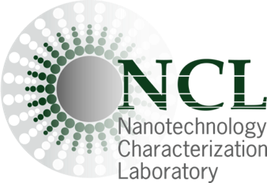
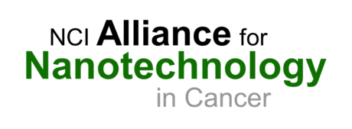

Nanotechnology Characterization Laboratory (NCL)
– Why It Was Established?
NCI embarked on implementation of nanotechnology solutions for cancer diagnosis, therapy, and prevention in 2004 via establishment of the NCI Alliance for Nanotechnology in Cancer program (http://nano.cancer.gov)
The Alliance consists of funded academic research and promotes efforts leading to the development of clinically worthy cancer interventions based on nanotechnology
NCL (http://ncl.cancer.gov) is one component of the Alliance program and was established to enable development of:
  Standard assays for nanomaterials characterization
  Hub for data of different nanomaterials
  Development of reference materials
  Interdisciplinary expertise
NCL does not develop nanomaterials and thus it does not ‘compete’ with academic or industrial researchers and serves as an objective entity to assess nanomaterial formulations
Notes:
--The Nanotechnology Characterization Laboratory or NCL located in Frederick, MD was established in 2004 as one component of the NCI Alliance for Nanotechnology in Cancer. More information about both can be found at the website links above.
--The larger Alliance program was established to fund academic research and to promote efforts leading to the development of clinically applicable cancer interventions utilizing nanotechnology.
--As such, the NCL was established to be one crucial part in this chain of bringing nanotechnology solutions from bench-to-bedside and, more specifically, existing in the preclinical space.
--Important to note here, is that the NCL is an entirely objective entity that does not develop nanomaterials and, as such, is not in competition with the extramural community. It is simply utilized as a extramural community resource to bridge the gap between novel idea and clinical translation.
--The NCL is located within FNLCR’s Advanced Technology Research Center, which is a facility designed to foster co-located partnership projects between its tenants, giving access to multiple technologies and platforms. NCL provides expertise in nanotechnology while simultaneously receiving access to cancer-related resources across FNLCR.

Slide 7
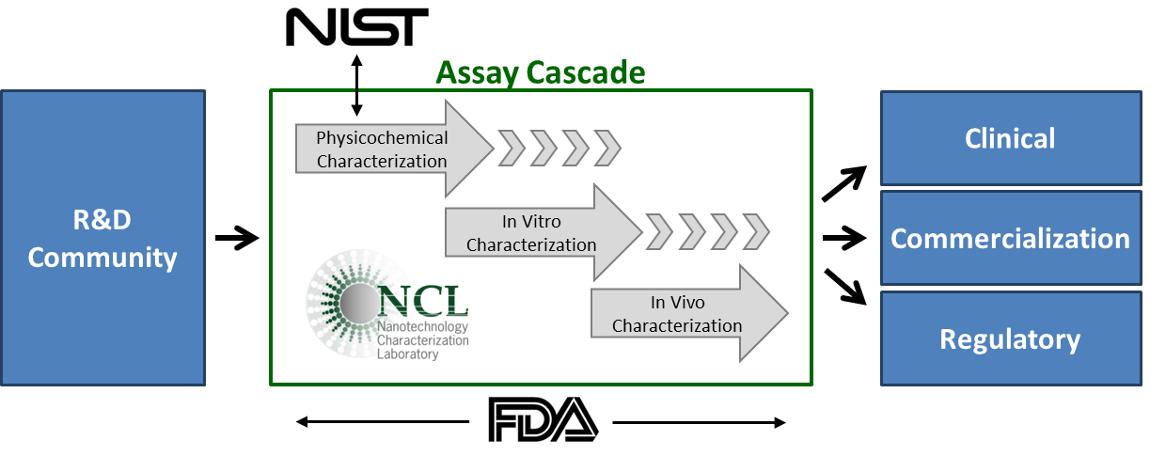
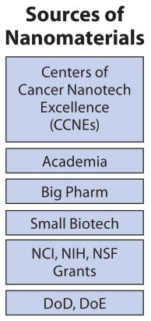
NCL – What is it?
The NCL is a resource for in-depth characterization of nanomaterials to be used in new diagnostics and therapeutics. The data produced by the NCL facilitates translation of promising nanotech formulations to the clinic.
The NCL was established in 2004 as an interagency collaboration among NCI, NIST, and FDA.
NCL preclinical characterization of nanomaterials via an assay cascade model includes:
  physicochemical characterization
  in vitro experiments
  in vivo testing for safety and efficacy
90% of NCL’s efforts support the extramural community.
Notes:
--The NCL is a collaboration between NCI, NIST and the FDA, and provides preclinical characterization services to researchers developing a nanotech cancer therapy or diagnostic.
--Nanomaterials submitted to the NCL are subjected to a three-tiered Assay Cascade of scientific tests, including physicochemical characterization, in vitro assessment, and in vivo evaluation for safety and efficacy. NIST also contributes to NCL’s physicochemical characterization process.
--The data generated from NCL characterization are intended for use in support of regulatory filings with the FDA, but the collaborators are also able to use NCL data in other ways – in publications, in grant applications, and to garner investment from venture capital.
--One successful – and unique – aspect of the NCL is that it offers nanomaterial submitters access to collaborating scientists with multidisciplinary expertise, experience with a wide range of nanomedicine types, an understanding of the regulatory process, and knowledge of the “lessons learned” from the successes and failures of other nanomedicines.

Slide 8
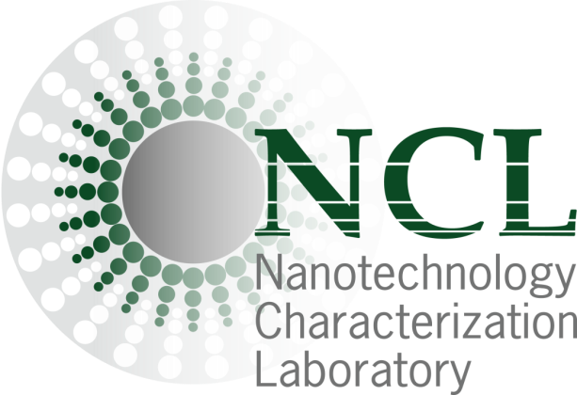
NCL – How is it Operated?
NCL receives applications every quarter from extramural community – academia, industry, and government. List of current collaborators go to: http://ncl.cancer.gov/NCLCollaborators
Applications are reviewed based on:
  Demonstrated efficacy in vitro and/or in animal models
  Advantages over existing cancer therapies or diagnostics
  Existing characterization data
  Inherent toxicity or environmental concerns
  Proposed path to clinical trials
Scientific Oversight Committee (SOC) made up of scientists from NCI, NIST, FDA and EPA provides oversight to the laboratory’s operation and convenes annually.
SOC for Accountability
Notes:
--NCL receives applications quarterly from the extramural community.
--Developers apply by demonstrating the anti-cancer efficacy of their compound. If accepted, the compound is transferred to the NCL under a material transfer agreement (MTA) and evaluated based on US FDA regulatory requirements.
--Additionally, NCL provides independent verification of results in order to help attract investment and de-risk products. It provides submitters a preview of what FDA may be concerned with based on past experience and provides “pharmaceutical mentorship” for materials scientists and engineers.
--In order to maintain good business and scientific practices, as well as to generate a model of accountability, the NCL is overseen by a Scientific Oversight Committee. The SOC is made up of scientists from the NCI, NIST, FDA, and the EPA who meet annually at the Frederick facility.

Slide 9
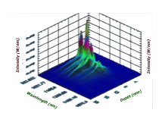
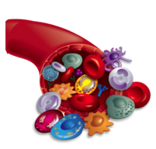
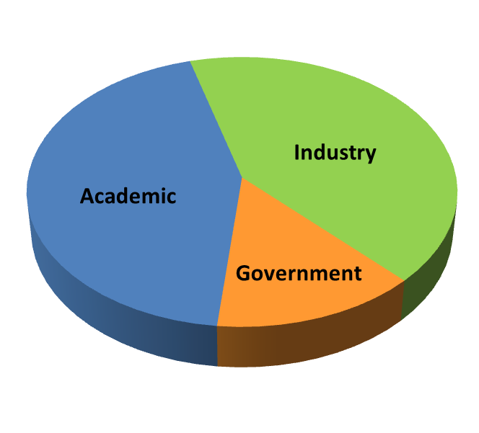
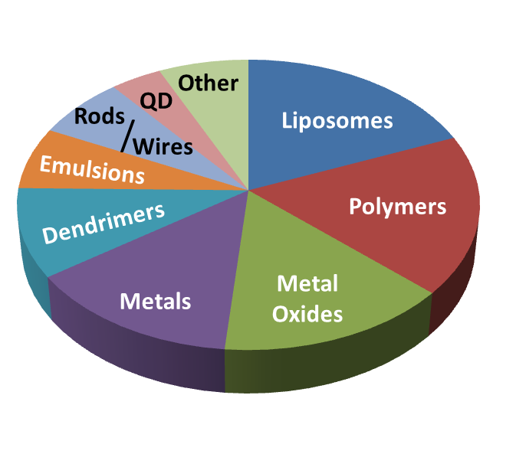
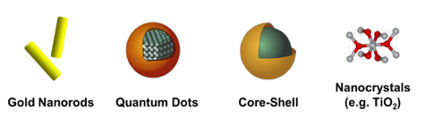
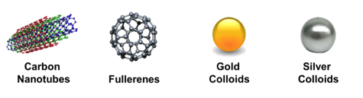
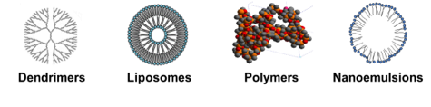
NCL – Assay Cascade Specifics
Physicochemical
In vitro
In vivo
NCL testing is tailored to the platform properties, API, route of administration, and intended therapeutic outcome of the individual nanomedicine.
NCL testing links physicochemical properties to biological outcomes.
More assay details go to: http://ncl.cancer.gov/assay_cascade
NCL has characterized 300+ unique nanomaterials and a wide range of platforms. Ten collaborators with products in clinical trials.
Source and Types of Samples
NCL is the only lab evaluating the wide variety of platforms used in nanomedicine.
Ten years of providing NCL Assay Cascade testing has given NCL expertise that is unique in the world.
Notes:
--NCL testing does not use a “one size fits all process”, as they don’t conduct every assay on every nanomedicine. As part of the application process, they give advice on what tests they expect will be informative, as such an Assay Cascade model is used.
--The 1st phase is physicochemical characterization where they look at properties such as size, surface charge, purity, stability, shelf-life, etc.
--The 2nd phase is the in vitro phase, which uses in vitro assays to look at mechanisms of biocompatibility and mechanisms of interaction with cells and tissues.
--The 3rd phase is in vivo characterization that includes, dose-range finding toxicity, pharmacokinetics, biodistribution, and much more.
--Using this model, the NCL has characterized over 300 unique nanoparticle systems over the last 10 years which has given NCL the collective expertise unique in the US and the world.

Slide 10
NCL – Quantified: 2007-2014
 | 2007 | 2008 | 2009 | 2010 | 2011 | 2012 | 2013 | 2014
Nanoparticles Submitted (unique formulations) | 37 | 40 | 34 | 48 | 27 | 32 | 31 | 6
Total Submitted Samples (multiple batches) | 90 | 83 | 44 | 77 | 103 | 89 | 51 | 29
MTAs/CAs/CRADAs | 11 | 15 | 19 | 12 | 14 | 7 | 12 | 23
Client Reports (confidential reports) | 4 | 6 | 8 | 9 | 10 | 4 | 8 | 9
Publications | 5 | 10 | 8 | 10 | 32 | 12 | 18 | 13
Animal Studies | 7 | 17 | 22 | 18 | 20 | 14 | 23 | 12
Notes:
--The numbers speak for themselves; however, are not meant to project future requirements.
--NCL receives on average 32 unique nanoparticle submissions and 71 total submitted samples per year.
--NCL generates an average of 14 CRADAs, 7 client reports, and 14 publications per year.
--Finally, NCL performs an average of 17 animal studies per year.

Slide 11
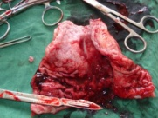
CPTAC: Map proteome/PTMs to each patient’s genome; develop assays for pathways and candidate biomarkers
Inputs
Analyses
Outputs
TCGA tumor collections
Analyze >100 tumors/cancer
breast, ovarian, colon
Proteome
Phosphoproteome
Other PTMs
Targeted protein / PTM
Cancer pathways
Protein isoforms
Molecular signatures
Genome-proteome relationships
Genome-signaling relationships
Protein targets
Assays for newly discovered proteins
Prospective tumor
collections
  Biological mechanisms:
  Are genomic aberrations detectable at protein level?
  What is their effect on protein function?
  Which events are drivers? Which are passengers?
  Clinical applications:
  Can proteomic information provide a better molecular taxonomy of cancer?
  Can genotypic information guide protein marker development?
Notes:
--Shifting away from our nanotechnology efforts, CSSI also manages the Clinical Proteomics Tumor Analysis Consortium or CPTAC, a research program designed to map a cancer patient’s proteome to their genome with a view toward developing assays for pathways and biomarker candidates. The CPTAC pipeline consists of prospectively collected human tumor samples which are genomically and proteomically characterized by research centers. The data are publicly released and are analyzed by a confederacy of bioinformatics experts with a diverse array of visualization and analysis tools. Some of the questions CPTAC attempts to answer include: “Which genomic aberrations are detectable at the protein level?” and “Can proteomic information provide a better molecular taxonomy of cancer?”. In addition to proteogenomic data, CPTAC distributes several resources to the biomedical research community, including antibody and protein assay characterization information.

Slide 12
FFRDC functions in CPTAC
Prospective biospecimen collection optimized for proteomics
    300 samples of Colon/Breast/Ovarian tumors
    < 30 minutes total ischemia
    Non-tumor adjacent tissue
    Blood/plasma
    ≥ 200 mg tumor
    Collect, process, qualify, store, and distribute samples
    Collect, qualify, and store accompanying clinical data
Genomic sequencing
Whole-exome sequencing
mRNAseq
miRNAseq
Alignment
Mutation calling
Quality control
Proteogenomic data analysis
    Integrate, analyze, and visualize CPTAC data
    Map proteomic variants to genomic aberrations
    Create networks derived from gene-gene, gene-protein, and protein-protein relationships
    Work with NVIDIA to identify cutting-edge research opportunities in proteogenomic bioinformatics
Notes:
--While the proteomic characterization is supported through NCI grants, the FFRDC provides many critical functions for CPTAC operations. First, the FFRDC oversees biospecimen collection, qualification, processing, storage, and distribution. They assist in developing collection protocols and case report forms, and they manage the subcontracts carrying out these activities. The FFRDC also provides genomic sequencing and data analysis through subcontracts, as well as quality control for the genomic data. Finally, the FFRDC has stimulated research in the area of proteogenomic characterization bioinformatic analysis. In one aspect of this work, the FFRDC collaborated with the company NVIDIA to leverage their expertise in graphics technology for improving visualization tools within proteogenomic bioinformatics.

Slide 13
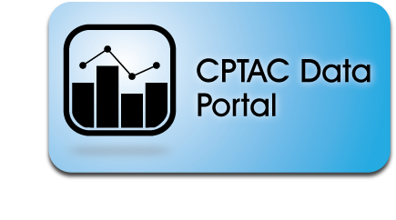
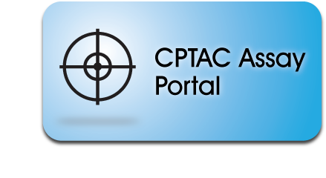
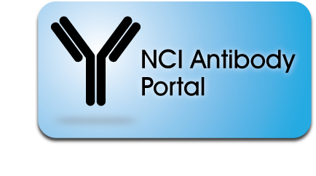


CPTAC Community Resources
Launched 2012
6.2 TB raw files
(89 TB equivalent downloaded)
Launched 2014
554 standardized targeted assays
(4,800 users/month)
Launched 2008
331 mAbs available
(2,171 units distributed)
proteomics.cancer.gov
assays.cancer.gov
antibodies.cancer.gov
Notes:
--There are 3 community resources within CPTAC: the Data, Assay and Antibody portals, two of which (Assay and Antibody portals) were developed and are maintained by FNLCR. The Data portal was launched in 2012 and it stores all of the proteomics data, which is all publically available, subject to some user guidelines. The Assay portal was launched in 2014 and already has more than 550 standardized assays available. The Antibody portal was created in 2008 and currently has 331 antibodies to 148 targets. All antibodies, their characterization data, and standard operating procedures are publically available on the portal. A unique feature of the Assay and Antibody portal is the use of LinkOut through PubMed. With LinkOut, we capitalize on PubMed keyword searches that match to our reagents or assays and PubMed provides a direct link to our portals.

Slide 14
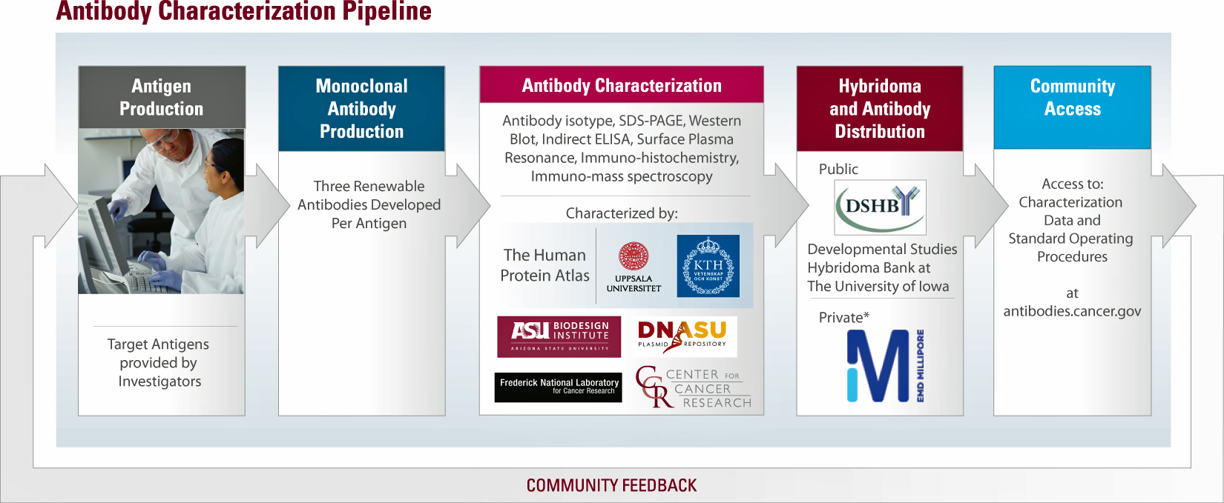
Affinity Reagents as Community Resource
  Current inventory: 331 validated monoclonal antibodies
Notes:
--This final CPTAC-related slide contains a schematic outlining the Antibody Characterization Laboratory (ACL) pipeline. FNLCR is where ACL is located. The ACL coordinates all of the activities in the pipeline in cooperation with the CPTAC office. Target proteins or peptides are received from the scientific community, vetted by an Antibody Scientific Committee and, if approved, up to 3 monoclonal antibodies are generated. These antibodies are characterized using a variety of techniques and then distributed through the Developmental Studies Hybridoma Bank at the University of Iowa and commercial vendors.

Slide 15
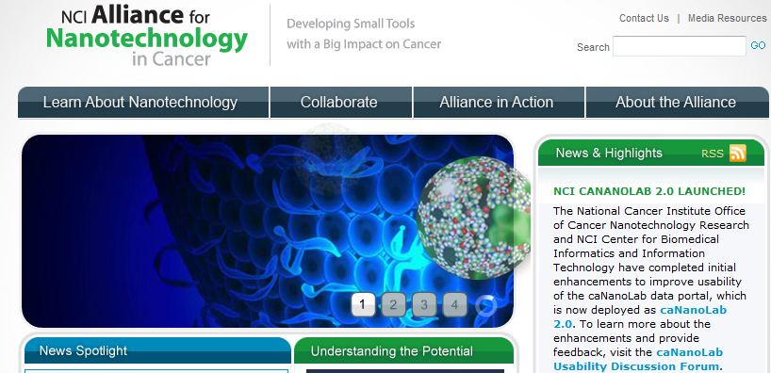
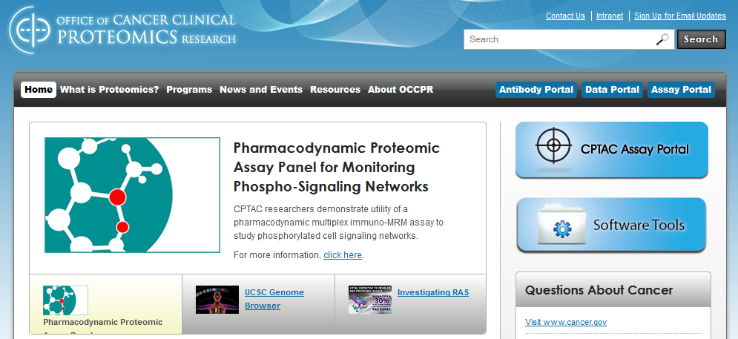
cssi.cancer.gov
nano.cancer.gov
proteomics.cancer.gov
Notes:
--In summary, I’ve touched on activities within the nanotechnology and proteomics offices and provided an overview of the center. I’ve added the websites for more information. We will also have printed materials on the offices and programs, including information on the FNLCR-related activities, available at the CSSI table. Thank you.

