Slide 1
NIAID ACTIVITIES THROUGH THE FNLCR
Date October 1, 2015
Presenter Ms. Laura McNay, Deputy Director for Operations and Management
Ms. Julia Metcalf, Clinical Research Scientist
Presenter’s Organization: Division of Clinical Research
Notes:
For a more accessible version of this file or to request additional information about the images contained in this PowerPoint presentation, please contact: the FNCLR Acquisition Team @ FNLCR_ACQ@mail.nih.gov.

Slide 2
Overview of the Presentation
NIAID Mission
NIAID Budget
NIAID Utilization of the FFRDC Contract
NIAID Clinical Program
Ebola Research Response
NIAID Laboratories

Slide 3
NIAID Mission
NIAID conducts and supports basic and applied research to better understand, treat, and ultimately prevent infectious, immunologic, and allergic diseases. For more than 60 years, NIAID research has led to new therapies, vaccines, diagnostic tests, and other technologies that have improved the health of millions of people in the United States and around the world.
Among the 27 Institutes and Centers that comprise the National Institutes of Health, NIAID has a unique mandate, which requires the Institute to respond to emerging public health threats. Toward this end, NIAID manages a complex and diverse research portfolio that aims to do the following:
Expand the breadth and depth of knowledge in all areas of infectious, immunologic, and allergic diseases
Develop flexible domestic and international research capacities to respond appropriately to emerging and re-emerging disease threats at home and abroad
NIAID advances the understanding, diagnosis, and treatment of many of the world’s most intractable and widespread diseases. Key research areas include newly emerging and re-emerging infectious diseases such as tuberculosis, Ebola, influenza, HIV/AIDS, biodefense, and immune-mediated diseases including asthma and allergy.

Slide 4
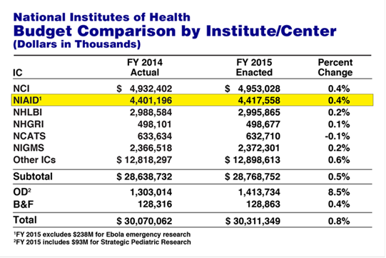
NIAID Budget
In fiscal year 2014, the NIAID budget was $4.4 billion. The Institute dedicated these funds to support scientific opportunities that align with its mission and address domestic and global health problems and diseases.

Slide 5
NIAID Utilization of the FFRDC Contract
NIAID utilizes this FFRDC in the following general areas:
Clinical Research Support
Support a complex international and domestic clinical research portfolio with activities including but not limited to:
Regulatory and monitoring
Project management
Strategic and operational planning
Logistics
Laboratory Support
Support the NIAID intramural clinical protocols from sample processing to assaying to data transfer plus overseeing a huge specimen repository
NIAID has been a recipient of these services for more than 30 years

Slide 6
NIAID Utilization of the FFRDC Contract
NIAID Divisions Utilizing the FFRDC (please see hand outs for listing):
Division of AIDS
China Tuberculosis Clinical Trials Network
Division of Clinical Research (majority of the NIAID to NCI budget)
10 major activity areas
43 sub activity areas
Division of Intramural Research
Labs
9 clinical studies in Africa, Uganda, Mali, and the US
Vaccine Research Center
Mali studies
Chikungunya vaccine trial

Slide 7
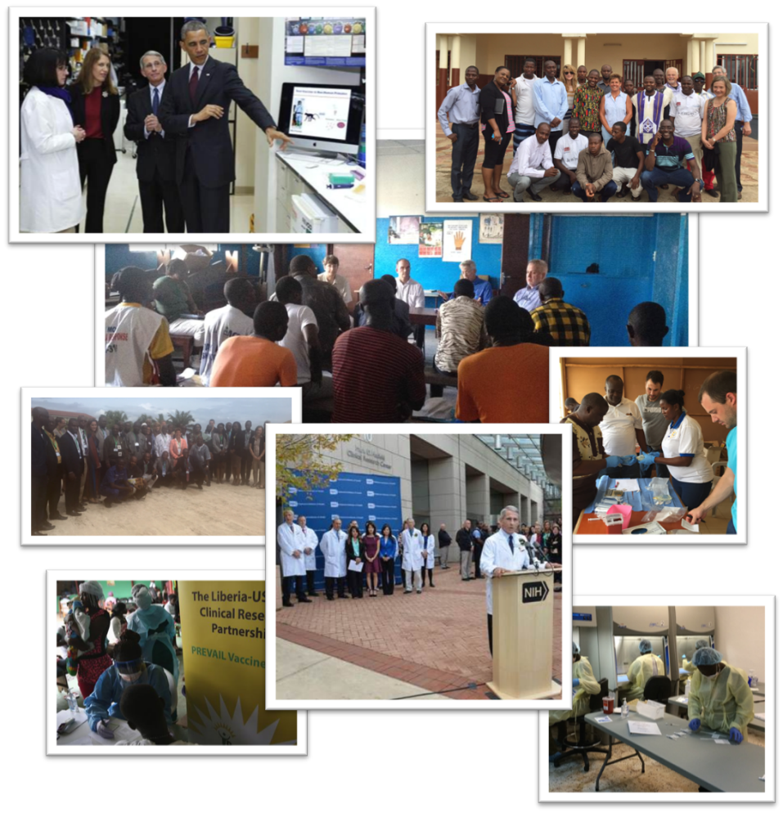
NIAID Ebola Clinical Research Response
The majority of activity for the NIAID DCR Ebola research response is supported through the current contract

Slide 8
NIAID Ebola Research Portfolio
Prevail I- Ebola Vaccine Study
Phase II/III randomized, double-blind, placebo-controlled study of the chimpanzee adenovirus 3 (ChAd3-EBO Z) -based vaccine and the Vesicular Stomatitis virus (VSVΔG-ZEBOV)
Liberia
Prevail II- Ebola Treatment Study
Randomized safety and efficacy study of therapeutics in the treatment of Ebola treatment of patients with known Ebola infection
US, Liberia, Sierra Leone, Guinea
Prevail III- Ebola Survivor Study
Ebola natural history study to characterize the clinical sequelae seen in Ebola virus disease patients and to assess whether survivors of EVD can transmit infection to household and sexual contacts.
Liberia

Slide 9
NIAID Ebola Research Accomplishments to Date
Enrollment of 1,500 participants in Prevail I
6 month follow up visits are ongoing
98% follow-up visit rate
Enrollment of 65 participants in Prevail II
Enrollment of over 600 participants in Prevail III
Completion and ongoing renovations at Liberian sites to include Redemption Hospital, Rennie Hospital, JFK Memorial Medical Center, Liberian Institute for Biomedical Research and the DuPort Road Clinic
Initiation of renovations to build laboratory and clinical research capacity in Guinea
Participation as a partner in the Liberian-led, West African Clinical Research Consortium to include Liberia, Sierra Leone, Guinea, Ivory Coast and Mali
Initiation of plans to help support a specimen repository

Slide 10
Laboratory Support
The Laboratory portion of the contract that supports the NIAID mission is an integrated program that does the following but not limited to:
strategizes with NIAID intramural clinical investigators about assays/methods, sample types and numbers
does data analysis and Bioinformatics
turns around clinical data within 24 hours of receipt
transfers data to CRIMSON (NIAID Clinical database)
develops new assays
oversees a repository of over 2 million biospecimen samples such as plasma, serum, PBML, nasopharyngeal, plasma units
has CLIA certification renewed every two years
laboratory facilities consist of BL2 and also 3 BL2* laboratories which are containment labs with antechambers but are not BL3 laboratories
besides support of intramural clinical labs there are basic research laboratories

Slide 11
Laboratory Support (cont.)
Type of assays or functions that are performed but not limited to:
Flow cytometry, both routine HIV and research
CBC
Oxidative metabolism of neutrophils
ELISA/MESO
Proliferation
Genomics, both HIV and DNA
Influenza Hemagglutination Inhibition Assay
EBV cell lines
Storage of plasma, serum, CSF, PBMC, nasopharyngeal, biopsies
Luciferase Immunoprecipitation Systems Assay - LIPS
Cell sorting by FACS and/or magnetic beads
Illumina sequencing

Slide 12
Laboratory Support (cont.)
NIAID Contractor Laboratory | FFRDC Laboratory
Laboratory of Immunoregulations | AIDS Monitoring Laboratory
 | Laboratory of Molecular Cell Biology
 | Virus Isolation & Serology Laboratory
 | Laboratory of Molecular Retrovirology
 | Laboratory of Human Retrovirology
 | Laboratory of Immunopathogenesis and Bioinformatics
Laboratory of Host Defenses | Neutrophil Monitoring Laboratory
Laboratory of Clinical Infectious Disease
Laboratory of Allergic Diseases | Immunological Monitoring Laboratory
Laboratory of Clinical Infectious Disease
Laboratory of Immunology
Laboratory of Host Defenses
NIAID Intramural Laboratory | FFRDC Laboratory
Laboratory of Immunoregulations | Clinical Service Program
Laboratory of Molecular Microbiology
Laboratory of Parasitic Diseases
Integrated Research Facility -AIRS
Notes:
This slide shows the NIAID Laboratories that utilize the FFRDC Contract laboratories. It demonstrates how many different NIAID laboratories rely on the work that is done by the FFRDC .

Slide 13
Laboratory Support (cont.)
The Laboratories, mentioned in the previous slide, receive clinical samples from NIAID intramural protocols that are studying following diseases or therapy but not limited to:
Human Immunodeficiency Virus -HIV
Hepatitis C Virus - HCV
Chronic Granulomatous Disease of Childhood - CGD
Eosinophilia
Season Flu such as H1N1
Autoimmune Lymphoproliferative Syndrome
Vaccine for HIV or Ebola

Slide 14
Laboratory Support (cont.)
NIAID NETWORKS AND INTERNATIONAL PROJECTS
INSIGHT –HIV and Seasonal Flu protocols
Assays real time samples from the trials since NIAID is a clinical site
Assay biomakers on baseline samples for the whole trial such as ESPRIT, SILCAAT
Repository for multiple international/domestic trials such as ESPRIT, SILCAAT, FLU
Assay HAI and PCR for the FLU IVIG trials
NIAID Influenza Research Collaboration – Seasonal FLU protocols
Repository for multiple Flu domestic trials both for test samples and plasma units
Tracking and shipping samples and units across the country
Assay HAI and PCR for these FLU trials
Ebola
Sent laboratory staff to set up the lab to Liberia
Advised on laboratory equipment for tests specified in the protocols
Assisting in interviewing and training of personnel going to Liberia
Assisting in establishing a specimen repository

