Slide 1
Office of Space and Facility Management
Presented By: Frank ‘Chris’ Bell and Sam Denny
Notes:
For a more accessible version of this file or to request additional information about the images contained in this PowerPoint presentation, please contact: the FNCLR Acquisition Team @ FNLCR_ACQ@mail.nih.gov.

Slide 2
Overview of FFRDC Facilities, Maintenance and Engineering (FME)
Notes:
*****PLACE SPEAKER NOTES HERE: NCI Frederick FME Program Manager – Frank ‘Chris’ Bell

Slide 3
Facilities, Maintenance and Engineering
Mission Support
FME acquires, manages and maintains quality facilities and capabilities
FME supports the Scientific mission through their work across the facility lifecycle
Notes:
The Goals and Objectives for the Facility Maintenance & Engineering group is to provide effective and efficient service, that significantly reduces costs, and provides NCI Frederick the best facility services.

Slide 4
Facilities, Maintenance and Engineering
FME - Functional areas
Operations and maintenance requests
Preventative maintenance activities
Safety Work Orders – Environment Health Safety (EHS)
Emergency Facility Response
Planning, Programming, Design, Infrastructure and Refurbishment, Commissioning, Activation - Support and Execution
Space Management
Janitorial Services
Notes:
Facilities Management – The primary Functional areas are (1) Operations and maintenance requests (2) preventative maintenance activities; (3) Safety Work Orders – EHS; (4) Emergency Facility Response; (5) Planning, Programming, Design, Infrastructure and Refurbishment, Commissioning, Activation - Support and Execution (otherwise known as planned work); (6) Space Management; (7) Janitorial Services. These programs cover government and contractor employees at the Government-owned NCI at Frederick facilities and the FNLCR leased facilities in Frederick County.

Slide 5
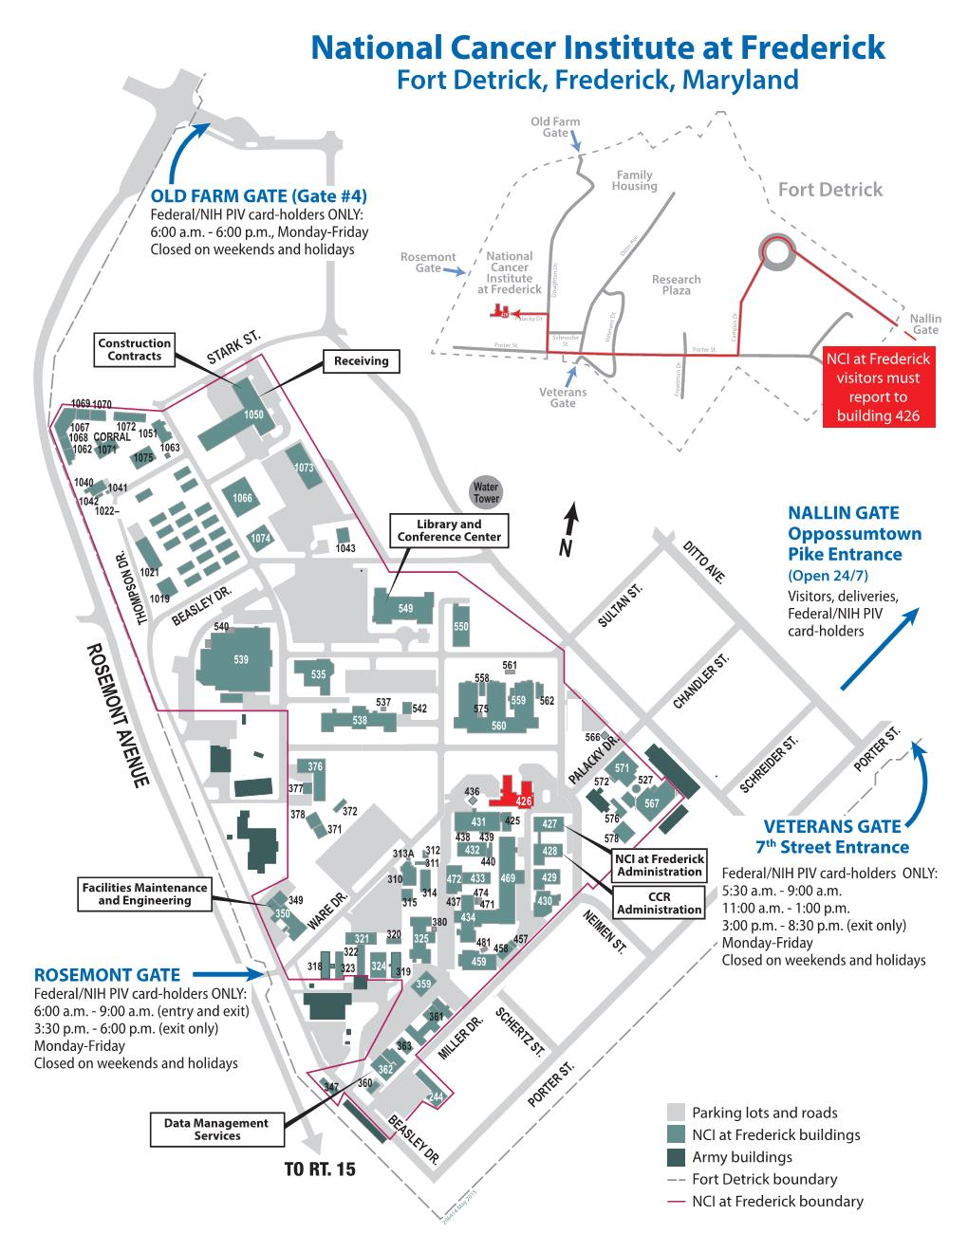
Facilities, Maintenance and Engineering
NCI at Frederick
Approximately
70 Acres
1.3 million GSF
Notes:
NCI Frederick and Fort Detrick Campus Maps. FME provides comprehensive FME service

Slide 6
Facilities, Maintenance and Engineering
Notes:
Percentage of spaces calculated from total GSF.

Slide 7
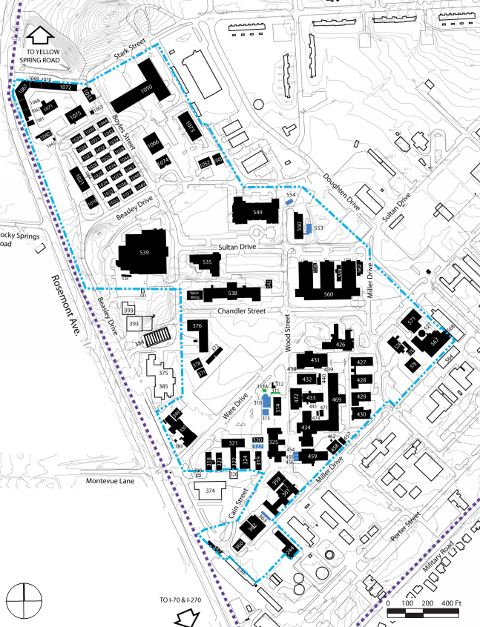
Facilities, Maintenance and Engineering
NCI at Frederick
Government Owned Buildings
Leased Buildings ‘Modular’
Government owned Buildings ‘Modular’
Notes:
Government owned vs Leased

Slide 8
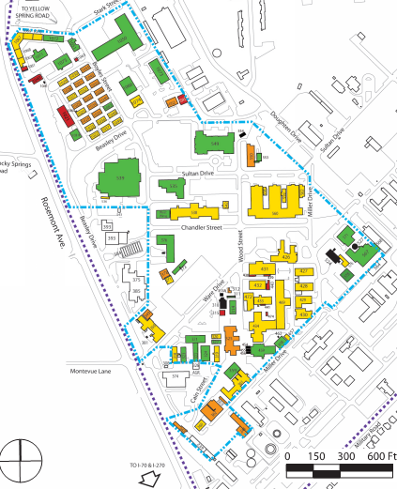
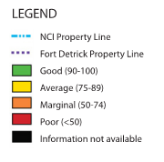
Facilities, Maintenance and Engineering
NCI at Frederick - Existing building Requirement Index (RI) 77.1 avg
Notes:
HHS uses Condition Index (CI) and Requirements Index (RI) as metrics to assess the physical condition of its facilities. These indexes are indicators of the physical condition of facilities at the time a visual condition assessment is performed. In addition to the metric, the visual condition assessment process, which gathers information necessary to calculate CI and RI, yields information about specific defects needed for planning and executing specific capital repair projects. When building conditions are surveyed, the identified deficiencies are classified according to priority.

Slide 9
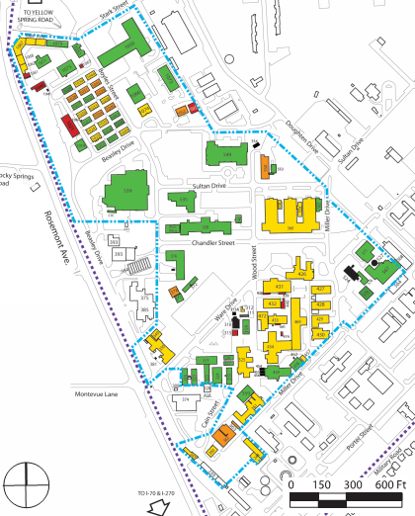
Facilities, Maintenance and Engineering
NCI at Frederick - Existing building Condition Index (CI) 81.5 avg
Notes:
HHS uses Condition Index (CI) and Requirements Index (RI) as metrics to assess the physical condition of its facilities. These indexes are indicators of the physical condition of facilities at the time a visual condition assessment is performed. In addition to the metric, the visual condition assessment process, which gathers information necessary to calculate CI and RI, yields information about specific defects needed for planning and executing specific capital repair projects. When building conditions are surveyed, the identified deficiencies are classified according to priority.

Slide 10
Facilities, Maintenance and Engineering
Primary Work Order Metrics FY13/FY14/F15
CY (Totals) | 2013 | 2014 | 2015 (Thru 9/20/15)
Operations & Maintenance Requests | 49% | 43% | 47%
Preventative Maintenance (PMs) | 45% | 53% | 48%
Safety Item - EHS | 6% | 4% | 5%

Slide 11
Facilities, Maintenance and Engineering
USAG Owned/Operated Utilities – (provided by US Army Garrison Command – IMCOM)
Electric infrastructure
Domestic Water infrastructure
Sewer infrastructure
NCI Owned Utilities (FME operates/manages all components)
Steam Generation & Infrastructure
Natural Gas infrastructure
Facility Back-up Generators & fuel
Notes:
NCI OSFM & the FNLCR coordinates with USAG – IMCOM.

Slide 12
Facilities, Maintenance and Engineering
USAG Public Works Operated Services – (Provided by US Army Garrison Command – IMCOM)
Security - Fort Detrick Military Police (NIH Police augments USAG MPs within NCI Campus)
Road snow plowing & removal
General Landscape & Grounds keeping (Leased Facility requirements vary)
NCI - FME Operated Services
General site maintenance including Pest Control
Snow plowing & removal on sidewalks
Notes:
NCI OSFM & the FNLCR coordinates with USAG – IMCOM.

Slide 13
Facilities, Maintenance and Engineering
Operational Requirements
HHS - NIH - NCI
Design Requirements Manual (DRM) - Design requirements and guidance manual for biomedical research laboratory and animal research facilities.
Facility Project Approval Agreement / CRIB
Biosafety in Microbiological and Biomedical Laboratories (BMBL)
Office of Space & Facilities Management (OSFM)
US Army Interagency Agreement

Slide 14
Overview of FFRDC Environment, Health and Safety (EHS)
Notes:
*****PLACE SPEAKER NOTES HERE:

Slide 15
Environment, Health and Safety
Current Activities
Protection Services
Occupational Health Programs
Environmental Protection Programs
Safety Programs
EHS Workload – Typical Daily Activities
Notes:
Mission – To provide comprehensive environment, health and safety programs and services to the NCI at Frederick staff and facilities.
These programs cover government and contractor employees at Government-owned and leased facilities.
The contractor is responsible for establishing and maintaining effective management systems to identify deficiencies and ensure that corrective actions are implemented in a timely manner.
Elements of the program may include, but are not limited to (i) accident reports and trend analysis; (ii) emergency management and preparedness;
(iii) OSHA compliant exposure monitoring and control; (iv) an Institutional Animal Care and Use Committee liaison; (v) an inspection program for facilities; (vi) a respiratory protection and air quality evaluation program;
(vii) A risk assessment program for industrial, chemical and biological hazards; (viii) monitoring of Select Agents; (ix) a biological control program and a radiation safety program with the site-specific
Radioactive material use licenses; (x) an OSHA training program; (xi) a program to facilitate AAALAC accreditation; (xii) a program to Perform Environmental Services; (xiii) and to provide institutional biosafety and biosafety officers.
The functional areas of this program are: Site Protection Services, Occupational Health Services, Environmental Protection Programs and Safety Programs.

Slide 16
Protection Services
Access Control for Managed Buildings
Key Issuance
Electronic Access Control System
Monitoring of Scientific Alarm Systems
Communication of Emergency Information
Shuttle Services
Daily Between NCI at Frederick and Bethesda Campus
Daily Between NCI at Frederick and ATRF
Notes:
Protection Services are provided on a 24/7 basis and include:
Access control for FNLCR buildings – this includes the issuance of keys as well as the management of the electronic access control system
Scientific alarms systems are monitored for abnormal status – approximately 1,000 alarm points.
Communication of emergency information is provided for events such as power outages and inclement weather
Shuttle services are provided from the FNLCR to:
NIH Bethesda Campus daily
ATRF daily
It should be noted that Fort Detrick provides the perimeter security for the site
Law enforcement activities for the Government-owned buildings is provided by the NIH Police

Slide 17
Occupational Health Programs
Occupational Health Clinic
Wellness Programs
Research Donor Programs
Health Surveillance Programs
Training
Notes:
The focus of the Occupational Health Service is to protect, maintain and promote the health of all employees
These services are available to both government and contractor staff
The primary function of the OHS is the operation of the Occupational Health Clinic
This unit provides assessment, stabilization and investigation of workplace injuries and illnesses.
The clinic provides physical examinations for pre employment and for employees returning to work following injuries and illnesses
The clinic also provides immunizations and vaccinations, including immunizations in advance of international travel
The Wellness Programs provided by the OHS include general wellness exams, smoking cessation and the Employee Assistance Program
The Research Donor Program serves as central repository for whole blood samples collected from healthy volunteers for use by FNLCR and Governmnet investigators
Health Surveillance programs are provided for employees regarding occupational exposures to various hazards
These surveillance programs include Bloodborne Pathogens, Asbestos, Hearing Conservation, Respiratory Protection, Lasers, Radiation and Animal Allergies
Finally, OHS provides health related training to staff, including First Aid and CPR/AED.

Slide 18
Environmental Protection Services
Environmental Compliance
State Regulatory Agencies
NEPA
Waste Management
Chemical Waste
Radioactive Waste
Bio-Hazardous Waste
Recycling
Notes:
The focus of environmental protection services includes environmental compliance and waste management
This includes compliance with State of Maryland regulations pertaining to discharges to air and water
and compliance with the National Environmental Protection Act (NEPA)
Waste management services include the pickup and disposal of hazardous waste (both chemical and radioactive waste).
Non hazardous waste is collected and disposed of by the FME housekeeping staff.
The waste management service also includes the recycling program
This is a single stream recycling for paper, plastics, metal and cardboard

Slide 19
Safety Programs
Industrial Hygiene
Bio-Safety
Industrial Safety
Life Safety
Radiation Safety
Notes:
The safety programs include Industrial Hygiene, Bio-Safety, Industrial Safety, Life Safety, and Radiation Safety.
The Industrial Hygiene program aims to minimize workplace risks due to exposure to chemicals or other physical hazards.
The Bio-Safety Program controls biological hazards within laboratories and the risks of exposures to researchers. This program also facilitates the Institutional Bio-Safety committee.
The Industrial Safety Program minimizes industrial risks to employees through engineering controls, administrative procedures (such as a Confined Space Entry and Lockout Tag out Programs) and by requiring the use of personal protective equipment.
The Life Safety Program ensures that building construction and fire protection features are in place to protect lives, property and mission essential research from the risks of fire.
The Radiation Safety Program ensures a safe working environment for persons working with radioactive materials or radiation-producing machines. This program also manages all site-specific
Radioactive material use licenses.

Slide 20
EHS Workload – Typical Daily Activities
Daily Activities
Protection Activities (28%)
Inspections (30%)
Safety Activities (32%)
OHS Patient Activities (10%)
Notes:
Based on annual workload data the average of daily activities performed by EHS Programs is as follows.
Protection activities represents 28% of the total
Inspection activities, represent 30%
Safety activities, represent 32%
OHS Patient Activities represent 10%

