Slide 1
RAS Initiative at the Federally Funded Research and Development Center at Frederick
Presented By: Sara S. Hook
Notes:
For a more accessible version of this file or to request additional information about the images contained in this PowerPoint presentation, please contact: the FNCLR Acquisition Team @ FNLCR_ACQ@mail.nih.gov.

Slide 2
Overview of Mission and Purpose
Notes:
*****PLACE SPEAKER NOTES HERE:

Slide 3
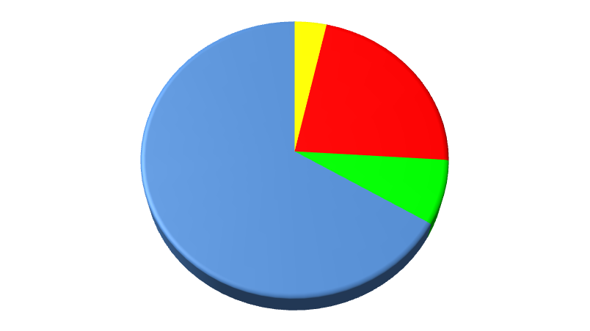
Overview of Mission and Purpose
In 2011, NCI Director Harold Varmus established the Frederick National Laboratory Advisory Committee (FNLAC). The FNLAC recommended that the FNLCR undertake important and ambitious projects in cancer research that would be difficult to pursue without an orchestrated effort.
After consultation with the extramural community, RAS was chosen as the first initiative, commenced in Oct. 2013, and is currently the only scientific effort operated out of the Immediate Office of the NCI Director.
RAS genes drive approximately 30% of all tumor types yet there are no direct or indirect RAS inhibitors.
HRAS 3.5%
KRAS 22.4%
NRAS 7.5%
Incidence of RAS mutations in all cancers (cosmic database)
Notes:
Focus on cancer with high mutation rates of KRAS: especially pancreatic, lung, and colorectal cancers

Slide 4
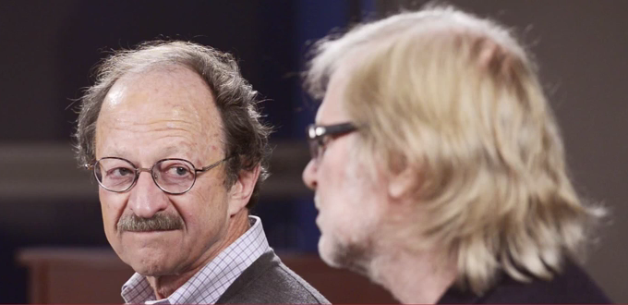
Overview of Mission and Purpose (continued)
The goals of the Initiative are broad:
    better understanding of the role of RAS mutations in cancer in order to solve the challenges of treating RAS-driven cancers; and
    build an open model of collaboration among government, academic, and industry researchers that will re-energize efforts to develop RAS therapeutics
Frank McCormick, renowned RAS researcher, was hired as the scientific advisor
Progress is monitored and evaluated by the ad hoc RAS working group and its parent committee, the FNLAC.

Slide 5
Overview of Scientific Work
Notes:
*****PLACE SPEAKER NOTES HERE:

Slide 6
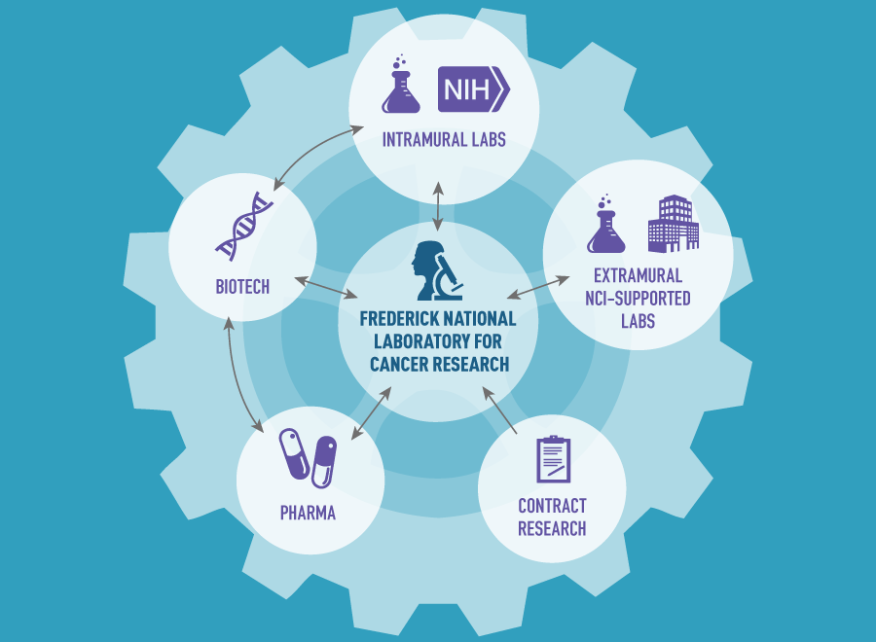
RAS Initiative Hub and Spoke model
The Initiative is a unique model for programs within the national lab. FNLCR staff in consultation with Dr. McCormick drive the research projects with collaborations extending to all sectors of the community.
Core ongoing research projects in the areas of:
--Structural Biology and Biochemistry
--RAS Assays (in vitro, cell based)
--Biology of Mutant KRAS Cell Lines
--Pathway Analysis
--Cell Surface Analysis
--RAS Reference Reagents

Slide 7
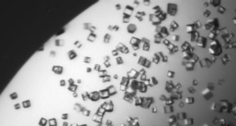
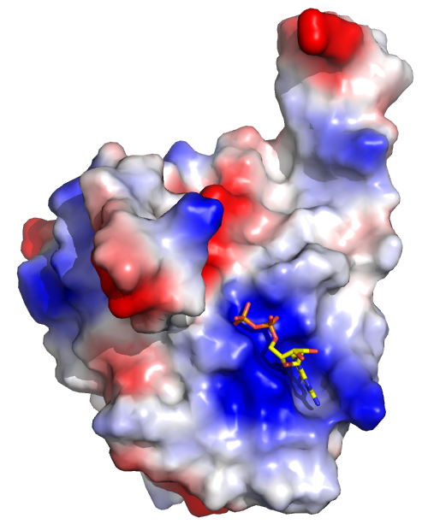
Structural Biology and Biochemistry
Objective of the group: using structural and biophysical approaches to determine how common oncogenic alleles of KRAS can be inhibited
    In vitro assays (FNLCR, collaborations with academia and NIST)
        Highlight: generating pure fully processed KRAS protein
    Crystal structures of mutant KRAS with/without binding partners, in
      silico screens (FNLCR, collaborations with academia, a CRO)
        Highlight: Solved a unique KRAS structure with a potential
        new “druggable” pocket.
    Solution structures with FNLCR generated proteins
    (with academia)
    Cryo-EM efforts with another program at FNLCR

Slide 8
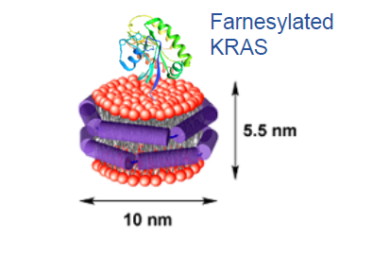
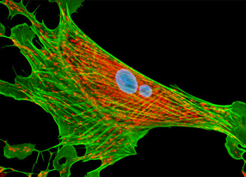
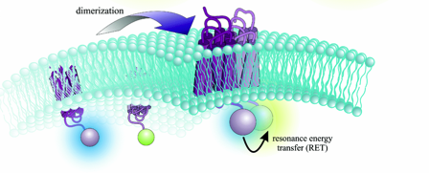
RAS Assays
In vitro assays to inhibit RAS function, interaction with binding proteins, interaction with the membrane [FNLCR efforts, collaboration with academic labs, pharmaceutical companies through a contractor CRADA (cCRADA)]
Cell based assays for drug screens:
    proliferation assays [low-medium throughput at FNLCR, high throughput National Center for Advancing Translational Science at NIH, pharmaceutical companies (cCRADA)]
    localization assays for RAS, multimers, and RAS interaction with binding partners [FNLCR, pharmaceutical companies (cCRADA)]
Notes:
Some of the assays are being run at FNLCR whereas others are being conducted in collaboration with partners as indicated in brackets.

Slide 9
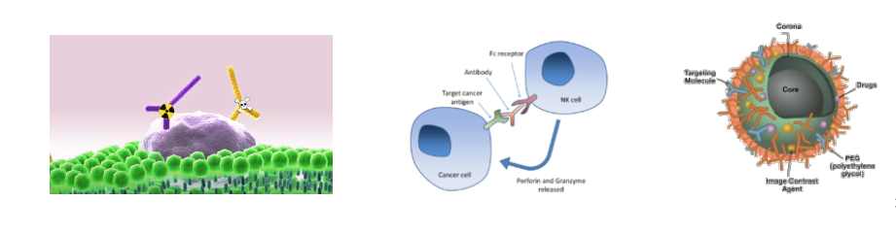
Cell Surface Analysis
The goal is to identify epitopes that might be used for antibody attack, immune-based therapies, or nanoparticle mediated drug delivery for mutant RAS cancers (FNLCR efforts and collaborations with academia, the biotechnology sector, another FNLCR program - the Nanotechnology Characterization Laboratory).

Slide 10
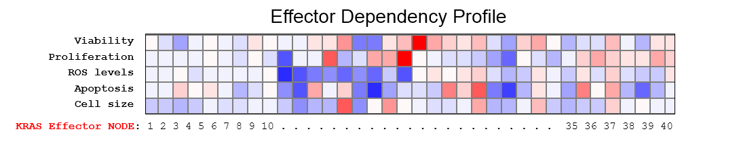
RAS Pathway Analysis
Signaling node analysis determines which “hallmarks of cancer" are affected when mutant KRAS or its effectors are ablated in lung, pancreatic, and colorectal cancer.
Bioinformatics efforts utilize FNLCR data and publically available data such as that from The Cancer Genome Atlas to identify trends and vulnerabilities of mutant RAS cancers.
Involves FNLCR efforts with academic collaborators.
1
Cellular response
0
0%
Node knockdown
100%

Slide 11
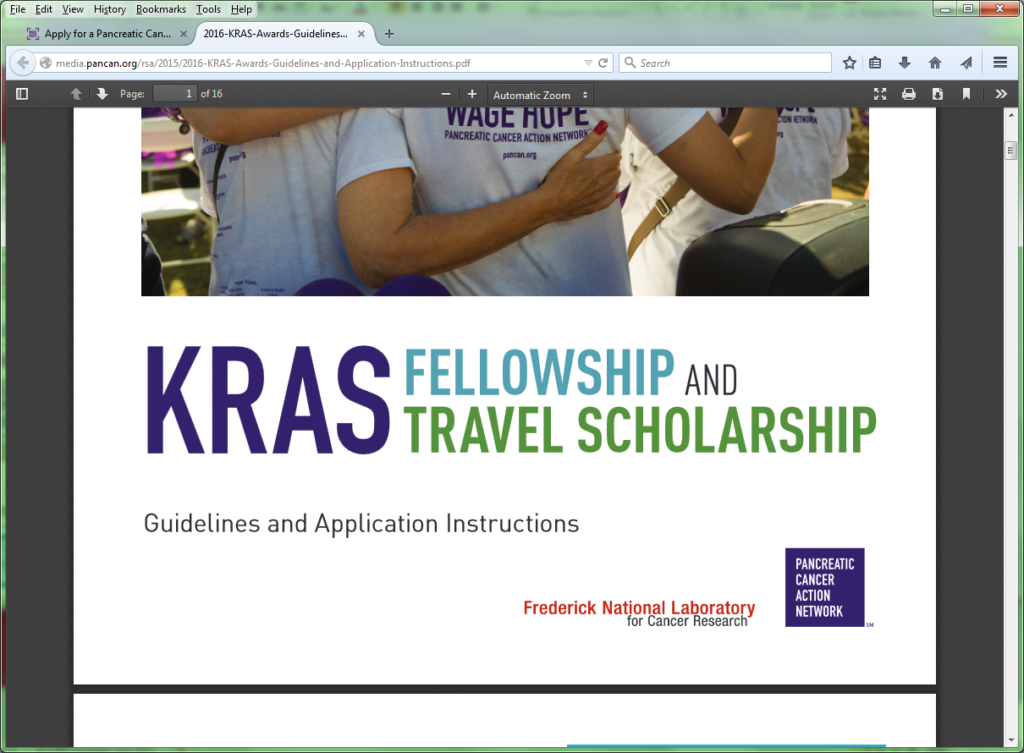
Other Spokes
RAS Synthetic Lethal Network: NCI awarded a cohort of grants to conduct next-generation screens to identify and validate target that are synthetic lethal with mutant KRAS.
FFRDC support to the NCI’s Clinical Proteomics Tumor Analysis Consortium to develop quantitative assays for proteins and phosphopeptides involved in RAS signaling.
NCI-supported post-doctoral fellows conducting RAS-related research.

Slide 12
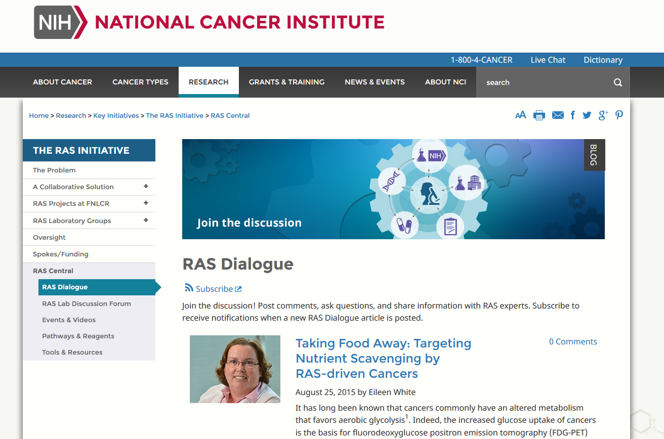
RAS Outreach – Cancer.gov/RAS
The RAS Initiative sends email updates to 4200 international researchers conducting RAS-related studies.
The Initiative has held workshops of topical interest to gain input from extramural experts. In December the FNLCR is hosting the first community-wide RAS Initiative Symposium.
Notes:
To find out more about the RAS Initiative please see our website. Additional details on the scientific progress of the Initiative can be found in the FNLAC presentations on the NCI website. http://deainfo.nci.nih.gov/advisory/fac/facmeetings.htm

Slide 13
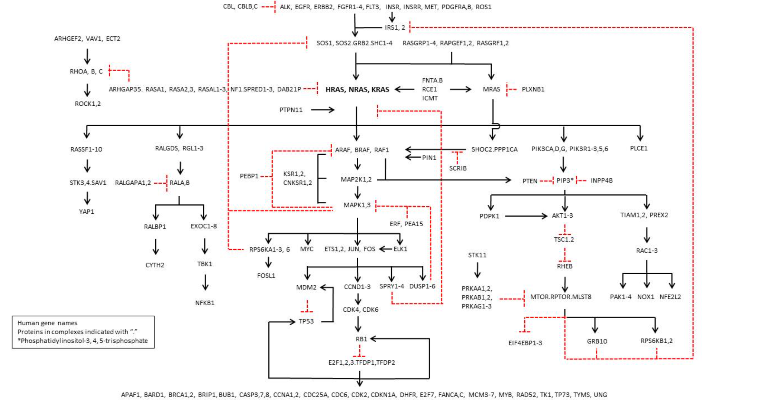
RAS pathway 2.0
RAS pathway clone collection with 180 total genes, 360 total constructs
Notes:
The RAS pathway has been redefined with input from the research community. A collection of cDNA clones have been made at the FNLCR for the community.

Slide 14
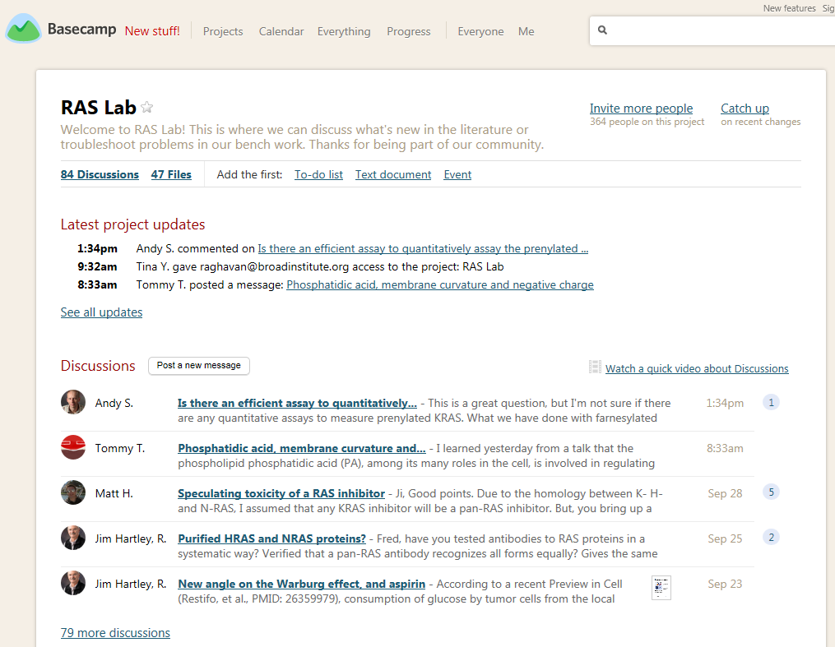
RAS Outreach
RAS Lab - an invitation only discussion forum to promote technical scientific exchange among RAS researchers. RAS Lab allows members to post and respond to messages, upload data, and contact one another for collaborations. Currently, more than 350 members are involved in the discussion.
Notes:
Invitations to join RAS Lab were sent to researchers on our email list serv. A link to RAS Lab can be found on cancer.gov/RAS

