Slide 1
Welcome to the NCI FFRDC Pre-Proposal Conference
Ms. Kristen A. Mistichelli, MPA Director, Office of Acquisitions National Cancer Institute
Notes:
For a more accessible version of this file or to request additional information about the images contained in this PowerPoint presentation, please contact: the FNCLR Acquisition Team @ FNLCR_ACQ@mail.nih.gov.

Slide 2
Introduction
Welcome!
Kristen Mistichelli, NCI Director of Acquisitions
Pre-Proposal Conference for the re-competition of NCI’s FFRDC
Frederick National Lab for Cancer Research (FNLCR)
Federally Funded Research and Development Center (FFRDC)
Both of the above terms will be used interchangeably
If you need assistance today, please locate someone with a RED lanyard.

Slide 3
Format for Today
All presentations will be given in this room. We will have scientific briefings on the work conducted through the FFRDC from 9:00 a.m. until approximately 3:00 p.m.
There will be periodic breaks throughout the day, including a little over an hour for lunch.
During breaks and lunch, please plan to follow up with any questions or comments that you have at the various information tables set up in the conference breakout rooms and in the lobby.
For today’s activities we have coordinated an overview of the research performed through the FNLCR including scientific presentations from a number of NCI Divisions, Offices and Centers and NIAID.
Information tables are also available in the conference rooms across the hall and in the lobby which will be available until 4:30 PM.

Slide 4
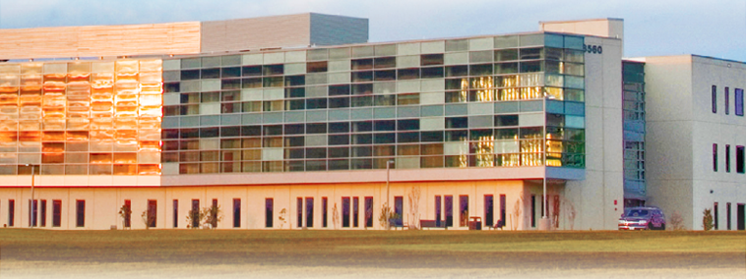
Tomorrow
We hope that you will also join us tomorrow in Frederick for the facility tours of the NCI’s FFRDC.
If you have not signed up, please see the FFRDC Business Operations Table for assistance.

Slide 5
NCI FNLCR
The Frederick National Laboratory for Cancer Research (FNLCR) is the only Federally Funded Research and Development Center (FFRDC) dedicated to biomedical research.
The FNLCR has been operated under contract since it began in the 1970s, and is currently operated by Leidos Biomedical Research, Inc., (formerly SAIC-Frederick, Inc.) for the National Cancer Institute (NCI), part of the U.S. National Institutes of Health (NIH).
The FNLCR brings public and private partners together to address the most difficult cancer research challenges.

Slide 6
Background
The FNLCR was established as the Frederick Cancer Research and Development Center in the early 1970’s when approximately 70 acres and 68 buildings of the U.S. Army were transferred to the U.S. Department of Health and Human Services (HHS).
In 1975, the FNLCR was designated an FFRDC, a government-owned, contractor-operated facility designed to achieve long-term research and development needs that could not be met as effectively by existing in-house or contractor resources.
The FFRDC provides a rapid response capability by using private sector resources to accomplish tasks that are integral to the mission and operation of NCI, and to keep pace with new discoveries, development opportunities, and health-care priorities.
Our Frederick National Laboratory for Cancer Research has become an internationally recognized center of scientific excellence in cancer and AIDS research and development.

Slide 7
You are invited to participate in our future…
We are here today looking forward, and, in some ways, also looking back. As NCI looks to our future, and the re-competition of this vital national resource, I am reminded of the “Space Race” under the Kennedy era.
Seeing that the United States was behind in the Space Race, John F. Kennedy proposed a plan for space exploration.
In an effort to take greater strides in this race, Kennedy’s ultimately successful plan was to gather academia, industry, and thought leaders from this Nation and asked that they partner to achieve this specific goal.
Great partnerships were formed between these groups, joining academia, industry, and other leaders in achievement.

Slide 8
You are invited to participate in our future…
We ask you today, to consider the same thing. This is our “Kennedy-esque” moment to partner to achieve our specific goals.
We chose to go to the Moon, not because it was easy, but because it was hard.
President Nixon charged us to allocate the same kind of concentrated effort that split the atom and took man to the moon to be turned towards conquering Cancer.
This charge has resulted in a national commitment to achieve this goal, at this time through the future development of the NCI FFRDC.

Slide 9
Following Up After Today
Please submit all questions electronically to the FNLCR Acquisition Team via FNLCR_ACQinfo@mail.nih.gov.
Any answers furnished during the conference are preliminary and are only to be relied upon when issued in writing on the FBO.
For information, including a draft SOW, the current contract for FFRDC support, and other background materials, please visit the FNLCR Acquisition Portal at:
http://ncioa.cancer.gov/oa-internet/fnlcr/index.html#/home
Notes:
At this time staff has been asked to limit discussions to current scientific projects. In order to ensure that each organization receives the same information we ask that questions be submitted electronically to the FNLCR Acquisition Team via FNLCR_ACQinfo@mail.nih.gov.

Slide 10
Next
Dr. James Doroshow
Deputy Director for Translational and Clinical Research
National Cancer Institute
Presents:
Overview of the FFRDC

