Slide 1
Tribute to Research Participants Together, We Will End Cancer As We Know It
Monica M. Bertagnolli, MD, FACS, FASCO
Director, National Cancer Institute
June 3, 2023
American Society of Clinical Oncology
@NCIDirector ​
@TheNCI​
Notes:
Other options:
Together, we can ECAWKI

Slide 3
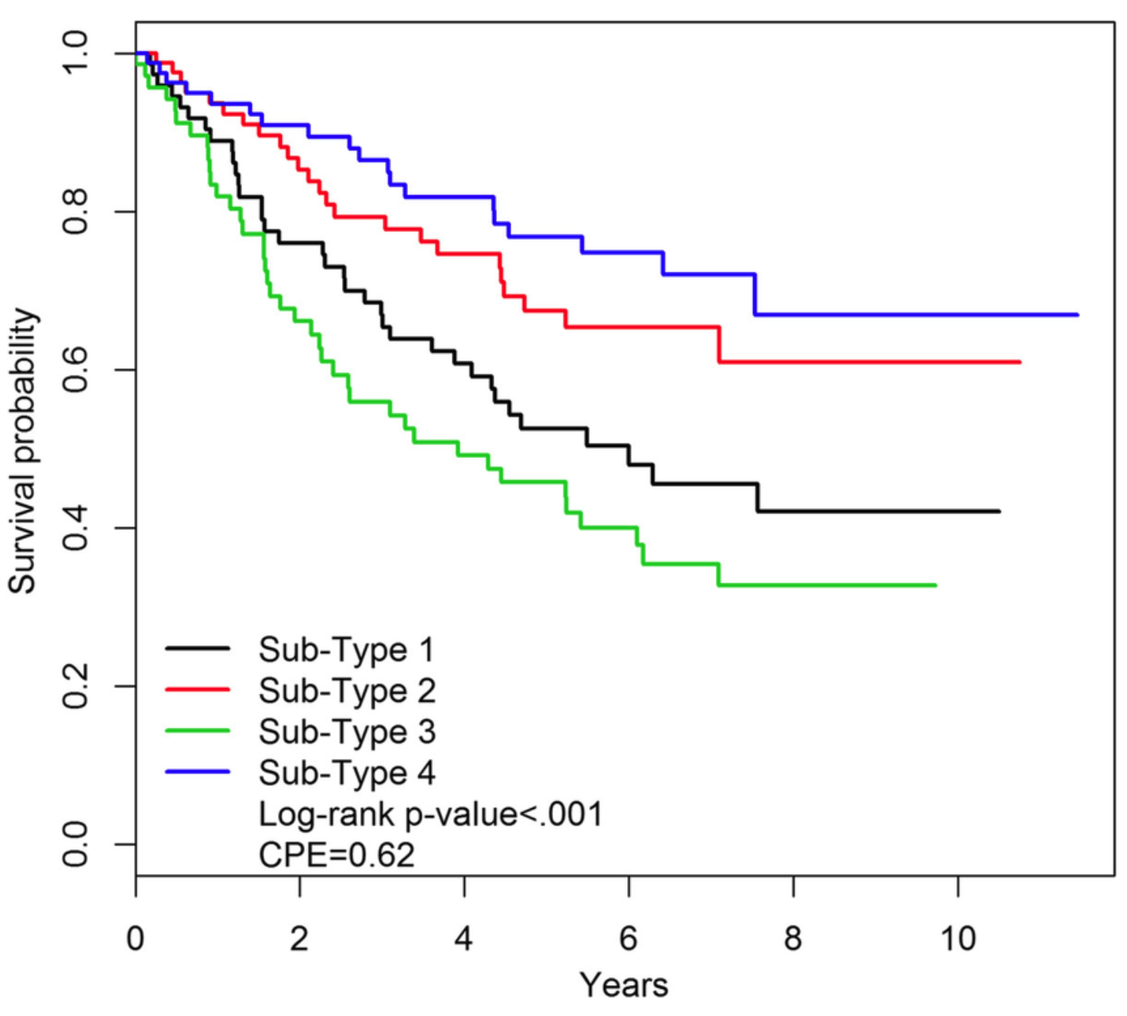
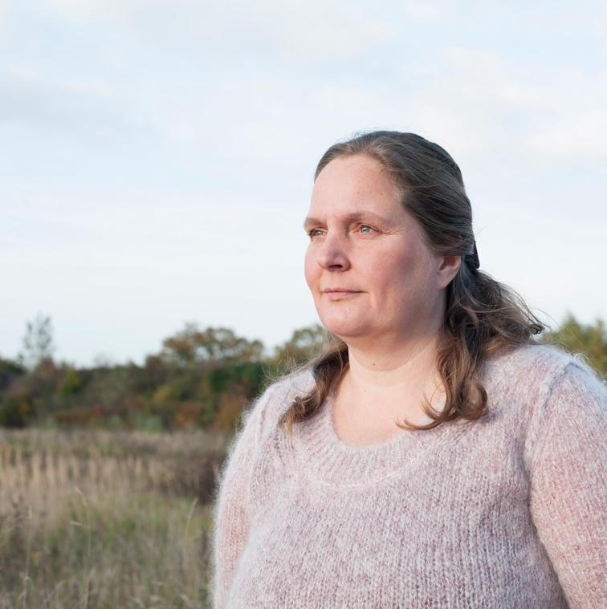

Slide 4
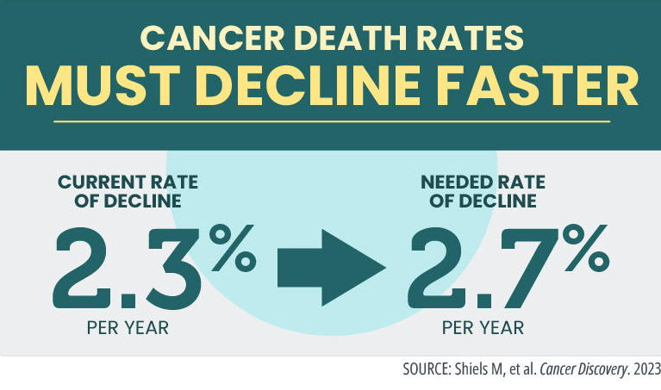
Achieving the Cancer Moonshot Goals
REDUCE CANCER MORTALITY BY AT LEAST
50%
over the next 25 years
and improve the experience of people and their families living with and surviving cancer.

Slide 5
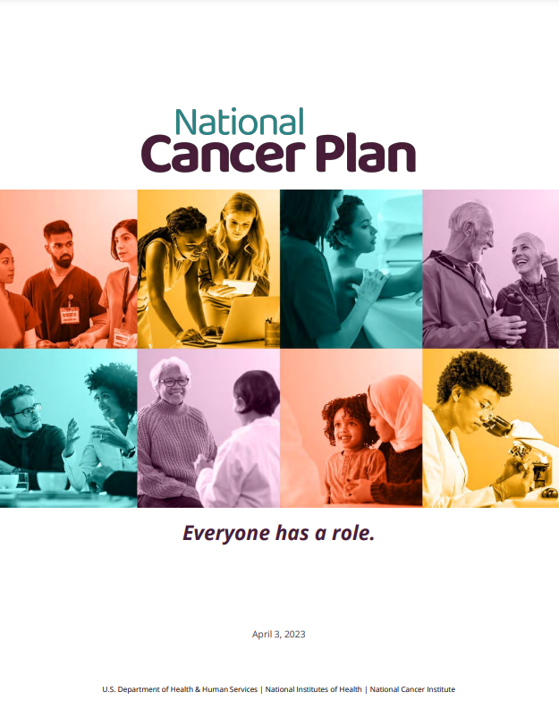
NationalCancerPlan.cancer.gov

Slide 6
All people and society adopt proven strategies that reduce the risk of cancer.

Slide 7
Cancers are detected and treated at early stages, enabling more effective treatment and reducing morbidity and mortality.

Slide 8
Effective treatment, with minimal side effects, is accessible to all people with all cancers, including those with rare cancers, metastatic cancers, and treatment-resistant disease.

Slide 9
Disparities in cancer risk factors, incidence, treatment side effects, and mortality are eliminated through equitable access to prevention, screening, treatment, and survivorship care.

Slide 10
The health care system delivers to all people evidence-based, patient-centered care that prioritizes prevention, reduces cancer morbidity and mortality, and improves the lives of cancer survivors, including people living with cancer.

Slide 11
Secure sharing of privacy-protected health data is standard practice throughout research, and researchers share and use available data to achieve rapid progress against cancer.

Slide 12
The cancer care and research workforce is diverse, reflects the communities served, and meets the needs of all people with cancer and those at risk for cancer, ensuring they live longer and healthier lives.

Slide 13
Every person with cancer or at risk for cancer has an opportunity to participate in research or otherwise contribute to the collective knowledge base, and barriers to their participation are eliminated.

Slide 14
Examples of NCI’s Contributions to Our Shared Goals
Pragmatica-Lung Study (S2302)
Clinical Trials Innovation Unit (CTIU)
Connecting Underrepresented Populations to Clinical Trials (CUSP2CT)
Telehealth Research Centers of Excellence (TRACE)
Childhood Cancer–Data Integration for Research, Education, Care, and Clinical Trials (CC-DIRECT)
NCI Community Oncology Research Program (NCORP)

Slide 15
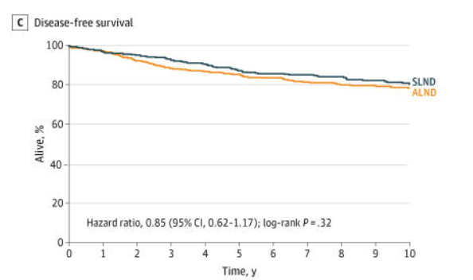
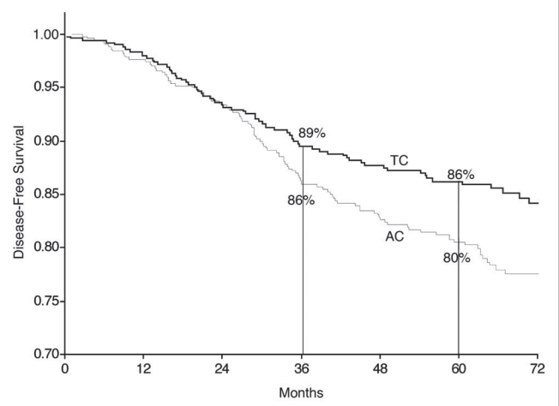
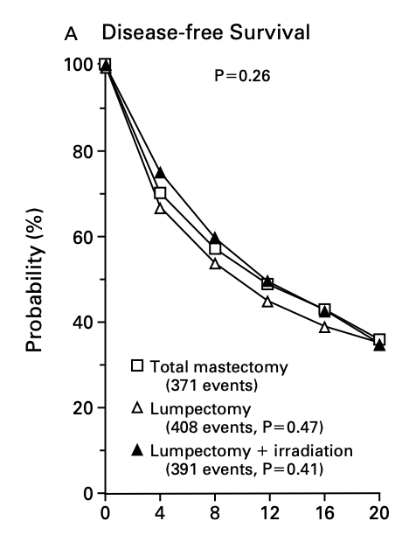
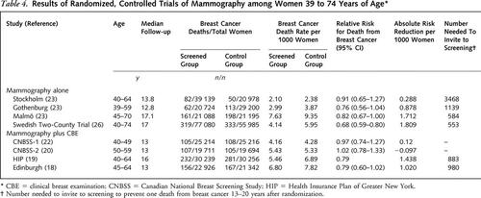
1971–2018
494,018 women

Slide 16
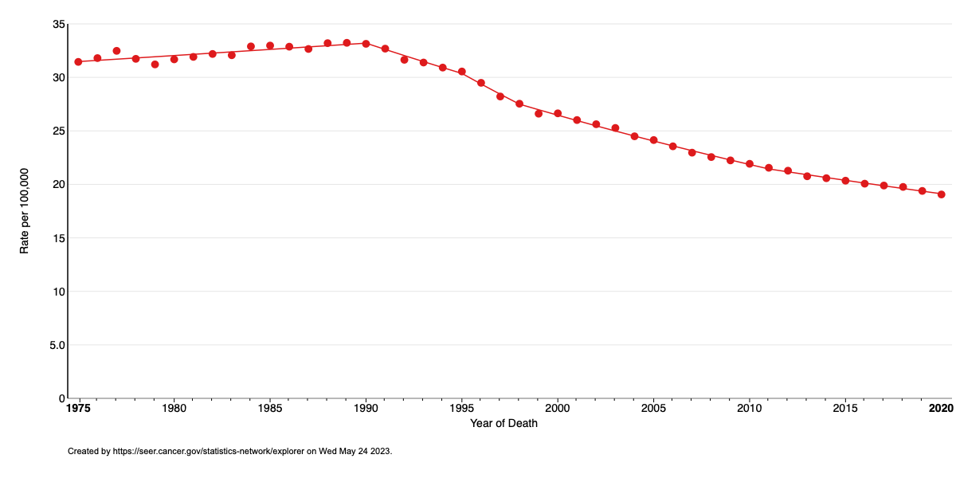
Breast Cancer Mortality (1975 – 2020)
seer.cancer.gov
Notes:
Source: https://www.istockphoto.com/photos/Collage

Slide 17
Notes:
Include everyone here.

Slide 18
www.cancer.gov
www.cancer.gov/espanol
1-800-4-CANCER
NCIinfo@nih.gov
@NCIDirector
@TheNCI
Thank you!

