Slide 1
Funding Opportunities and Research
Resources from the NIH Common Fund
Elizabeth Wilder, Ph.D.
Director
Office of Strategic Coordination
Division of Program Coordination, Planning, and Strategic Initiatives
Office of the NIH Director
http://www.commonfund.nih.gov

Slide 2



























27 NIH Institutes and Centers
National Institute of
Deafness and
Communications Disorders
NIAMS
National Institute of Arthritis and
Musculoskeletal and Skin Diseases
Clinical Center
National Institute of
Biomedical Imaging
and Bioengineering
International Center
National Institute of Diabetes and
Digestive and Kidney Diseases

Slide 3



The Office of the Director (OD)
Notes:
3
The goals of the agency are as follows:
- foster fundamental creative discoveries, innovative research strategies, and their applications as a basis to advance significantly the Nation's capacity to protect and improve health;
- develop, maintain, and renew scientific human and physical resources that will ensure the Nation's capability to prevent disease;
- expand the knowledge base in medical and associated sciences in order to enhance the Nation's economic well-being and ensure a continued high return on the public investment in research; and
- exemplify and promote the highest level of scientific integrity, public accountability, and social responsibility in the conduct of science.
In realizing these goals, the NIH provides leadership and direction to programs designed to improve the health of the Nation by conducting and supporting research:
- in the causes, diagnosis, prevention, and cure of human diseases;
- in the processes of human growth and development;
- in the biological effects of environmental contaminants;
- in the understanding of mental, addictive and physical disorders; and
- in directing programs for the collection, dissemination, and exchange of information in medicine and health, including the development and support of medical libraries and the training of medical librarians and other health information specialists.

Slide 4
Current Common Fund Programs (FY16)
Data/Tools/Methods
New Paradigms
Undiagnosed
Diseases
Program
Extracellular RNA
Communication
Stimulating Peripheral
Activity to Relieve
Conditions (SPARC)
Illuminating the
Druggable Genome
Big Data to
Knowledge
(BD2K)
Regulatory
Science
NIH
Center for
Regenerative
Medicine
Health
Economics
Enhancing the Diversity
of the NIH-Funded
Workforce
Strengthening
the
Biomedical Research
Workforce
Glycoscience
Single
Cell
Analysis
Protein
Capture
Gulf Oil Spill
Long Term
Follow Up
Human
Microbiome
Knockout
Mouse
Phenotyping
HCS Research
Collaboratory
High-Risk
Research
Common Fund
Science of
Behavior
Change
Global
Health
Pioneer Awards
New Innovator Awards
Transformative Research Awards
Early Independence Awards
Library of
Integrated Network-
Based Cellular
Signatures
(LINCS)
Genotype-
Tissue
Expression
4D Nucleome
Mechanisms of
Physical
Activity
Metabolomics
Epigenomics
Transformative Workforce Support
New Types of Clinical Partnerships
http://commonfund.nih.gov/
Notes:
CF programs can be clustered loosely into 4 categories, based on what they deliver to the community (with multiple programs relevant to multiple categories):
Transformational paradigms
Transformative research tools and methods
Transformative clinical research partnerships
Innovative ways to support investigators

Slide 5
CF Programs Build “Foundations” to Catalyze Research
■ New Approaches to Foster Innovation and Invigorate the Research Workforce
■ High-Risk High-Reward (Pioneer, New Innovator, Transformative Research, Early Independence Awards)
■ Broadening Experiences in Scientific Training (BEST) Awards (New in FY13)
■ Enhancing Diversity in the NIH-funded Workforce (New in FY13)
■ New Tools, Infrastructure, and Data to Support or Establish New Fields of Study
■ Metabolomics
■ Libraries of Integrated Network-based Cellular Signatures (LINCS)
■ Knock-Out Mouse Phenotyping Project (KOMP2)
■ Protein Capture Reagents
■ New Technologies and Approaches to Overcome Barriers to Progress in a Field
■ Single Cell Analysis
■ PROMIS: Patient Report Outcomes Management System
■ Glycoscience

Slide 6
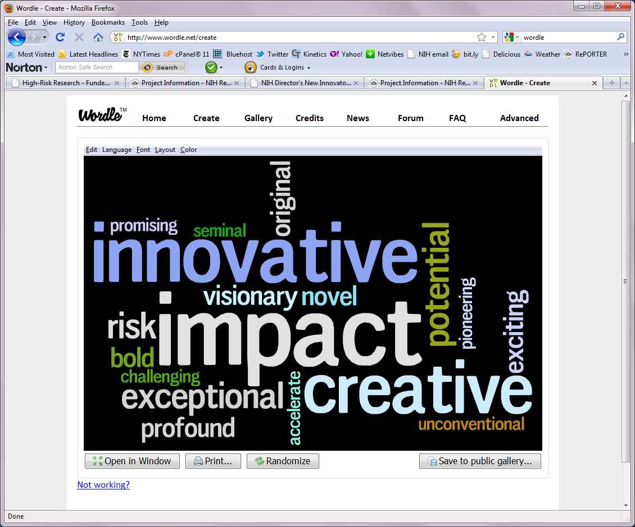




High-Risk High-Reward (HRHR) Research
New approaches to support exceptionally creative scientists who propose highly innovative approaches to major contemporary challenges in biomedical research
Novel approaches to peer review and funding mechanisms
Preliminary data not required
Shortened application
Transformative Research Awards allow multi-disciplinary teams of investigators
TRA

Slide 7
CF Programs Build “Foundations” to Catalyze Research
■ New Approaches to Foster Innovation and Invigorate the Research Workforce
■ High-Risk High-Reward (Pioneer, New Innovator, Transformative Research, Early Independence Awards)
■ Broadening Experiences in Scientific Training (BEST) Awards (New in FY13)
■ Increasing Diversity in the NIH-funded Workforce (New in FY13)
■ New Tools, Infrastructure, and Data to Support or Establish New Fields of Study
■ Metabolomics
■ Libraries of Integrated Network-based Cellular Signatures (LINCS)
■ Knock-Out Mouse Phenotyping Project (KOMP2)
■ Protein Capture Reagents
■ New Technologies and Approaches to Overcome Barriers to Progress in a Field
■ Single Cell Analysis
■ PROMIS: Patient Report Outcomes Management System
■ Glycoscience

Slide 8
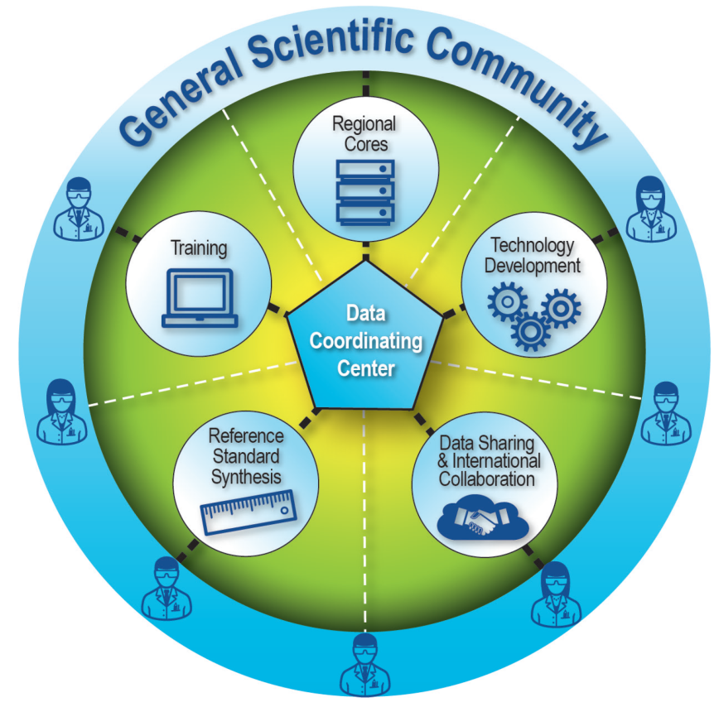
Metabolomics Program Activities
Six Regional Comprehensive Metabolomics Resource Cores (RCMRCs)
Development of Metabolomics Technologies
Metabolomics Training
Synthesis of High-Quality Reference Standards
Data Sharing and International Collaboration
https://commonfund.nih.gov/metabolomics/
Notes:
Regional Comprehensive Metabolomics Resource Cores (RCMRCs) to provide metabolomics services for the greater research community and develop cutting-edge technologies to enhance the sensitivity and speed with which specific elements of the metabolome can be identified and quantified. The Common Fund is supporting six RCMRCs:
Michigan Regional Comprehensive Metabolomics Resource Core (MRC)² at the University of Michigan
NIH West Coast Metabolomics Center at the University of California, Davis
NIH Eastern Regional Comprehensive Metabolomics Resource Core at RTI International (Durham, North Carolina)
Southeast Center for Integrated Metabolomics (SECIM) at the University of Florida
Resource Center for Stable Isotope-Resolved Metabolomics (RC-SIRM) at the University of Kentucky
Mayo Clinic Metabolomics Resource Core (Rochester, Minnesota)
Development of Metabolomics Technologies to improve how samples are obtained, prepared, and handled; to increase the accuracy and precision of metabolomics detectors; and to make data handling and analysis more robust. These activities are carried out by individual researchers throughout the country.
Metabolomics Training, ranging from introductory training for researchers new to the field to advanced hands-on training for metabolomics experts in emergent technologies and approaches. The program’s training activities also include mentored research awards for young investigators.
Synthesis of High-Quality Reference Standards for common metabolites that are not currently available, as well as for novel ones with high potential for use in translational research. RTI International and SRI International were awarded contracts for synthesis of select metabolites nominated by researchers. To make a nomination, visit the Metabolomics Workbench at http://www.metabolomicsworkbench.org/.
Data Sharing and International Collaboration to facilitate communication and exchange of data among metabolomics researchers worldwide. All grantees in the Common Fund Metabolomics program are required to submit data to the Metabolomics Workbench, managed by the program’s Data Repository and Coordinating Center (see below). Other metabolomics researchers are encouraged to use the Metabolomics Workbench to share their data with the greater metabolomics community. Data from the site are shared with the metabolomeXchange, an international collaboration of metabolomics data repositories, which links to data sets from researchers around the globe. The data and other resources developed by the Common Fund Metabolomics program are managed by the Data Repository and Coordinating Center (DRCC) at the San Diego Supercomputer Center, University of California, San Diego. The DRCC makes these materials publicly available through the Metabolomics Workbench website: http://www. metabolomicsworkbench.org/.

Slide 9
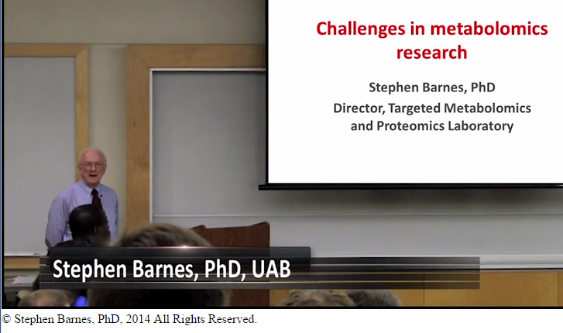

Metabolomics Training
Metabolomics Training ranges from introductory training for researchers new to the field to advanced training for metabolomics experts in emergent approaches.
Administrative supplements and early career awards (K01) integrate practical metabolomics training into research projects and collaborations.
Online Training Materials: tutorials, archived videocasts, as well as slides and videos from workshops.
http://www.metabolomicsworkbench.org/training/index.html
Notes:
Metabolomics Training and Education
An important goal of the NIH Common Fund Metabolomics Program is to provide training and mentoring opportunities to a broad spectrum of users - ranging from those who are interested in learning what comprises metabolomics and how metabolomics approaches might benefit their research to metabolomics experts, who may be interested in learning more about new technologies and new approaches to metabolomics research.
Multiple Types of Training are occurring through the Metabolomics Program
Hands on workshops/courses at the University of Alabama at Birmingham (Stephen Barnes in photo) and at the RCMRCs.
“Metabolomics in Medicine” interactive online learning platform developed at the University of North Carolina (banner displayed).
Archived training materials and videos available at the Metabolomics Workbench.
Hands-on research training in the form of Administrative Supplements, the P&F Program, and Early Career Awards.
Training Events: http://www.metabolomicsworkbench.org/training/events.php
Our Regional Comprehensive Metabolomics Resource Cores (RCMRC)s and the University of Alabama at Birmingham offer a variety of events, providing instruction and hands-on training related to topics including (but not limited to!)
practice and theory in metabolomic applications
study design
sample collection
hands-on training in mass spectrometry
stable isotope-resolved metabolomics
data processing
data interpretation
tools for data visualization
hypothesis exploration
latest research in metabolomics
Online Materials: http://www.metabolomicsworkbench.org/training/online.php
These online resources include materials that cover range of topics, including
introduction to metabolomics ("What is metabolomics?")
the metabolomics investigative process ("Some Cells Know How to Keep Their Secrets")
state of metabolomics technologies ("State of Metabolomics Technologies in Translational Medicine")
an example of how metabolomics can lead to diagnosis and treatment of a serious health issue ("Metabolomics of Bacterial Biofilms")
video series with videos that demonstrate how to use metabolomics, study design, tissue preparation, hardware, data analysis, and more - offered by the Michigan Regional Comprehensive Metabolomics Resource Core

Slide 10
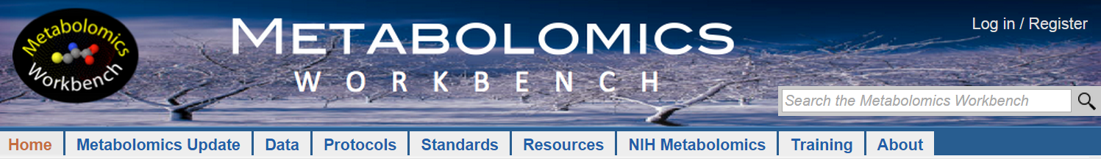
Summary Metabolomics Program Resources
The Data Repository and Coordinating Center (DRCC) at UC San Diego makes data and all other resources available through the Metabolomics Workbench
Resources accessible through the Metabolomics Workbench:
RCMRCs: metabolomics services, Pilot & Feasibility projects, training.
Metabolomics data from program consortium members and international sources.
Training: hands-on training courses, workshops, and symposia, as well as online training materials.
Metabolite standards and nominations for synthesis are available through the Workbench.
http://www.metabolomicsworkbench.org/resources/index.html
Notes:
This slide is meant to stand in for program accomplishments. Creating and making these resources available is arguably the greatest accomplishment of the program thus far. We will want to add the Ring Trial once it is completed and published, though.
RCMRCs:
Each RCMRC maintains its own website. A comparison of RCMRC areas of expertise and links to their websites http://www.metabolomicsworkbench.org/nihmetabolomics/rcmrcs.php.
Pilot and Feasibility Studies Through the RCMRCs:
Each RCMRC supports Pilot and Feasibility (P&F) awards that are intended to (1) provide opportunities for investigators to advance basic, clinical, and translational biomedical science by incorporating metabolomic technologies into their research and (2) support projects that will provide preliminary data for new extramural proposal submissions. The call for P&F proposals occurs annually. Learn more about past and current P&F projects on the Metabolomics Workbench: http://www.metabolomicsworkbench.org/nihmetabolomics/ pilotandfeasibility.html.
Standards:
As part of the NIH Common Fund's Metabolomics Program, the Metabolite Standards Synthesis Cores (MSSC) —RTI International and SRI International — aim to provide metabolomics researchers with high quality metabolite standards. We invite researchers to nominate compounds for synthesis. Nominated compounds will be reviewed by the NIH Common Fund’s executive committee, and prioritized for synthesis. Anyone can view the list of nominated compounds, view the current status of the nomination, and view which standards have been synthesized.

Slide 11
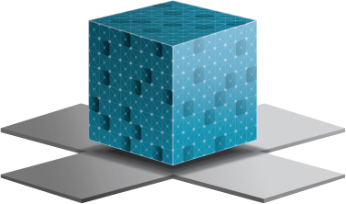
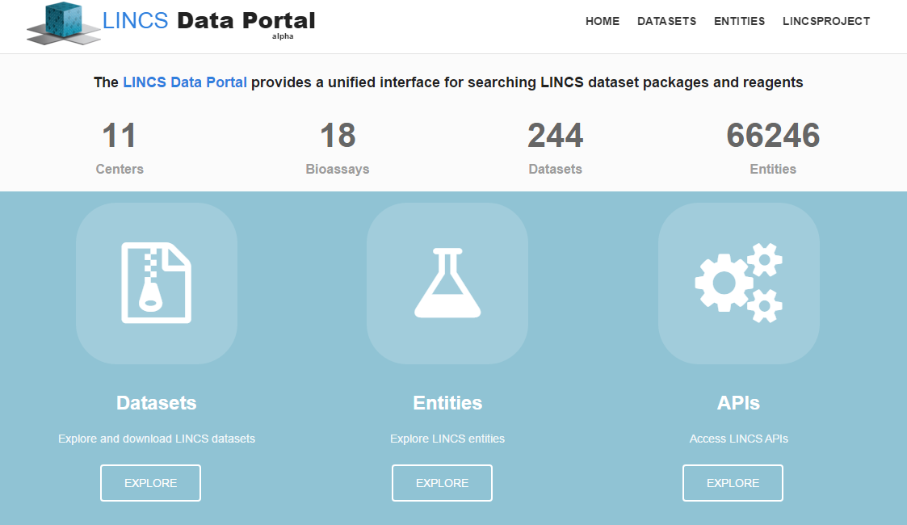
LINCS
Cells
Perturbing Entities
Assays

Slide 12
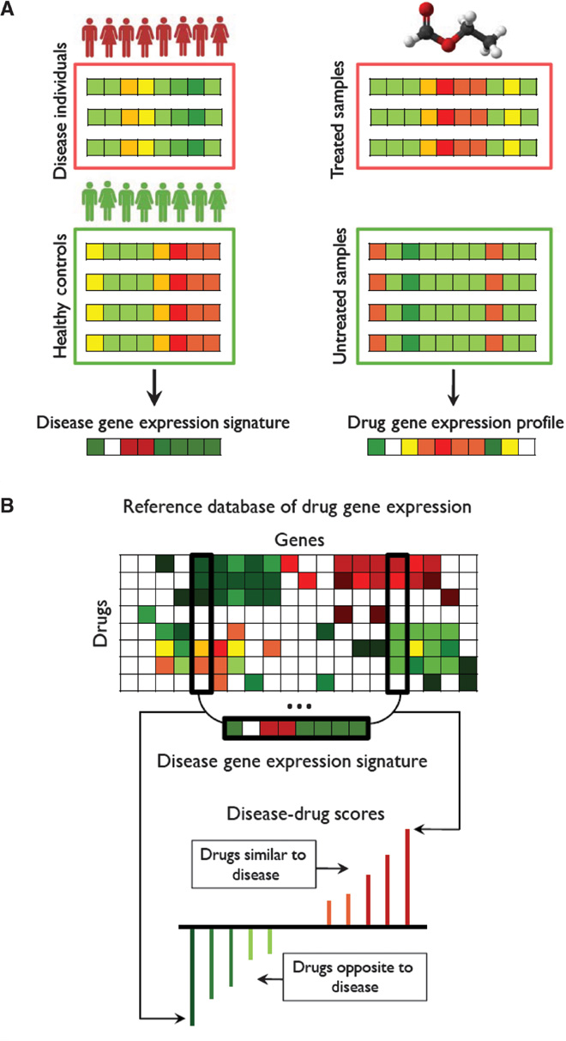

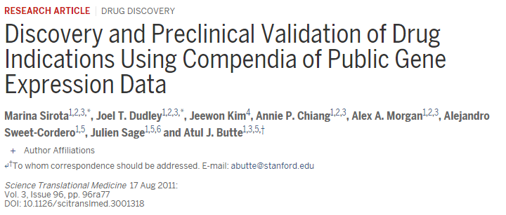
Using LINCS Data

Slide 13
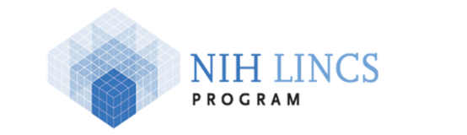
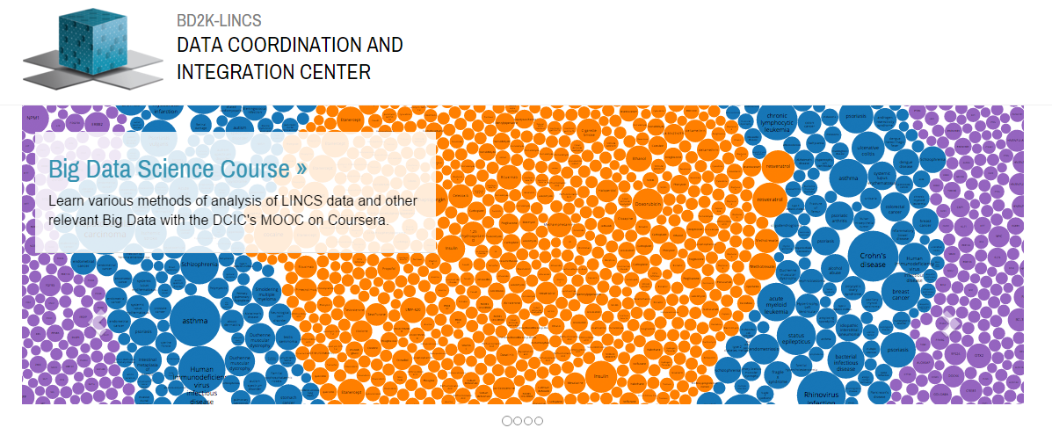
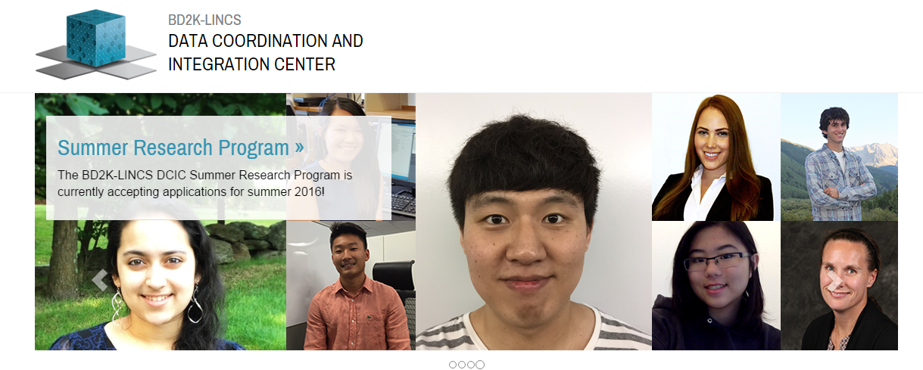
http://www.lincsproject.org/

Slide 14
Knockout Mouse Phenotyping Program (KOMP²)
■ Partnership with International Mouse Phenotyping Consortium (IMPC)
■ Standardized, broad phenotyping of 5,000 KO mice derived from IKMC ES cells
■ Definition of in vivo function of mammalian genes and identification of new models of disease
■ Data stored in a centralized database (European Molecular Biology Lab)
Database
Web server
Mice/Embryos
Mouse Production
KOMP Repository
Microinjection
Germline Transmission
LacZ staining
Lethality/Fertility
Cryopreservation
Tracking
Analysis
Display
KOMP ES cells
EuCOMM ES cells
Mice/Embryos
Data
ES cells
Data
Mice/Embryos
Cohort breeding
Phenotyping
Data Upload
Cohort breeding
Phenotyping
Data Upload
Cohort breeding
Phenotyping
Data Upload
Nominate a gene for phenotyping at http://www.kompphenotype.org/
Learn about the international effort at http://www.mousephenotype.org/
Mouse Phenotyping Center(s)
KOMP² Phenotyping Process
For more information: http://commonfund.nih.gov/KOMP2/

Slide 15
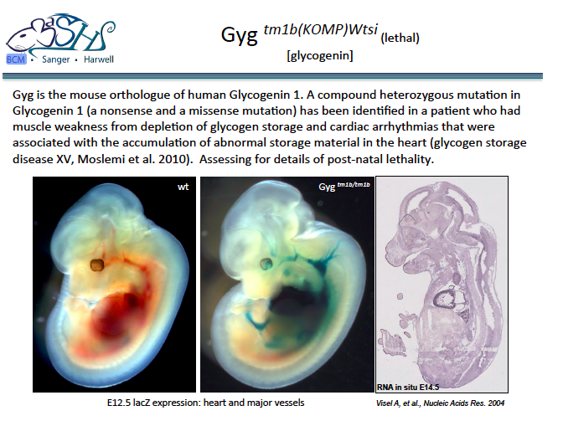

Slide 16
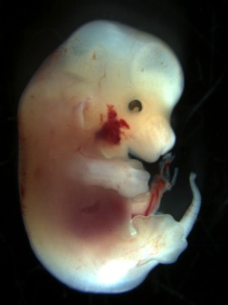
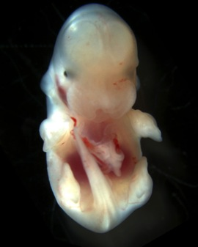
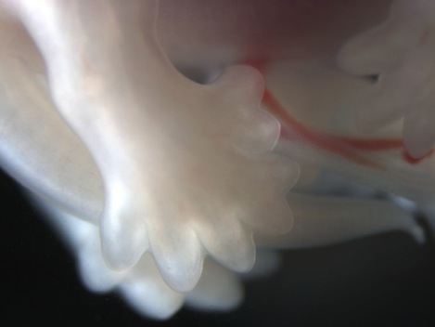
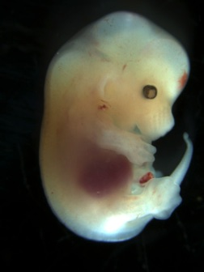
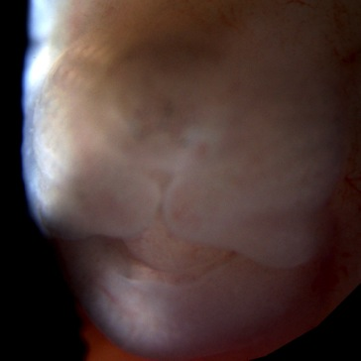
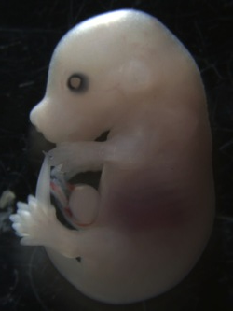
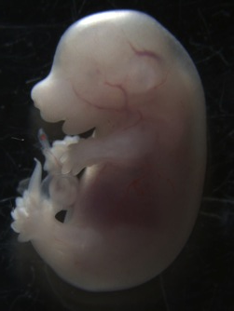
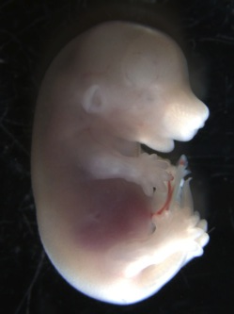
Rab34^{tm1b(EUCOMM)Hmgu/J}
 | WT | Het | Hom
Wean (46) | 15 | 31 | 0
E14.5 (4) | 1 | 1 | 2
E15.5 (15) |  |  | 1
RAB34, member RAS oncogene family
novel
E14.5 MP terms: polydactyly, facial cleft, abnormal craniofacial development, abnormal eye morphology
E15.5 MP terms: polydactyly, facial cleft, abnormal eye morphology, anopthalmia, edema
E15.5
+/-
-/-
-/-
E14.5
-/-
-/-
-/-
+/+
-/-
-/-
E15.5
-/-
Notes:
Nat Genet. 1994 Apr;6(4):348-56.
Msx1 deficient mice exhibit cleft palate and abnormalities of craniofacial and tooth development.
Satokata I1, Maas R.

Slide 17

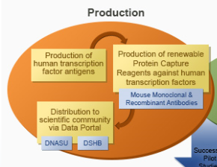
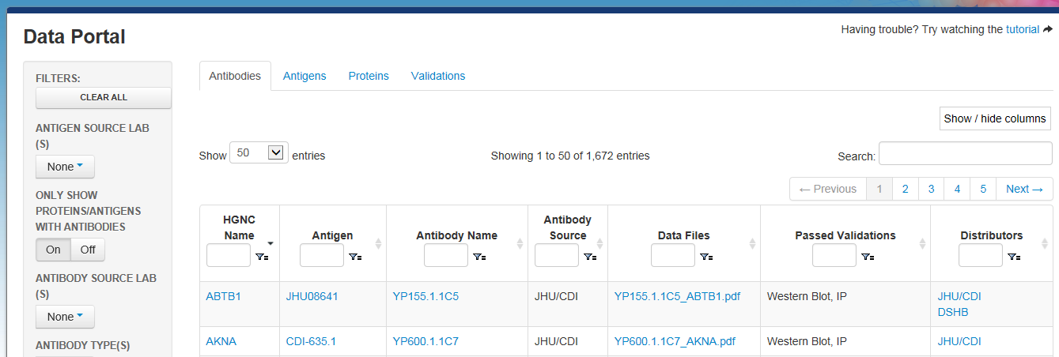
Soon to be independently validated

Slide 18
CF Programs Build “Foundations” to Catalyze Research
■ New Approaches to Foster Innovation and Invigorate the Research Workforce
■ High-Risk High-Reward (Pioneer, New Innovator, Transformative Research, Early Independence Awards)
■ Broadening Experiences in Scientific Training (BEST) Awards (New in FY13)
■ Increasing Diversity in the NIH-funded Workforce (New in FY13)
■ New Tools, Infrastructure, and Data to Support or Establish New Fields of Study
■ Metabolomics
■ Libraries of Integrated Network-based Cellular Signatures (LINCS)
■ Knock-Out Mouse Phenotyping Project (KOMP2)
■ Protein Capture Reagents
■ New Technologies and Approaches to Overcome Barriers to Progress in a Field
■ Single Cell Analysis
■ PROMIS: Patient Report Outcomes Management System
■ Glycoscience

Slide 19
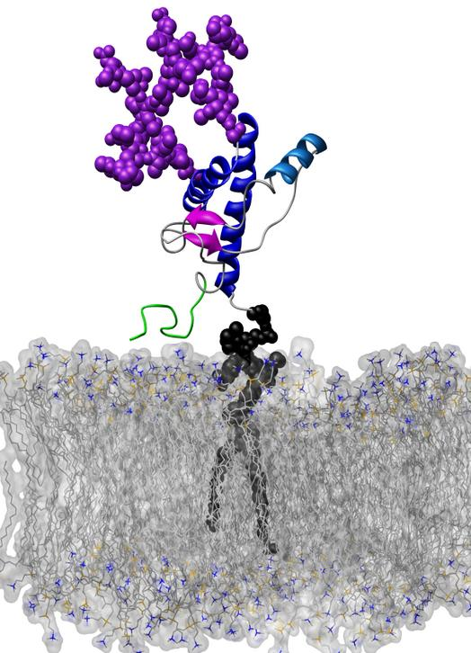
Glycoscience Goals
To develop accessible new tools and technologies that make glycoscience possible for any biomedical investigator.
less complex
easily available and affordable
easy to understand and adapt to different systems

Slide 20
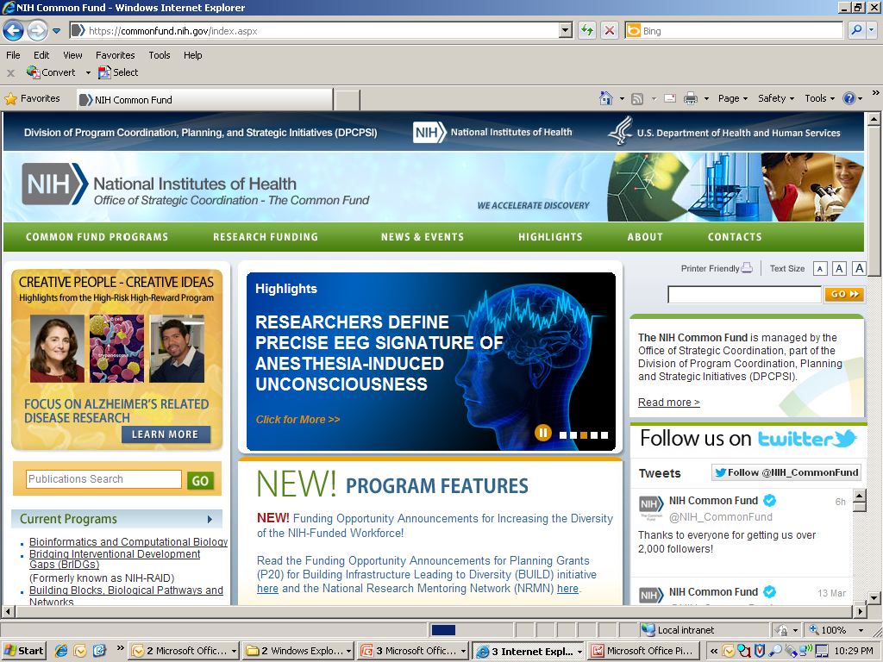

Slide 21
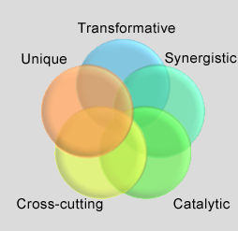
For more information:
http://commonfund.nih.gov/
Contact information:
Today’s talk – Betsy Wilder betsywilder@nih.gov
Pioneer, TR01, New Innovators, Early Independence Award – Ravi Basavappa basavapr@od.nih.gov
Other Questions:
Ellie Murcia murciae@od.nih.gov
21

Slide 22
Thank you!
Any Questions?

