Slide 1
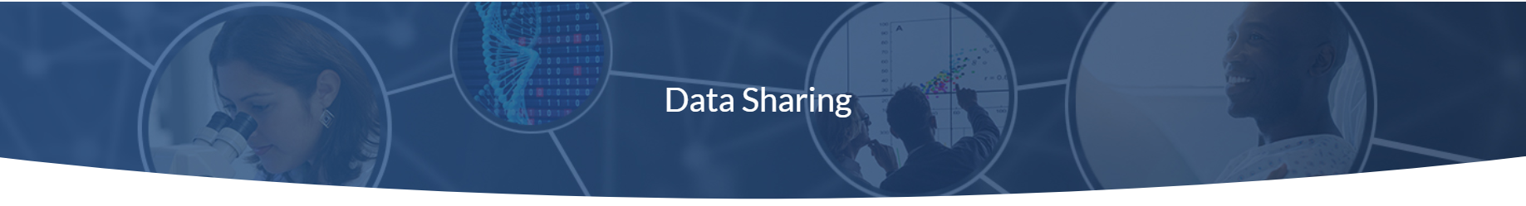

Data Management & Sharing at NCI
Sylvia Gayle, Ph.D.
Office of Data Sharing
October 30, 2020
https://datascience.cancer.gov/data-sharing

Slide 2

Today’s Presenter
Sylvia Gayle, Ph.D.,
Health Science Administrator
NCI Office of Data Sharing

Slide 3
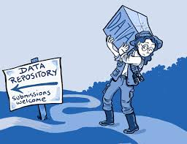

What IS Data Sharing?
Data sharing – practice of making research data & metadata available for use by the broader community
Translation of research results into
knowledge, products & procedures
improvement of human health
Replication of results is key
Transparency & openness are part of the scientific method
Can be done a variety of ways

Slide 4
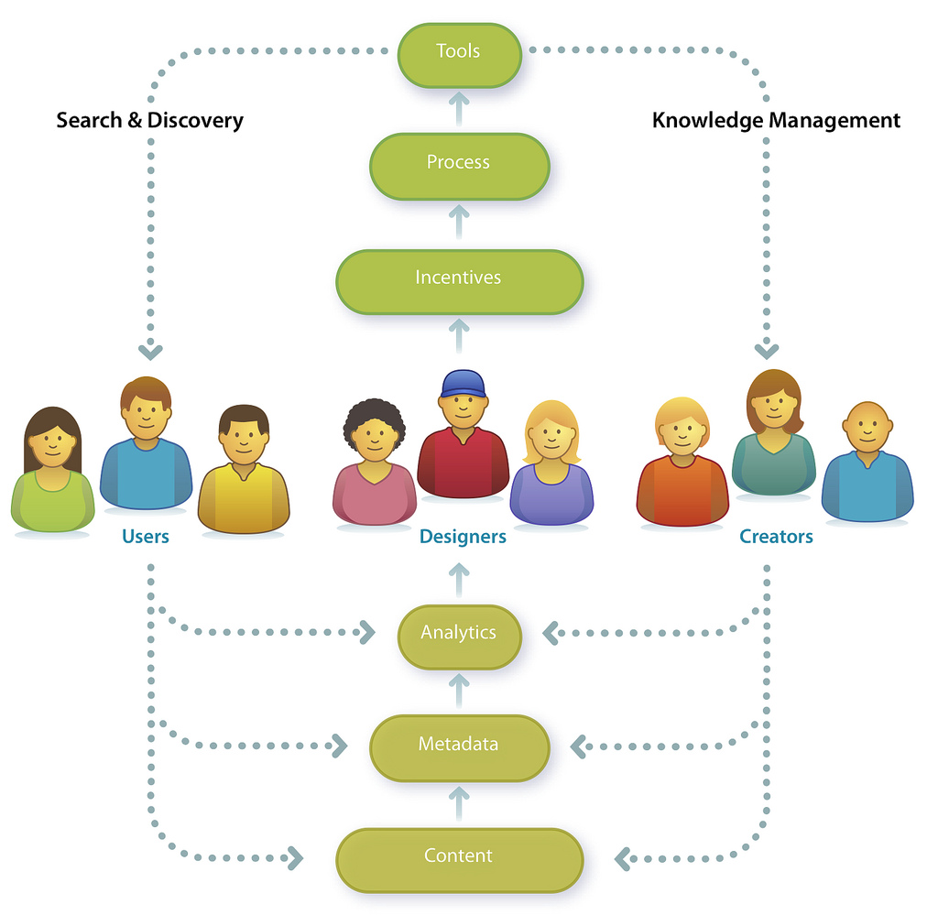
Benefits of Data Sharing
Increases statistical power & scientific value by integrating data from multiple studies
Enables & facilitates:
Reproducibility & validation of research results
Investigation of wide range of research questions
Innovation of methods and tools for research
Reduces duplication and saves time, valuable resources & experimental costs

Slide 5

Barriers to Data Sharing
  Confidentiality and privacy concerns
  Lack of knowledge about how to submit data
  Policies that limit data access
  Lack of knowledge about where data exist
  Lack of knowledge about how to access data
  Lengthy approval process for accessing data

Slide 6

NCI Office of Data Sharing (ODS)
Established to enhance data sharing for the NCI and the cancer research community
Headquartered within the Center for Biomedical Informatics and Information Technology (CBIIT)
https://datascience.cancer.gov/data-sharing

Slide 7



Office of Data Sharing Mission
“To create a comprehensive data sharing vision and strategy for NCI which advocates for the proper balance between broad and equitable data sharing with the needs of the research and participant communities.”
Jaime Guidry Auvil
Ph.D.
Director
Vivian Ota Wang
Ph.D.
Deputy Director
Subhashini Jagu
Ph.D.
Freddie Pruitt
Ph.D.
Sylvia Gayle
Ph.D.
Joseph Flores-Toro
Ph.D.
https://datascience.cancer.gov/data-sharing

Slide 8




What does the Office of Data Sharing do?
NCI Data Sharing Vision
Data Access and Submission
Guide implementation and interpretation of data access and sharing policies and standards.
Guide NCI’s data submission and access policies and processes.
NCI Data Sharing Guidance
Ethical/Social/Legal
Implications for Data Sharing
Provide data sharing guidance and resources
Advise on considerations for ethical data access and sharing.

Slide 9


Lead NCI Data Sharing, Management and Access
    Establish the NCI approach to Data Sharing policies considering:
      NCI mission
      DOC programmatic priorities
      Patient/ study participant intent
    Educate and incentivize NCI & NIH personnel and external cancer research stakeholders to support understanding of, and compliance with, the NIH & NCI policies.
    Lead data sharing expectations for NCI Cancer MoonshotSM Public Access and Data Sharing Policy.
    Represent NCI on NIH and external governance committees.

Slide 10

Relevant NIH & NCI Data Sharing Policies
White House Initiative
(2013 “Holdren Memo”)
Draft NIH Policy on Data Management & Sharing
NCI Cancer MoonshotSM Public Access & Data Sharing Policy
NIH Data Sharing Policy
NIH Public Access Policy (Publications)
HHS Rule & NIH Policy on Clinical Trial Results
Genomic Data Sharing Policy
Model Organism Policy
Big Data to Knowledge (BD2K) Initiative
Research
Tools Policy
GWAS Policy
NIH Intramural Human Data Sharing Policy
Modernization of NIH Clinical Trials
1999
2003
2004
2007
2008
2012
2014
2015
2017
2019
Investigators must share any information necessary to understand, develop or reproduce published research (raw data, statistical methods, tools, source code)
Credit to Dina Paltoo & Laura Lyman Rodriguez, adapted

Slide 11
Clinical Trials Access Policy
Goal: Ensuring public availability of results from NCI-supported clinical trials
Expectations
Timely and comprehensive access to the final results of clinical trials
Policy incorporated as a term & condition of award/contract
Scope
NCI-supported clinical trials from all NCI funded research grants
Cooperative agreements and/or contracts that support covered interventional clinical trials
Public Access
Electronic version of final, peer-reviewed manuscript to NLM PubMed Central with in 12 months of publication date
Submission of study reports to accessible registries
Available within 12 months of the Trial’s Primary Completion Date

Slide 12
NCI Cancer MoonshotSM Mission
“Enable all participants across the cancer research & care continuum to contribute, access, combine & analyze diverse data that will enable new discoveries and lead to lowering the burden of cancer.”
- NCI Cancer MoonshotSM Mission
NCI Office of Data Sharing

Slide 13
Moonshot Public Access & Data Sharing Policy
Make publications & data immediately & broadly available to the public, with no fee for access.
Expectations
Data Management & Sharing plan required:
  How publications will be made immediately available (open-access publication policy)
  Management plan for scientific data (when & where data will be preserved & shared)
Plan becomes term & condition of award/ contract deliverable
To extent feasible, data must be:
  shared immediately & widely
  preferably shared through an appropriate NIH data repository (e.g. CRDC, GDC, TCIA, NCBI/dbGaP)
  Open-access attribution license (Creative Commons or equivalent); allows copy, distribution, use & credits authors
Scope
All NCI-Supported Cancer Moonshot Research Projects generating Publications & Data on or after October 1, 2017.
Extramural grants, contracts, intramural research projects; no $ threshold
Applies to human and non-human data
Public Access
Electronic version of final, peer-reviewed manuscripts to NLM PubMed Central within 4 weeks of journal release
Made publicly available immediately with no embargo

Slide 14
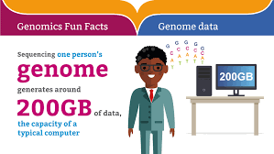
Benefits/Rationale for GDS
Enhance scientific progress and accelerate translation of genomic research into treatments, products and procedures that benefit public health
Examine relationships between genomic data and phenotypes while respecting rights of research participants
Unshared Information represents lost opportunity to improve public health
Encourage data access and sharing unencumbered by intellectual property claims (discourage premature claims on pre-competitive information)
Increased availability of data to a wide range of secondary data users not engaged in human subjects research (45 CFR 46)

Slide 15
NIH Genomic Data Sharing (GDS) Policy
Goal: Set expectations for making genomics data (& associated phenotype/ exposure) available in a timely fashion for broader discovery by researcher community
Expectations
Genomics data will be made available for the research community with specific timing expectations by data processing level for:
  Submission to a NIH controlled-access repository (dbGaP, SRA)
  Release of data to broader research community for discovery within 9 months → publication
Data will be de-identified in accordance with applicable laws & regulations to protect patient privacy & confidentiality
Scope
Large-scale genomics studies; some smaller studies (programmatic priority, rare diseases)
Extramural grants, contracts, intramural research projects; no $ threshold
Applies to human and non-human data
Public Access
Individual level, potentially identifiable data shared in controlled-access space (requires approval by Data Access Committee)
Genomic Summary Results broadly available

Slide 16
NIH Genomic Data Sharing Policy
Data Sharing (Human & Non-Human) – made available through NIH-supported repositories & resources remain standard mechanism (e.g. GDC, GenBank, SRA)
  Studies with data derived from human specimens registered in dbGaP
Release of L2/L3 Genomic Data;
FREE to PUBLISH
Generate Genomic Data (GDS)
Submit Full, QA/QC Genomic Data to NIH (GDS)
Data Cleanup/ QC
Data Analyses/ Manuscript Preparation
L4 Genomic Data Released at Time of Submission
3 Months
6 Months

Slide 17
Expectations for Genomic Data Submission & Public Release
Level | General Description of Data Processing | Example of Data Types | Data submission Expectation | Data Release Timeline
0 | Raw data generated directly from instrument | Instrument image data | Not Expected | N/A
1 | Initial sequence reads; most fundamental form of data after basic translation of raw input | DNA sequence reads, ChIP-Seq, RNA-Seq reads, SNP arrays, Array CGH | Human data: Project specific, after data | Human data: Up to 6 months after data submission
2 | Data after an initial round of analysis or computation to clean the data & assess basic quality measures | DNA sequence alignments to a reference or de novo assembly, RNA expression profiling | cleaning & quality control (generally 3 | is initiated or at acceptance of initial publication,
3 | Analysis to identify genetic variants, gene expression patterns or other data features | SNP or structural variant calls, expression peaks, epigenomic features | months after data generation). | whichever comes first.
4 | Final analysis that relates the genomic data to phenotype or other biological states | Relationships of genotype-phenotype, RNA expression or epigenomic patterns to biological state | Human data: Data submitted as analyses are completed. | Human data: Data released with publication.
*Non-human data submission & release expected no later than the time of initial publication.

Slide 18
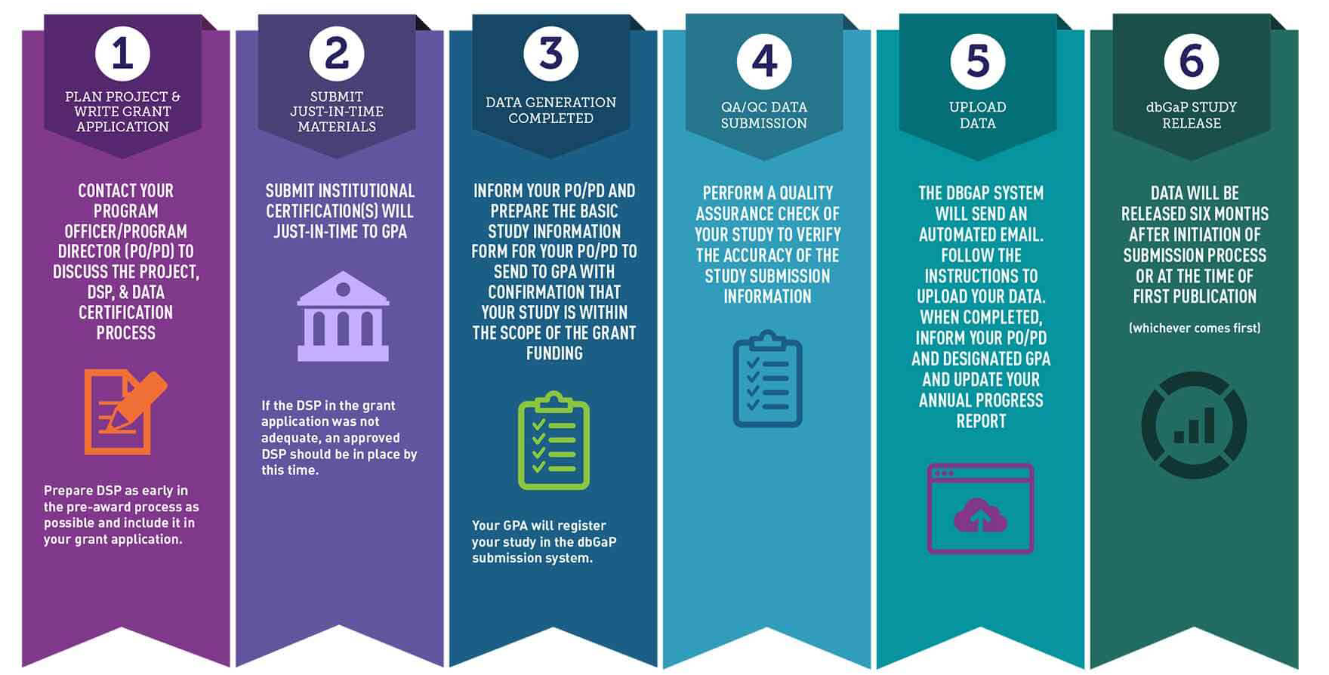
Expectations for Genomic and Phenomic Data Submission
& Public Release

Slide 19

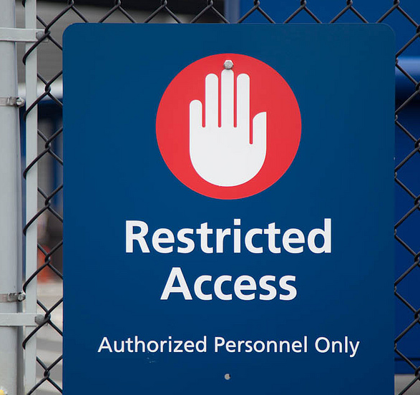
Unrestricted- vs Controlled-access to Human Genomic Data
Unrestricted/ Open-access Tier: data are publicly available to anyone (ie. The 1000 Genomes Project); includes study protocols, metadata, certain phenotype data, genomic summary results (sensitive populations may apply for all controlled-access).
Managed-access Tier: investigators must sign a data use agreement and obtain approval from NCI program staff (scientific review)
Controlled-access Tier: investigators must sign a data access agreement and obtain approval from NIH Data Access Committees (ethical review) to use the requested data (e.g., dbGaP); includes individual-level sequence data and potentially identifiable phenotype and analyzed data (*unless informed consent explicitly states unrestricted-access to individual-level human genomics data is appropriate)
      Informed consent is the basis for institutions to determine the appropriateness of submitting human data to
      unrestricted or controlled-access NIH data repositories*

Slide 20
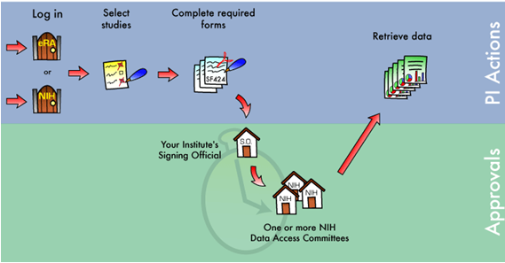

The dbGaP Data Request Process

Slide 21
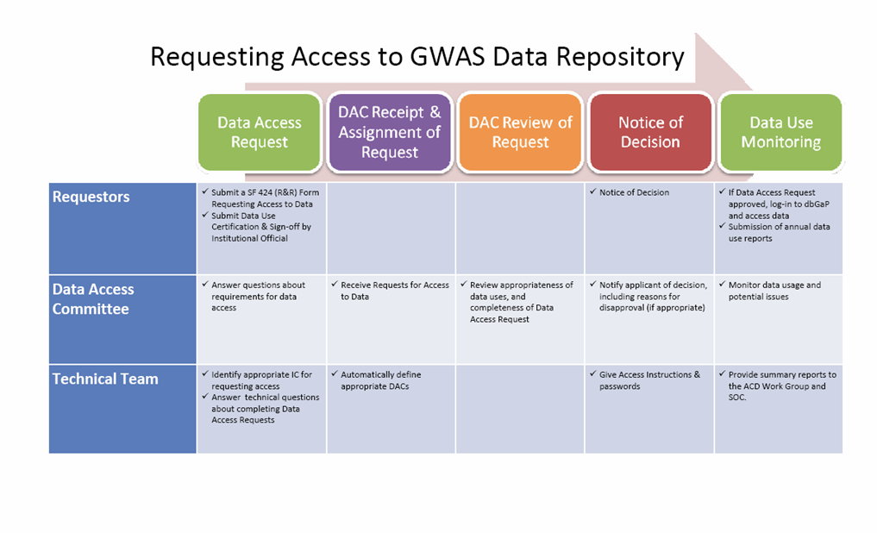
The dbGaP Data Request Process
Requester submits Data Access Request (DAR) to Institutional Signing Official
Signing Official (SO) approves and submits to Data Access Committee (DAC) staff
DAC Staff DAR pre-review
Full Data Access Committee (DAC) review
Data Access Request (DAR) is approved or disapproved
Requestor is notified by email of DAC decision
Requestor can access data (1 year)
Requester completes Annual Report
  Renew access or closeout.
Credit to L. Lyman Rodriguez, J. Ostell & M. Feolo – NHGRI, NCBI

Slide 22
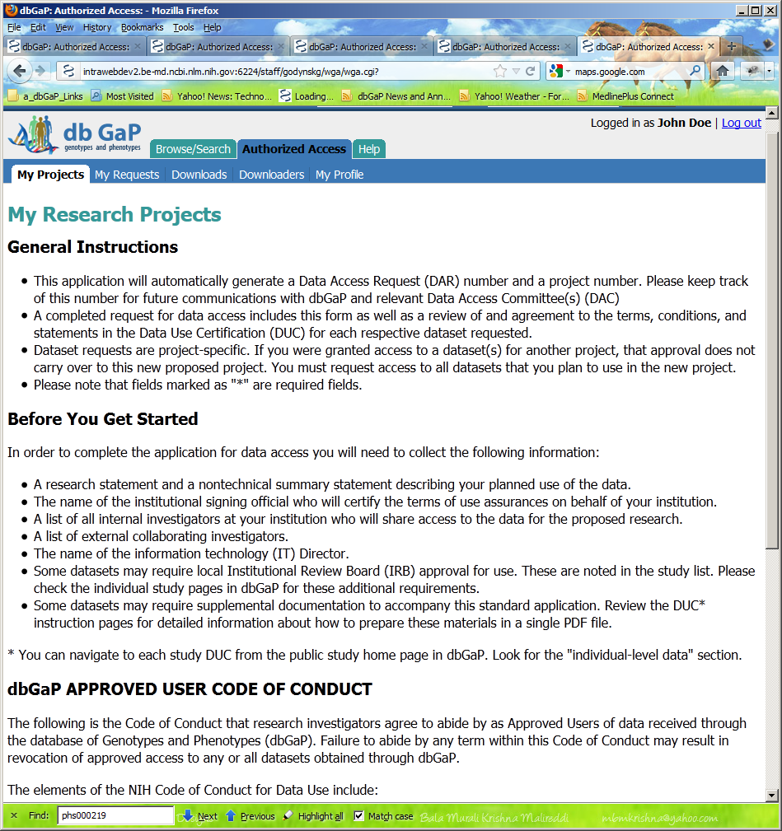
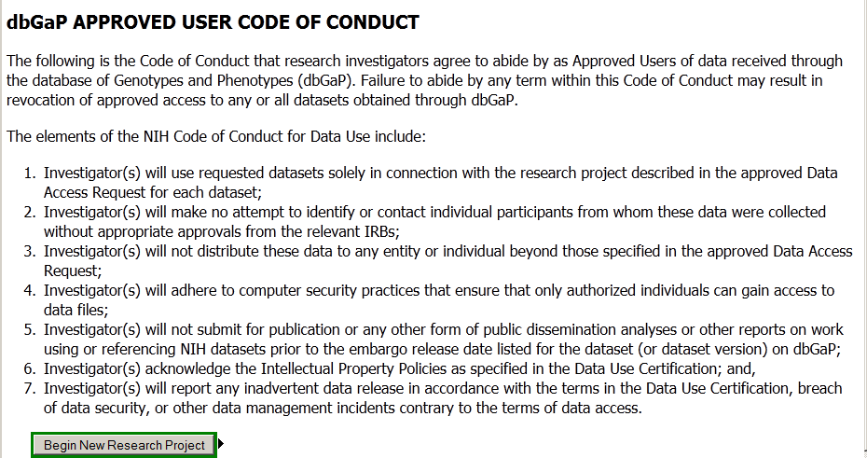
NIH Code of Conduct for Genomic Data Use
  Investigators agree to:
    Use requested datasets only for the research described in their Data Access Request (DAR)
    Not distribute data to individuals not specified in their DAR
    Not attempt to contact or identify research participants
    Adhere to dbGaP Best Practices that ensure data security
    Report Data Management Incidents
    The proposed Research Use Statement is consistent with the Genomic Data Sharing Policy
    Not re-deposit data in public databases
    *External collaborators must independently apply for data access.

Slide 23
Number of NIH dbGaP Data Access Requests By Year
# of DATA ACCESS REQUESTS
YEAR
(Courtesy: Adapted from J Guidry Auvil, NCI – NIH)

Slide 24

  Data Access Requests by NIH Data Access Committee (01/01/2020 – 09/24/2020)
DATA ACCESS COMMITTEE (DAC) | # TOTAL DATA ACCESS REQUESTS | # DATA ACCESS REQUESTS APPROVED | # DATA ACCESS REQUESTS DISAPPROVED
CDAC | 190 | 187 | 1
ES DAC | 85 | 58 | 3
JAAMH | 4506 | 3948 | 65
JARDE | 451 | 352 | 75
Kids First | 231 | 191 | 37
NCATS | 56 | 0 | 0
NCI | 9605 | 8302 | 1124
NDAR | 444 | 180 | 0
NEI | 416 | 281 | 30
NHGRI | 5466 | 4486 | 743
NHLBI | 7690 | 5551 | 1375
NIAID | 146 | 111 | 8
NICHD | 306 | 181 | 4
NIDCD | 10 | 0 | 0
NIDDK | 774 | 473 | 21
NIGMS | 362 | 266 | 11
NINDS | 1092 | 906 | 50
NINR | 6 | 5 | 0
ALL DACS | 31317 | 25299 | 3560

Slide 25

ODS Data Access Centralization
Data Access Requests (x100)
Response Time (Days)
88.6
Implemented multiple team approach
  Expedited reviews for datasets with broader data uses
  General Research Use
  Health, Medical & Biomedical
  Disease Specific Cancer
53.4
24.2
0.5
Jan – Jun, 2018
July 2018 – October 2020

Slide 26




Seek Appropriate Balance
Natural tension between values & needs of all stakeholders:
  Protect privacy of subjects and research integrity of study
  Respect broad range of participant wishes
  Promote health advances through research
  Support investigators and their ability to do good work

Slide 27

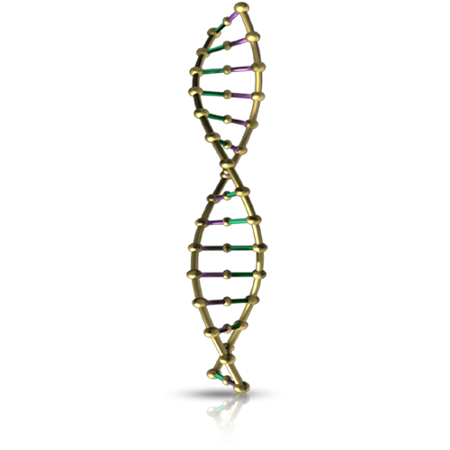
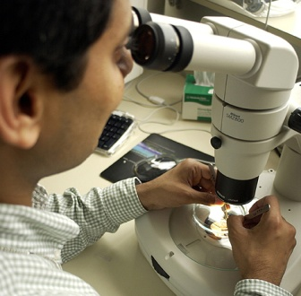




ODS Guidance Across Data Life Cycle
Data Collection
Data Sharing Plans
Data Submission
& Management
Data Distribution &
Secondary Use
Research Participants
Submitting Investigators
Data Repositories/ Registries
Recipient
Investigators
Managed Access
Unrestricted Access
Controlled Access [Sensitive data]
Credit to Vivian Ota Wang – ODS

Slide 28






Contact Us About Data Sharing
nciofficeofdatasharing@mail.nih.gov
Questions
#NCIODS
datasharing.cancer.gov

