Slide 1
Retroviruses
Retroviruses
TRACO lecture series
September 9, 2024
Frank Maldarelli
HIV Dynamics and Replication Program
NCI

Slide 2
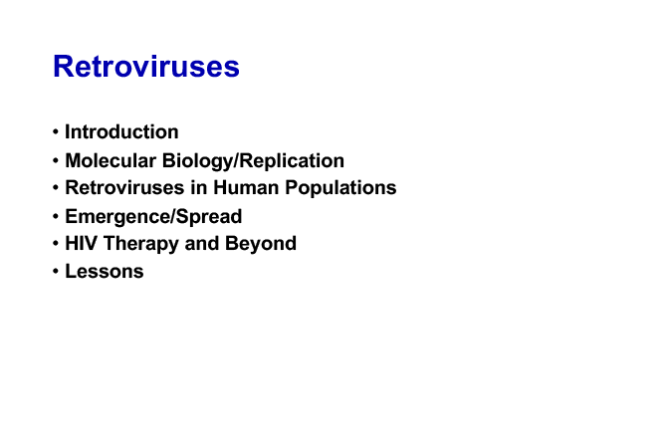
Retroviruses

Slide 3
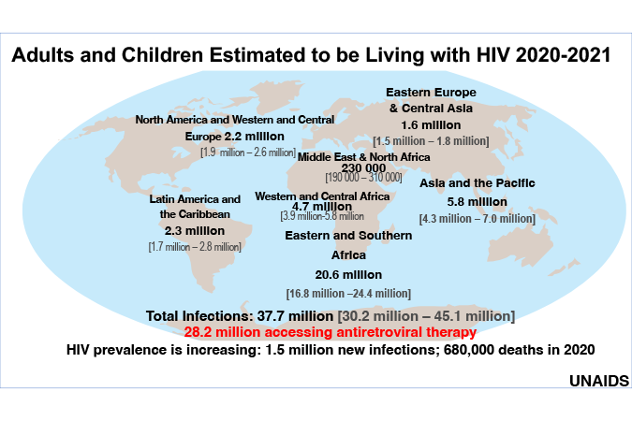
HIV cases

Slide 4
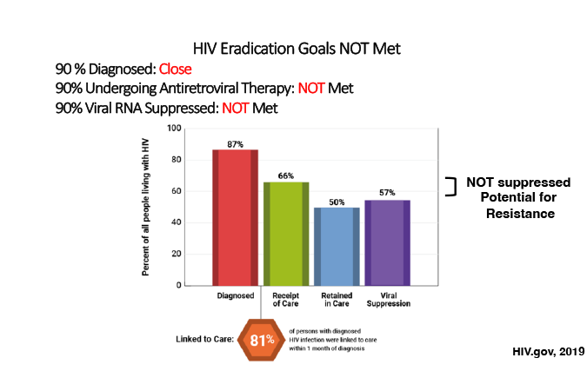
HIV eradication goals not met

Slide 5
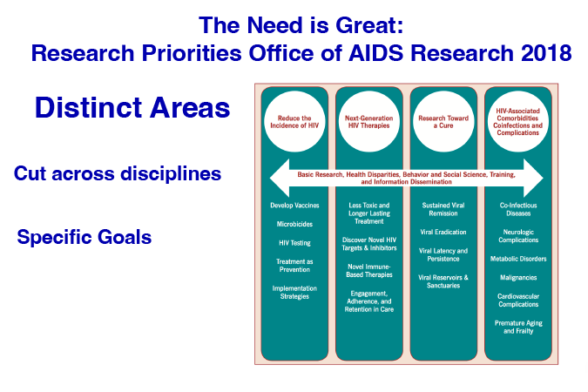
The need is great

Slide 6
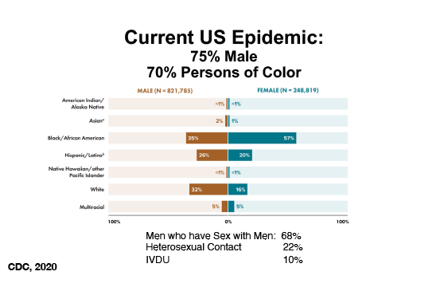
US epidemic

Slide 7
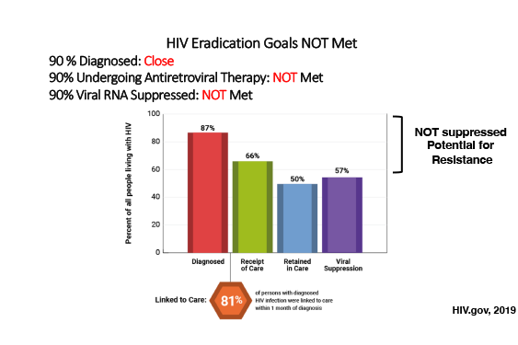
Goals not met

Slide 8
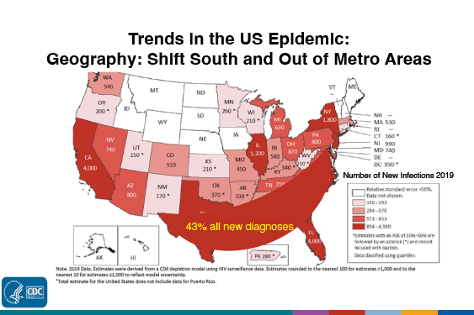
Trends in the US

Slide 9
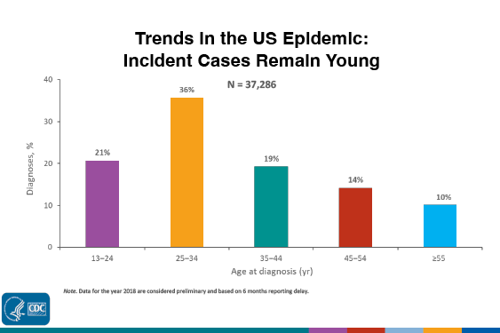
US epidemic

Slide 10
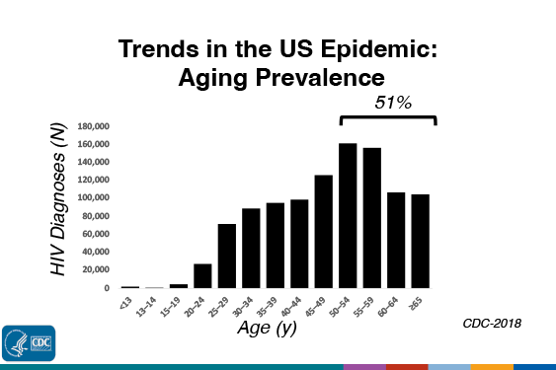
Aging prevalence

Slide 11
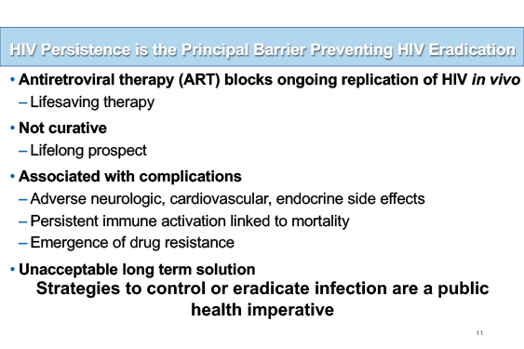
HIV persistence

Slide 12
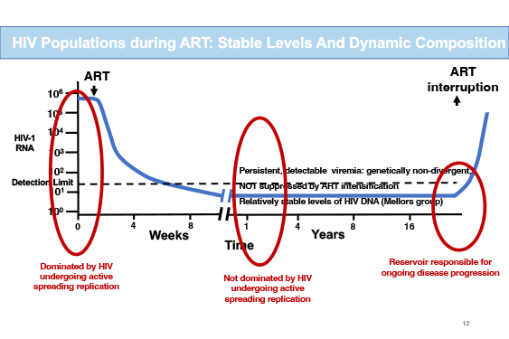
HIV populations

Slide 13
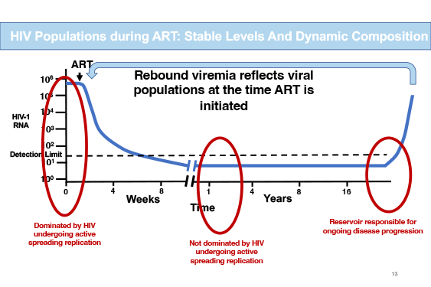
HIV populations

Slide 14
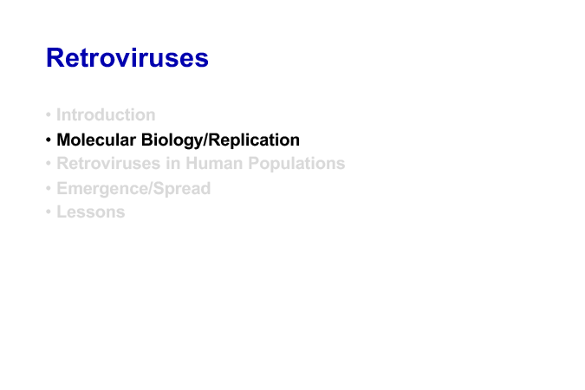
Molecular biology/replication

Slide 15
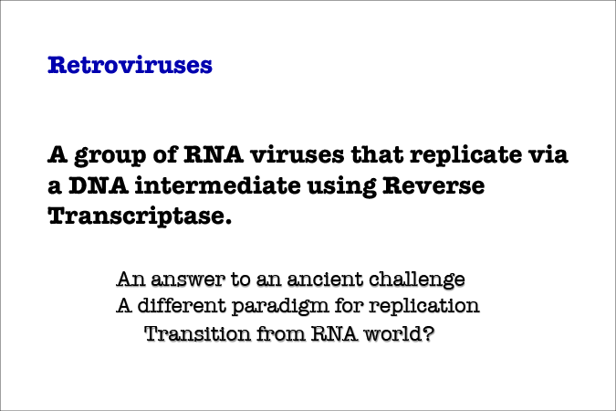
Retroviruses

Slide 16
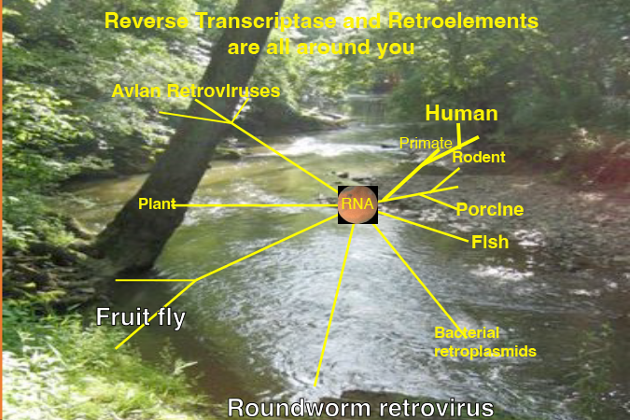
Retroviruses

Slide 17
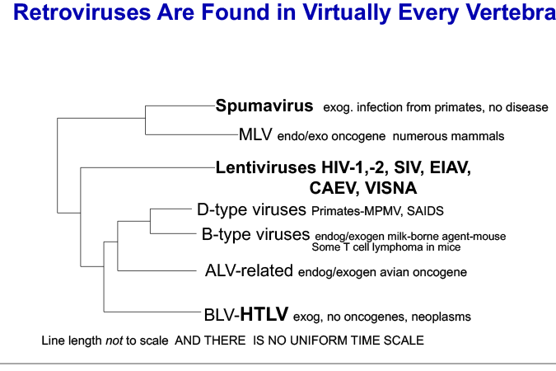
Retroviruses

Slide 18
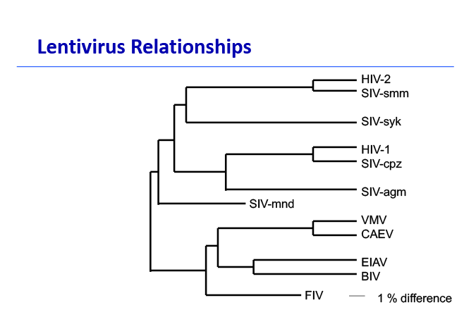
Lenitvirus relationships

Slide 19
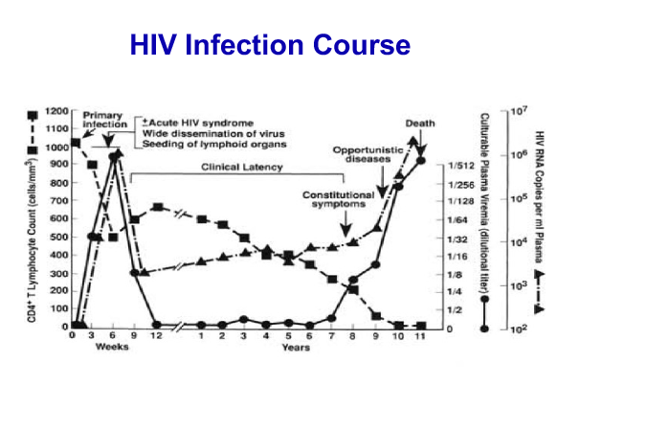
HIV infection curve

Slide 20
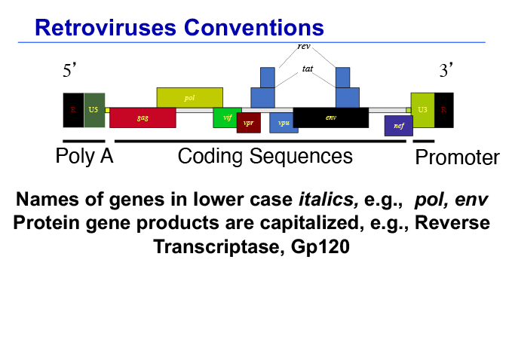
Retroviruses conventions

Slide 21
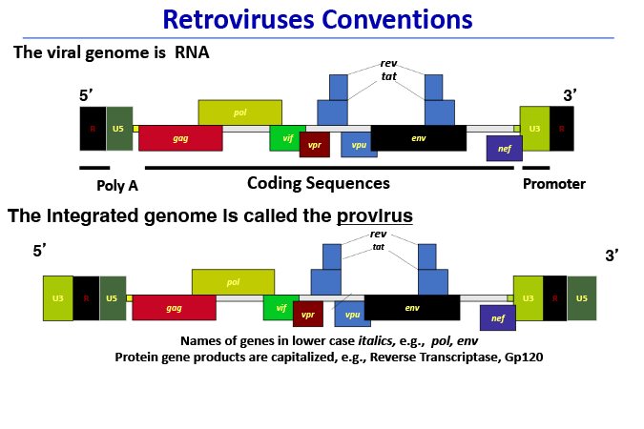
Retrovirus conventions

Slide 22
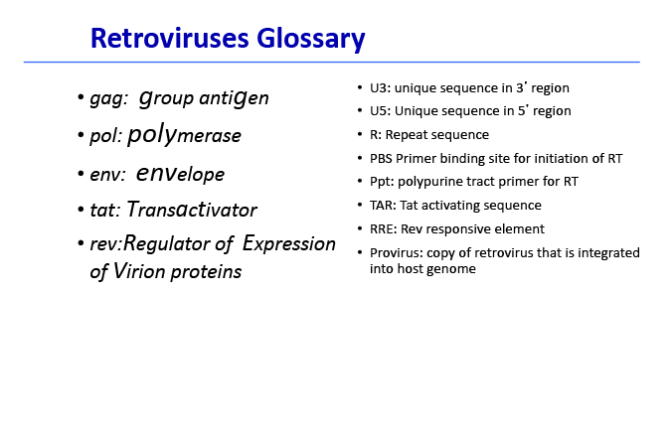
Retrovirus glossary

Slide 23
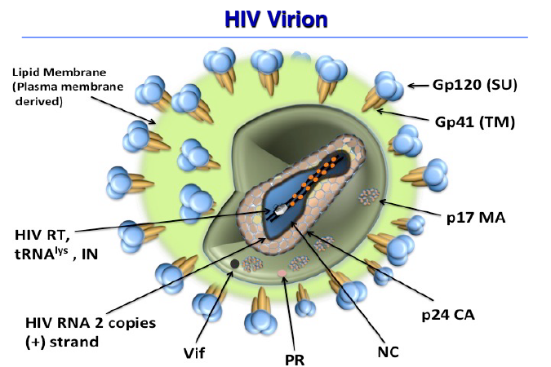
HIV virion

Slide 24
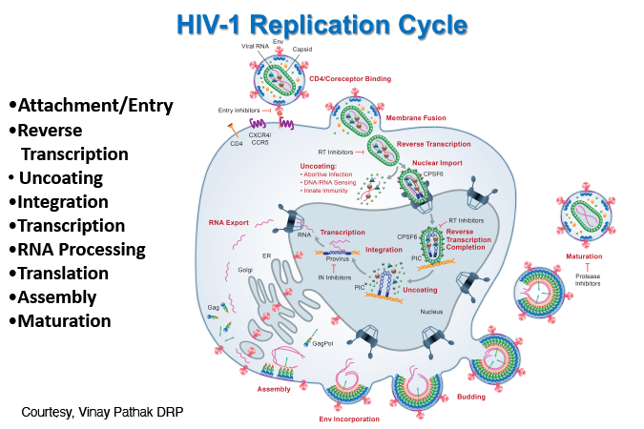
HIV-1 replication cycle

Slide 25
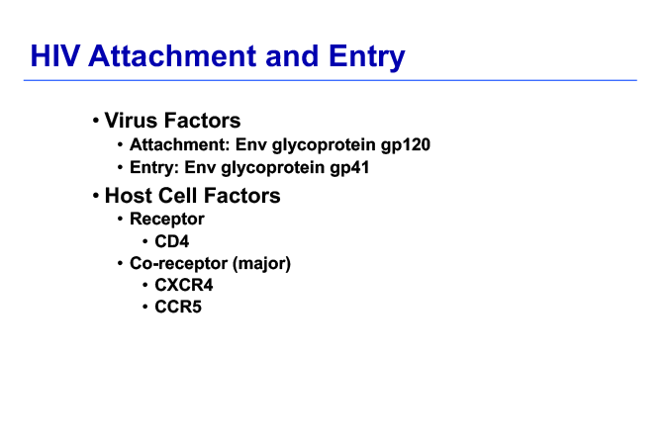
HIV attachment and entry

Slide 26
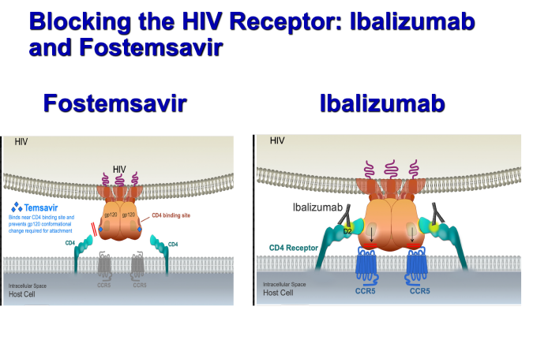
Blocking the HIV receptor

Slide 27
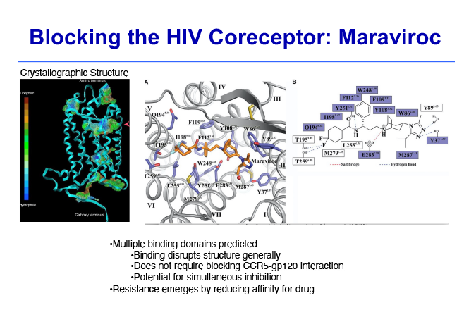
Blocking the HIV coreceptor

Slide 28
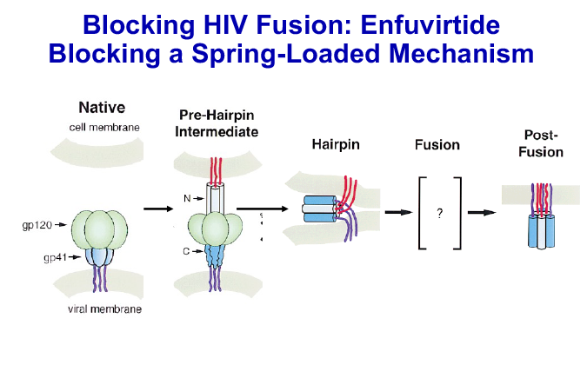
Blocking HIV fusion

Slide 29
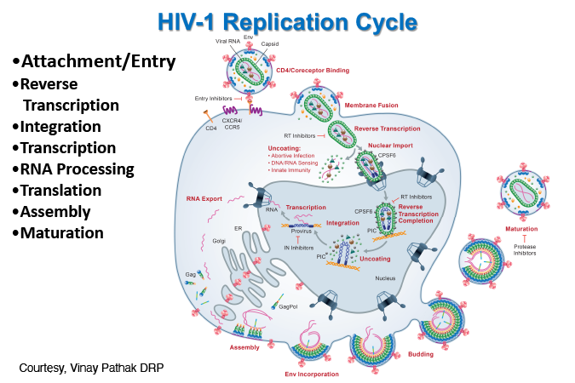
HIV-1 replication cycle

Slide 30
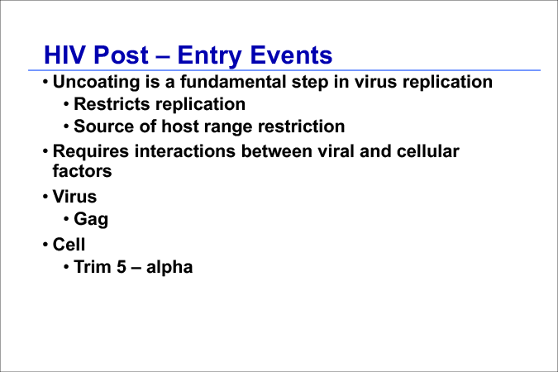
HIV Post-entry events

Slide 31
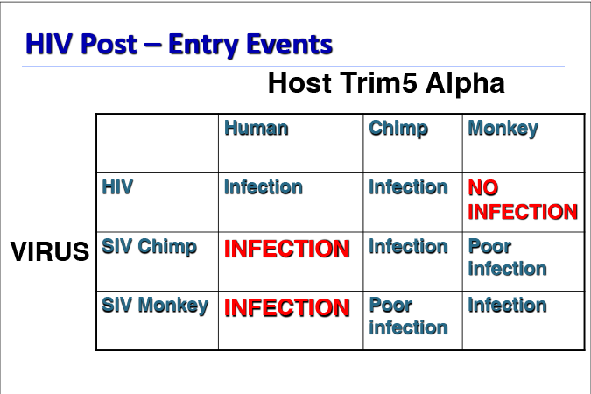
HIV Post-entry events

Slide 32
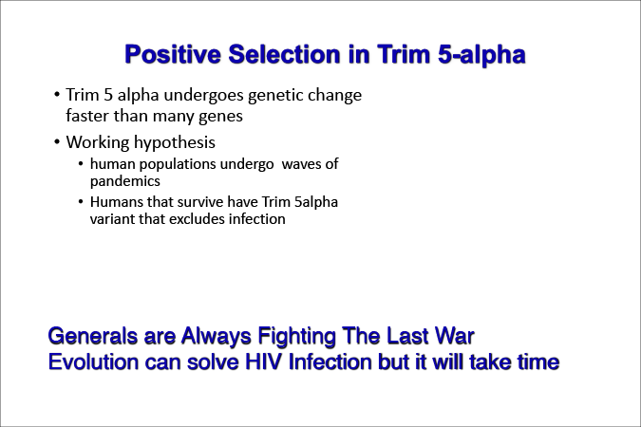
Positive selection in Trim 5-alpha

Slide 33
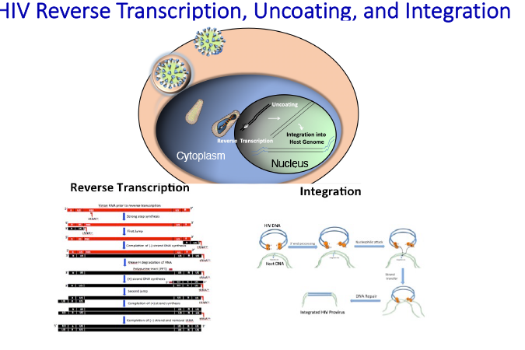
HIV reverse transcription, uncoating and integration

Slide 34
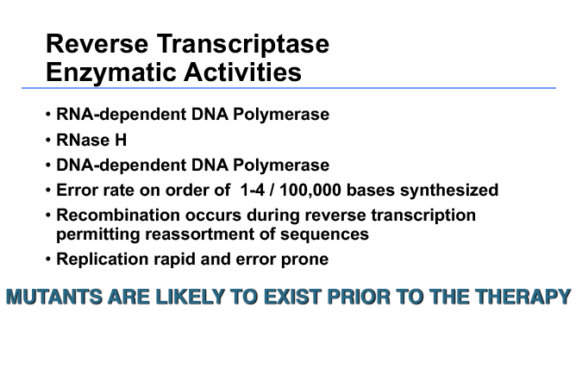
Reverse transcriptase enzymatic activities

Slide 35
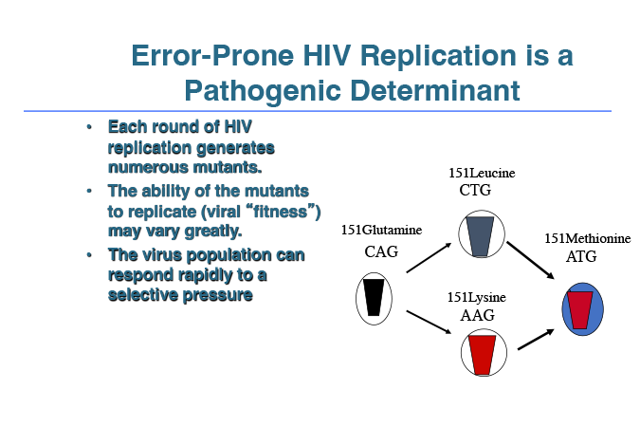
Error-prone HIV replication

Slide 36
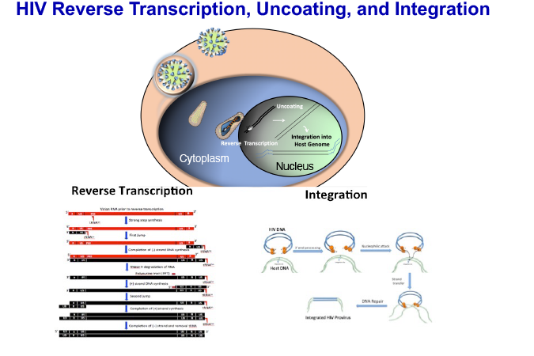
HIV reverse transcription, uncoating and integration

Slide 37
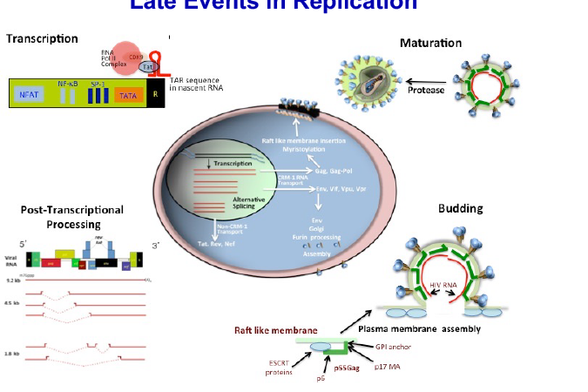
Replication late events

Slide 38
Translation

Slide 39
HIV particle maturation

Slide 40
Retroviruses
Introduction
Molecular Biology/Replication
Retroviruses in Human Populations
Emergence/Spread
Lessons

Slide 41
Lentivirus Relationships
HIV-2
SIV-smm
SIV-syk
HIV-1
SIV-cpz
SIV-agm
VMV
CAEV
EIAV
BIV
SIV-mnd
FIV
1 % difference

Slide 42
HTLV distribution

Slide 43
HTLV-I ATL
Long Latency (>30 years)
    Small pediatric series in SA
Epidemiology
  Approximately 1% of HTLV- I infected adults
Associated syndromes
  Infectious
    TB, MAC, Leprosy
    PCP
    Strongyloides
    Scabies esp. Norwegian scabies
  Noninfectious-hypercalcemia+lytic bone lesions
Therapy-Chemotherapy, Ifn, anti-Tac
Notes:
Despite the name there are several patterns of disease which are characterized by chronicity ot smoldering
The combination of the facts that the disease is largely clonal or oligoclonal and there is a long latency between infection and development of illness suggests that the events leading to disease are slow and may involve an additional transforming event
Recently gastric lympoma was identified with HTLV-I integrated so these designations may undergo change
can be primary gastric NHL with HTLV-I integration
Eur J Gastroenterol Hepatol 2000 Mar;12(3):357-60

Slide 44
HIV-1 origins

Slide 45
Bushmeat trade

Slide 46
HIV Spread
Biologic
  Blood and body fluid
  Iatrogenic
    Blood transfusion
    Vaccination –needles not vaccine
  Mother to Child
Non-Biologic
  Political
  Economic
  Multiple Epidemics

Slide 47
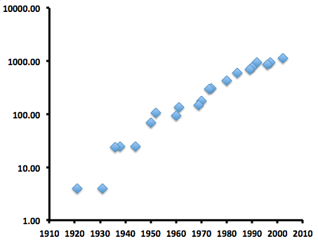
Zoonotic Transmission of HIV Coincides with Population Expansion in Africa
Human Population (millions)
Year
http://www.populstat.info/

Slide 48
HIV spread

Slide 49
HIV spread

Slide 50
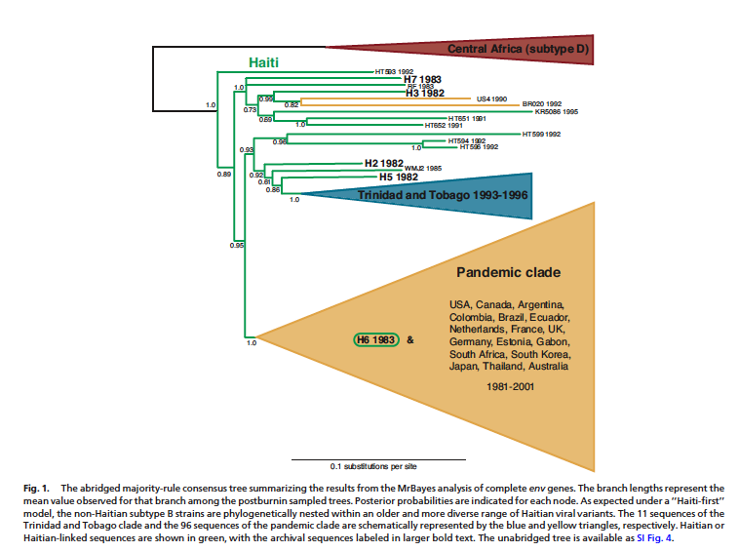
HIV Spread
Worobey et al.

Slide 51
HIV Therapy and Beyond

Slide 52
Treatment for all

Slide 53
Worlds AIDS day

Slide 54
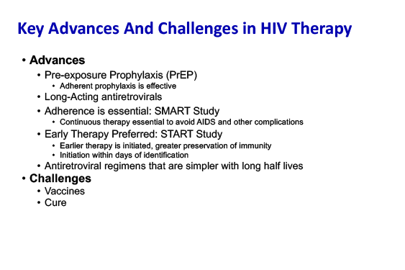
Key advances

Slide 55
Lessons
Viruses are bad and should be avoided
Except when they save the planet
And maybe if it saves you from the next virus
Epidemics are not single events
Epidemics evolve
Detailed understanding of replication leads to new therapy
Antivirals are useful
  Instituted as early as possible
  Adherence is essential

