Slide 1

Predoc to Postdoc Transition Award (F99/K00)
PA-27-037
Webinar is only for prospective NCI applicants
Mariam Eljanne, Ph.D.
mariam.eljanne@nih.gov
Center for Cancer Training
July 20, 2026
Notes:
Everybody is muted so please put your questions in the chat. The slides and recording will be posted on the NCI F99/K00 webpage under resources.
There is no need to write down any notes since everything I will say will be in my slides. I put all my notes in my slides.
This Notice of funding opportunity or NOFO is an NIH parent NOFO but this webinar is only for prospective NCI applicants since it is specific for NCI program

Slide 2
Outline
Background
Timeline
Eligibility – who may apply
Funding
Special Application Instructions

Slide 3
A note about NIH for newcomers to the NIH system:
NCI is the National Cancer Institute, the oldest of the 27 institutes and centers that comprise the NIH.
NOFO means Notice Of Funding Opportunity. NOFO is the generic “umbrella” term for all types of funding mechanisms offered by the NIH.
NRSA refers to National Research Service Awards – these are the congressionally-mandated fellowships offered by NIH:
F30: MD/PhDs
F31: doctoral students
F32: postdocs
F99/K00 is NOT an NRSA fellowship!
The NIH Fiscal Year (abbreviated FY) starts on October 1 and ends September 30.
Notes:
I apologize to the veterans of NIH grant system who are very familiar with all these terms, but we have many newcomers, so I like to define few key terms for them to be able to follow my presentation.

Slide 4
Why Offer the F99/K00 Program?
Notes:
The F99/K00 was initially developed by NCI, then other NIH institutes developed their own F99/K00 program and now considering the wide spread of this program among many NIH institutes, the NIH developed a parent NOFO.
NCI initially developed this funding program in an effort to encourage promising PhD student to continue their career in cancer research.
Currently there is a significant imbalance between the numbers of biomedical trainees and the available tenure track faculty positions. And
There is an imbalance between the numbers of biomedical researchers and available research grants.
One of the many consequences of this imbalance is that promising individuals are opting for careers outside academic research because An independent research career is being viewed as a less viable career choice

Slide 5
The F99/K00 is a New Pathway
Notes:
The F99/K00 program was developed by the NCI leadership to explore innovative ideas to address this issue.

Slide 6
Purpose of the F99/K00
Show that a cancer research career is rewarding, valuable, and viable
Identify the most promising doctoral research students
Engage and retain them in cancer research community
Facilitate their joining top laboratories of their choice in the cancer field
Position trainees for other NIH awards
Establish a dual-phase transition award for late-stage graduate students to transition to postdoctoral studies
1-2 y From Graduation
other NIH awards
Notes:
NCI hopes that this dual-phase transition award will identify and encourage promising graduate students to commit to pursuing independent cancer research careers by facilitating their joining top labs in the cancer field and make them more competitive for other NIH award.
More importantly we hope to show to the awardees and their peers that NCI supports a tractable career pathway for the talented and committed scientists.

Slide 7
F99/K00
Dual-phase Funding:
1-2 years of support for completing dissertation research training (F99)
Up to 3 years of support for postdoctoral training (K00)
* The two phases are intended to be continuous in time
Transition when the dissertation research is complete
Funding for the F99 phase will not be extended beyond 2 years
1-2 y from graduation
other NIH awards
1-2 y From Graduation

Slide 8
Parent F99/K00 PA-27-037 Key Changes
Category | Former NCI F99/K00 NOFO | New NIH Parent F99/K00 NOFO
Application deadlines | One due date per year | Three due dates per year
Number of applications per institution per due date | Limited to one | Unlimited
Eligibility – US Citizenship or Permanent Residency | Not required | Required by the time of award
Eligibility – Institutional nomination | Required | Not required
Eligibility – time from PhD | Must be in 3rd or 4th year of research doctoral program | Must have 1-2 years from the requested start date before completion of their doctoral degree
Salary Limit for K00 phase | Limit of $76K per year | Limit of $80K per year
K00 duration of support | Up to 4 years | Up to 3 years
NOFO PA-27-037 | Email NCIF99-K00@nih.gov
Notes:
This NIH NOFO has some key differences from previous NCI NOFOs, so it’s very important to read it carefully and not rely solely on experience with prior years announcements.
Non-compliant applications will be administratively withdrawn.
If you know an awardee from prior years and plan to model your application on theirs, keep this in mind!

Slide 9
The F99/K00 Timeline
August 8, 2026
November 2026 (eRA Commons)
Application is due
Review of application (CSR)
July 8, 2026
April 2027
Submission opens
Award earliest start
June 16, 2026
1. F99 Fellow completes dissertation & seeks/accepts a cancer-focused postdoc position
NOFO publication
2. Postdoc institution submits the
K00 transition application to NCI
3. K00 scholar conducts the research and career development activities
NCI ICO website/fellowship
Notes:
This new NOFO has 3 receipt dates/year as I mentioned, similar to the NRSA fellowships.
The NOFO was published on June 16, 2026. Applications will be due August 8, December 8, and April 8 for the next 3 years. The NCI website has a page devoted to the F99/K00 that was just updated.
Review occurs at the NIH Center for Scientific Review or CSR and not at the NCI as it used to happen.
Final selection of applications for funding will occur January 2027 when NCI council meets.
Awards will start as early as April 2027 and then the cycles are repeated. See the NOFO table of dates.
What happens next, if you receive an F99/K00 award?
During the F99 phase: You have up to 2 years to complete your dissertation research and secure a cancer-focused postdoc position.
In year 1, you come to a mandatory NCI F99 and K00 awardees meeting.
NCI will not approve transitions to the K00 phase before the end of the first year of the award.
4. Contact your F99 Program Director, 9 months before you are ready to graduate, for advice on the K00 transition process and application, which will be submitted by the postdoc (K00) institution. Details are in the NOFO and NCI ICO page (the link is at the bottom of the slide).
5. Then you graduate, start your new postdoc position, and conduct the research and career development activities planned for the K00 phase, which gives you up to 3 years of support.

Slide 10
Eligibility
Students earning PhD or other doctoral research degree ((e.g., EngD, DNSc, DrPH, DSW, PharmD, ScD))
Doctoral research degree students with 1-2 years from finishing up dissertation research at the time of the award
All domestic institution/organization types that grant PhD or other research degrees (e.g., EngD, DNSc, DrPH, DSW, PharmD, ScD)
Individual must be a citizen, a non-citizen national of the United States, or have been lawfully admitted for permanent residence (at the time of award)
Unsuccessful applicants may resubmit if still eligible
Current F31 awardees are eligible
Notes:
Who can apply?
The intended candidates are PhD or other doctoral research degree students who are within 2 years of graduating at the time of the award.
Dual-degree, or professional doctorate/clinical degree students are not eligible. This is because their training timeline is not compatible with this funding mechanism: The two phases are intended to be continuous in time
If you mainly work at a non-academic research center, you must apply through the institution that will confer your degree. But the research center can contribute to the application.
US citizenship, green card, or US permanent residency are required at the time of the award to be eligible for the F99/K00 program.
This award is intended for students who are near the end of their dissertation and so they really should be beyond the stage of intending to submit an F31. However, for those who still wish to submit an F31 after the F99/K00 has been submitted, we advise you to wait until the release of the F99/K00 SS since the NIH does not allow two applications with substantial overlap to be under review at the same time.

Slide 11
Funding
1-2 years of support for completing doctoral research dissertation (F99)
Stipend, Tuition, and Training Related Expenses are similar to F31
Funds to attend an F99 Fellows meeting
Up to 3 years of support for postdoc training (K00) at a US institution
Higher salary than F32
Up to $80,000/year + fringe benefits (cannot exceed the institutional base salary)
Up to $30,000/year for research and career development expenses
8% Indirect Costs allowed for the Institution
Funds to attend a K00 Scholars meeting
NCI ICO website/fellowship
Notes:
How is the award structured financially?
The predoc F99 phase will give support for up to 2 years but will not be extended. So you need to graduate by the end of year 2 of your award and be ready to transition to the postdoc phase.
In the K00 postdoc phase, you are an employee with full benefits. The salary in the K00 is up to 80K/year but cannot exceed the institution base salary. This is an NIH policy.
This slide and the NCI ICO website give you details of what to expect budget wise in both phases.
You may do your postdoc at the NIH or other national laboratory, but if you do, the funds will come from a different source.

Slide 12
Special Instructions for F99/K00 Application
Use the Fellowship-Forms-I.pdf with the following modifications:
Fellowship Applicant Section has modified instructions
Specific Aims and Research Strategy follow a non-traditional format
Review Criteria are different from the F31!
Notes:
The F99 uses the same SF424 fellowship application package that is used for other fellowships, including the F31 NRSA pre-doctoral fellowship.
But there are some key differences from the F31.
Fellowship Applicant Section has modified instructions
The Specific Aims and Research Strategy Sections of the F99 do not use the typical research grant format. I’ll elaborate on this in few minutes.
Review Criteria are different from the F31!

Slide 13
General Guidance
Read the NOFO including review criteria
Read Section F.130 (Program Overview) of Application Guide: Fellowship-Forms-I.pdf
Start NOW on Letters of Reference (F.130)
Provide directions to your referees (reference letter writers) – they submit through eRA Commons. See NIH Reference Letter website
3 minimum, 5 maximum (NOT in Letters of Support or Other Attachments)
Referees should not be directly involved in the application - not sponsor, co-sponsor, or collaborator
Check the status often – late letters are not accepted
If the 3 required letters are missing, application will not be reviewed
Notes:
You must read the NOFO instructions in Section IV. Application and Submission Information very carefully!
There is a hierarchy to instructions for applying to the NIH:
first there’s the NIH application guide, which gives generic instructions
Then there are specific instructions for various types of applications (individual fellowships have their own section), and
Then there is the NOFO (PA-27-037)
If there is different advice offered, remember that the NOFO overrules the application guide - follow the NOFO.
Reference letters: Your referees must submit new reference letters every time you submit an application. NIH does not re-use letters from a different/prior application.
Referees should not be directly involved in the application - not sponsor, co-sponsor, or collaborator.
Check the status often – late reference letters are not accepted.
It is your responsibility to follow up with the referees
If the 3 required letters are missing, application will not be reviewed

Slide 14
SF424 (R&R) F.200
8. Type of Application: NEW or RESUBMISSION
12. Start Date: the start of the F99 phase
12. Ending Date: the end of the K00 phase
15. Estimated Project Funding: covers both phases
Use the Budget in the NCI ICO Webpage/individual-fellowship & your current institution’s fringe benefits costs
21. Cover Letter
Cite PA-27-037 and include list of your referees
Notes:
The F.200 form is often called the Cover Sheet. It is 2 pages and contains nuts and bolts information.
Please request the maximum time allowed (5 years = 2 years for F99 and 3 years for K00).
The NIH issues grants in 1-year blocks, and you don’t want to run short if you need an extra day or an extra month to finish the F99 phase. You can always finish earlier than 2 year but not less than 1 year

Slide 15
R&R Other Project Information F.220
1. Human Subjects: More on this later (F.500)!
2. Vertebrate Animals: More on this later (F.430)!
6. International activities
Although foreign institutions are not allowed to apply, foreign components are permitted
Notes:
The Research and Related Other Project Information forms in this section are all about your current university and your current project, not the postdoc K00 phase.
1 & 2: This section starts off with Human Subjects and Vertebrate Animals. These are basic yes/no questions, but in a later section F.500 and F430, there are more parts. I’ll give advice later on these topics at the end of my talk.
6. International activities: Although foreign institutions are not allowed to apply, foreign components are permitted. If you have foreign collaborators, list them here.

Slide 16
Project/Performance Site Location(s) F.230
Degree-granting institution must submit application
If research is not done on the degree-granting campus, add a second site
Degree-granting institution may be the primary or secondary performance site
If work involves Human Subjects or Vertebrate Animals, be sure the site where the work will be done has the proper assurances
Notes:
For those doing all of their research at their degree-granting university, this part is straightforward.
▪ For others, a second performance site should be added. The primary site should be where most of the work will be done.
▪ The Human Subjects and Vertebrate Animal approvals must be for each site where the work will be done.

Slide 17
Senior/Key Personnel F.240
Candidate: your role is PD/PI
Sponsor: role is “Other (Specify)” then
Enter “Sponsor” or “Co- Sponsor” in the Other Project Role Category field
Others (Collaborators, Contributors)
Include here if they contribute in a substantive, meaningful way to the project (not just handing you a reagent)
May not write letters of reference for you!
Include biosketches of collaborators
Notes:
Key Personnel: you must list yourself and your sponsor.
I’ll give some advice about the biosketches on the next slide.
Co-sponsors: reviewers look to see if their role is substantive and well defined in the proposal.
Do not include a co-sponsor just to have one, or just because they are famous!
If your sponsor has limited mentoring experience, a co-sponsor who has an established track record of mentoring grad students might help your case. But only if the person meets with you regularly and is highly engaged in your training plan.

Slide 18
Biosketches
Candidates use the Predoctoral Fellowship Biographical Sketch Common Form
It is OK for fellows to list manuscripts in preparation, submitted, or in revision
Provide a link to your MyNCBI list of publications/products
Personal statement:
Explains suitability for role on this fellowship project
May cite up to 4 relevant publications or research products
Contributions to Science (up to 5):
Fellowship applicants may want to highlight 2-3 contributions
Each no longer than ½ page including citations
Notes:
Biosketches are required for all Senior/Key Personnel and Other Significant Contributors. Be sure to use the Biographical Sketch Common Form.
Fellowship applicants may include manuscripts in preparation, submitted, or in revision, but these carry less weight with reviewers.
If one of these gets published and there is more than 30 days before the actual review date, you may submit an update to the Scientific Review Officer, who runs the review meeting and will be listed as the contact in your eRA commons account.
You may also use an update to report any positive changes in sponsor funding (new grants), since reviewers weigh this heavily when evaluating your sponsor.
Personal Statement: Briefly describe why you are well-suited for your role(s) in this project.
It helps if the sponsor and other key personnel customize their PS to their roles in this application;
don’t just use their research biosketch from other grants.
Yours should include aspects of your training; your previous experimental work on this specific topic or related topics; your technical expertise; your collaborators or scientific environment; and/or your past performance in this or related fields.
If there are factors affecting your past productivity that you wish to explain, such as family care responsibilities, illness, disability, or military service, you may address them in your personal statement.
Indicate if you have published or created research products under another name.
Contributions to science: Briefly describe up to five of your most significant contributions to science.

Slide 19
PHS Fellowship Supplemental Form F.430
Fellowship Applicant Section
Research Training Plan Section
Sponsor(s), Collaborator(s), and Consultant(s) Section
Institutional Environment and Commitment to Training Section
Other Research Training Plan Section
Additional Information Section
Budget Section
Appendix
Notes:
Finally – the “heart” of the application! I’ll go over the parts in red in some detail.
My advice is to carefully read the NOFO instructions and the review criteria before writing this part.
Every part of the application is important, so don’t focus solely on the research plan.
Appendix rules are very strict. Don’t risk being returned without review for “overstuffing.”
ATTENTION: EVERYONE MUST WRITE IN THEIR OWN WORDS– FOR ALL FELLOWSHIP APPLICATIONS!!
NCI will not fund an f or k application that was copy/pasted from a sponsor’s prior grant even if it was not funded and even if it receives a great score. And yes, we do check!

Slide 20
Major Components in An Application: R01 vs. F
Notes:
This slide shows the major components of the fellowship application vs the R01 application.
Your sponsor is used to focusing on the research strategy in an R01 application which has 12 pages. But training grants devote about half of that space to the applicant and the career development (6 pages).
Do not skimp on this! Read and follow all instructions.
If your sponsor does not provide the information as requested in the instructions for the sponsor statement, ask for revision – you are the PI and this is YOUR grant application.

Slide 21
Fellowship Applicant Section
Applicant’s Background and Goals for Fellowship Training
Doctoral Dissertation and Research Experience
Training Goals and Objectives
Activities Planned Under This Award
Reinforced by the Research Training Plan & the Sponsor Section
Describe personalized career goals with appropriate career stages for both phases and beyond
Include research & career development activities for the entire award period (both phases)
Identify areas for growth and development
Propose activities to address these areas
Notes:
The candidate is not required to be doing cancer research for the F99 phase but MUST propose doing cancer-focused research for the K00 phase.
Fellowship Applicant Section:
Develop this in collaboration with your sponsor but it should be written by you.
This section is 6 pages long – my advice is to use it all!
This section should reinforce the Research Plan and be consistent with what your sponsor says. Some redundancy is OK.
Use this attachment with its 3 sub-sections to describe personalized career goals with appropriate career stages for both phases and beyond.
Be sure to include both research & career development activities for the entire award period (both phases).
Allotting 100% of your time only to research is probably not a good idea, but neither is allotting only 60%.
You may wish to identify areas for growth and development and then propose activities to address these areas.
It is up to you as the candidate to make a strong case that your training has prepared you for a future career in cancer research, committed to pursuing a career as an independent cancer researcher, and that you are sincere in your commitment.
1. Doctoral Dissertation and Research Experience: Summarize all of your research
experience in chronological order. include the areas studied and conclusions drawn. Place your current field and prior training within the context of your ultimate career goal.
2. Training Goals and Objectives: Describe your long-term career goal, the training goals for
each phase and explain how this award will enable the attainment of these goals. Identify
the skills, theories, conceptual approaches, etc. to be learned or enhanced during the
award. What skills do you have, what is needed for your future independent career? How
will you identify a K00 mentor? Discuss how the proposed research will facilitate your
transition to the next career stage: F99 → K00 → later on.
3. Activities Planned Under This Award: Describe the scientific and professional development
activities planned for each phase and explain how the activities will facilitate the transition
to each subsequent career stage. Include a timeline with scientific, professional
development, and career milestones. Describe, by year, the activities (research,
coursework, etc.) and estimate the percentage of time to be devoted to each activity. The
activities should be individually tailored to your career and be well-integrated with your
research project. Describe the skills and techniques as well as any planned, non-research
activities (e.g. those relating to professional development and clinical activities). Provide a
timeline!

Slide 22
Research Training Plan Section
3. Specific Aims*
4. Research Strategy
5. Respective Contributions
6. Selection of Sponsor and Institution
8. Training in the Responsible Conduct of Research
Follow the normal guidance for 5, 6, and 8. I’ll go over Specific Aims and Research Strategy next.
Notes:
Let’s turn to the Research Training Plan which includes section 5, 6, and 8 that follow normal guidance. Specific Aims and Research Strategy have some special instructions. I’ll go over them next

Slide 23
Specific Aims (1 page)
All applications MUST have these two Specific Aims:
Aim 1: The Dissertation Research Project – progress thus far and what is planned to finish the dissertation (does NOT have to be in cancer research)
Aim 2: The Postdoctoral Research Direction (must be cancer focused for NCI)
Research Experiences in Clinical Trials
If the applicant is proposing to gain experience in a clinical trial as part of his or her research training, describe the relationship of the proposed research project to the clinical trial.
Notes:
The typical candidate is far along in their defined dissertation research project but has yet not committed to a specific postdoc lab.
This presents a challenge for writing a traditional Research Training Plan – We do not want to prolong the time to degree by having applicants propose additional new experiments for the F99 phase, and applicants are not yet in a position to write a detailed research proposal for the K00 phase.
To address this, all applications are required to use these 2 specific aims. You can think about them in the following way:
Think of Aim 1 as setting up the dissertation’s specific hypothesis and objectives that will be used to examine the hypothesis and the preliminary data, then describing the methods/approaches/techniques to be used for the remaining experiments.
Add a discussion of the expected outcomes, possible problems and how they will be managed, and, when appropriate, alternative approaches that might be tried if the initial approaches do not work.
Aim 2: Should not be a continuation of the PhD research, unless you plan to take on a whole new aspect of the project. For example, a physicist might propose to work on the biology of the same project for his/her postdoc phase. Reviewers look for the training potential – the need for additional training. That’s hard to do if you merely continue your PhD project.
Predocs must move to a new institution for the postdoc phase. Staying with the PhD sponsor will not be allowed.

Slide 24
Research Strategy Section (6 pages)
Aim 1 – Scientific Foundation and Rationale Provide a thoughtful overview of the dissertation research, including the scientific question being addressed and its potential impact on the dissertation research field.
A progress report on the dissertation research project thus far
Aim 1 – Approach (2 parts):
A detailed research proposal for the work to be completed in the F99 phase
Aim 2 – Scientific Foundation and Rationale Describe a specific scientific question or observation that will be investigated. Explain how this question or observation is related to the candidate's research interests and how this work will help advance this research direction. Explain the significance of and rationale for the K00 research direction.
Aim 2 – Approach: A general description of how the research will be conducted, including approaches and methodologies, anticipated results, challenges that might arise and how to address them.
The application title, project summary, and project narrative should reflect BOTH dissertation project and postdoc plans.
Notes:
The Research Strategy has 2 components: Scientific Foundation and Rationale and Approach. Innovation is not required for fellowships.
The combination of plans for the PhD and postdoc phases should prepare the applicant for a career as an independent investigator in cancer research.
There should be a logical and compelling connection between the phases and the aims, and they should support the career goals.
The application title, project summary, and project narrative should reflect BOTH dissertation project and postdoc plans.
Use your best judgement! Reviewers will be looking to see that you can coherently explain your dissertation project, that you have a handle on the science that remains to be done, and that it is reasonable to complete the work within a 1-2 year period.
Do not neglect Aim 2! I recommend at least 2 pages. Remember that the K00 phase makes up about 2/3 of the funding period. So do not skimp on this part just because you don’t yet have a defined postdoc project.
You might discuss a pressing problem in an area of cancer research, why that area stimulates your interest, and where you see yourself contributing. What approach will you take? Consider the kinds of skills you will need (but don’t have yet) to succeed in that career.
If you need some coursework or other training in the F99 phase to prepare you for the K00 phase, plan for this in the “Activities planned” part of the Fellowship Applicant section.

Slide 25
Sponsor(s), Collaborator(s), and Consultant(s) Section
Sponsor and Co-Sponsor Statements
Research Support Available – for your dissertation project
Previous Fellows/Trainees
Training Plan, Environment, Research Facilities
Total Number of Fellows/Trainees to be Supervised During the Fellowship
Candidate’s Qualifications and Potential for a Research Career – as an independent investigator
Letters of Support from Collaborators, Contributors, Consultants
Notes:
The Sponsor statement is written by your sponsor and co-sponsors. There are 5 parts.
Research Support Available: list all current and pending research and research training support specifically available for this particular training fellowship. If the sponsor’s research support will end prior to the end of the proposed training period or sponsor has no funding currently, the sponsor should provide a contingency plan for how the fellow’s research will be supported.
Previous Fellows/Trainees: Give the total number of predoctoral and postdoctoral individuals previously sponsored. Select up to five that are representative and, for those five, provide information on time spent in the lab, their present employing organizations, and position titles or occupations.
Training Plan, Environment, Research Facilities: Describe the research training plan that the sponsor has developed specifically for the Fellowship candidate. This should be individualized for the candidate, keeping in mind his/her strengths and any gaps and needed skills. Include items such as classes, seminars, opportunities for interaction with other groups and scientists, and professional skills development opportunities. Describe the research environment and available research facilities and equipment. Indicate the relationship of the proposed research training to the candidate's career goals.
Describe the skills and techniques that the applicant will learn. Relate these to the applicant’s career goals. If a sponsor team is proposed, this plan should describe the role of each sponsor and how they will communicate and coordinate their efforts to mentor the candidate effectively.
The training plan should facilitate the candidate's transition to the next stage of his/her career.
Total # of trainees to be supervised in the lab at this time. Describe how often sponsor meets with the candidate.
Candidate's Qualifications and Potential for a Research Career: Describes how the Fellowship candidate is suited for this research training opportunity based on his/her academic record and research experience level, including how the research training plan, and sponsor’s own expertise will assist in producing an independent researcher.
Letters of Support are not the same as letters of reference – they should simply state what the person will provide to the project (reagent/expertise, etc.) 6 pages total.
Collaborators biosketches may be included as key personnel (recommend you do this). Again, it helps if they adjust their personal statements to their roles on the fellowship project.
Lack of a track record of mentoring, weak history or no current grant funding: REMEMBER these are part of the review criteria – you will likely be at a disadvantage.
To mitigate weaknesses in this part, be sure the training plan is well written and detailed, and customized for you.
Do not add a co-sponsor just to shore up the primary sponsor “on paper.” Add a co-sponsor only if the person meets a key need that your sponsor does not provide. the co-sponsor’s role should be clearly defined, the involvement should be substantive, and interactions with the candidate should be regular. Is there already an established collaboration between sponsor/co-sponsor? Do the planned activities and career goals warrant the co-sponsor’s participation?
6 pages includes the information from All sponsors/co-sponsors combined. It may be written by the primary sponsor, by both together (“we”) or with separately written parts by each sponsor. But the information from all Sponsor and co-Sponsor must be covered within the 6 pages.
Reviewers look to see if the co-sponsor involvement is well-justified and integrated into the overall plan, or if it is just window dressing. Reviewers also look to see that the sponsor’s training plan for you reinforces your career goals and activities.
Be sure all of the sections support the same overall story. Disconnects between the candidate and sponsor sections generally review very badly.

Slide 26
F99/K00 Review Criteria and Scoring
Overall Impact
Likelihood for fellowship to enhance candidate’s potential for, and commitment to, an independent scientific research career
3 Scored Review Criteria:
Candidate's Goals, Preparedness and Potential
Research Training Plan
Commitment to Candidate, Mentoring and Training Environment
Notes:
This is how review works: 3 reviewers are assigned to your application. Each provides a number from 1 – 9 (1 is best) for the 3 individual review criteria and then they provide a preliminary overall impact score. This happens before the study section meets.
The overall score is NOT an average of the 3 individual review criteria scores.
At the review meeting, reviewers who are in conflict of interest step out of the room when an application comes up for review.
Those applications with the better (meaning lower) average preliminary overall impact scores are discussed. Reviewers may also ask for any application to be rescued and reviewed. When the discussion in the Study Section is over, every member of the study section in the room votes on a final impact score. Those final scores are eventually averaged and multiplied by 10 - that is the score you receive.
For fellowship and career development grants, the whole is often greater than the sum of the parts. Reviewers look to see whether each section of the application connects well to the overall goal. Use this to your advantage – one section should reinforce and not contradict what is in the other sections. Reviewers want to see that the application is well-thought out, and that the sections and other components are well-integrated and part of a greater plan.
Fellowship review criteria
Candidate's Goals, Preparedness and Potential: Assesses the fellow’s academic record, research experience, and potential to develop as an independent biomedical researcher. [1, 2]
Research Training Plan: Evaluates the scientific merit of the project, its rigor, feasibility, and its appropriateness as a training vehicle. [1, 2, 3, 4]
Commitment to Candidate, Mentoring and Training Environment: Evaluates the quality of the sponsor's mentoring plan, the sponsor's track record, and the institutional resources dedicated to the fellow’s success. [1, 2]

Slide 27
Differences in Review Criteria Between F99/K00 & F31
Candidate's Goals, Preparedness and Potential
Evaluates plans to monitor the progress in research & career development for both phases and the professional skills milestones for transitioning to K00
Research Training Plan : Evaluates the research plans for both phases and the research milestones for transitioning to K00
Commitment to Candidate, Mentoring and Training Environment
Evaluates the plan for identifying a K00 mentor
Evaluates the plan to identify a K00 institution and mentor and its fit with the K00 research direction
Notes:
Differences in Review Criteria Between F99/K00 & F31
Candidate's Goals, Preparedness and Potential:
1. Reviewers evaluate plans to monitor the progress in research & career development for both phases and the professional skills milestones for transitioning to K00.
Research Training Plan: Reviewers want details and milestones for both phases! Use your timeline in the fellowship applicant section wisely to reinforce the research plan and integrate it with professional development activities.
Commitment to Candidate, Mentoring and Training Environment:
Biosketch and current sponsor statement are important but also the plan to identify a good K00 mentor, and how you describe the type of mentor and institution you seek for the K00 phase.
Institutional Environment: there is a specific section about the F99 phase, but when scoring, reviewers also evaluate the postdoc plans. Reviewers want to see your ambition here, to reach out for the best mentor in the best institution. The F99/K00 is an elite program meant to pick those who want to excel in the next phase. But you do not need to be at a high-powered lab/institution for your PhD to get an award.
Fellowship review criteria
Candidate's Goals, Preparedness and Potential: Assesses the fellow’s academic record, research experience, and potential to develop as an independent biomedical researcher. [1, 2]
Research Training Plan: Evaluates the scientific merit of the project, its rigor, feasibility, and its appropriateness as a training vehicle. [1, 2, 3, 4]
Commitment to Candidate, Mentoring and Training Environment: Evaluates the quality of the sponsor's mentoring plan, the sponsor's track record, and the institutional resources dedicated to the fellow’s success. [1, 2]

Slide 28
Vertebrate Animals
As applicable to the F99-phase research only
Follow current NIH Guidelines and include a Vertebrate Animal Section in the application
if reviewers raise concerns, this holds up the award
Xenografts: identify the source of human tissue
Might qualify it as Human Subjects Research
IACUC approval needed before an award can be made, but not for submitting the application
Notes:
Finally, I want to say a couple of words about Vertebrate Animals and Human Subjects. For these 2 sections, only report what will be done in the F99 phase even if the K00 has Vertebrate Animals and/or Human Subjects. The K00 application will have its own Vertebrate Animals and Human Subjects sections when you graduate and submit the K00 application.
Mistakes in these sections can cause doubt in reviewers minds about the involvement of the sponsor, and this can change reviewer scores.

Slide 29
Human Subjects Research
As applicable to the F99-phase research only
It is important to note that for HS, an investigator is defined as anyone involved in conducting the research
If your work uses human materials but does not qualify as HS, you must explain this.
If reviewers raise concerns, this holds up the award
Decision Tool: https://grants.nih.gov/policy/humansubjects/hs-decision.htm
IRB approval is needed before an award can be made, but not to submit an application
Notes:
HUMAN SUBJECTS: There are some common mistakes that show up frequently. First, who is an investigator?
Individuals who provide coded information or specimens and collaborate on other activities related to the research or training are considered to be involved in the research. This includes providers who will be co-authors.
If any investigator has access to the PII (personal identifiable information), the fellowship will be considered Human Subject research, even if the applicant does not have access to the PII.
Human samples and data from people who are dead is not HS Research.
You can use the Decision Tool that walks you through different questions about your research to determine what type of human subject research you will be doing in your project: https://grants.nih.gov/policy/humansubjects/hs-decision.htm
You can also visit NIH HS Research website.

Slide 30
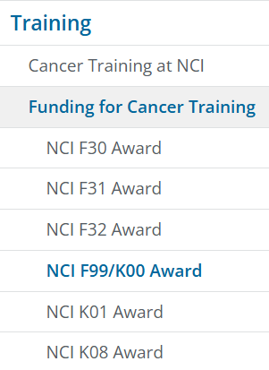
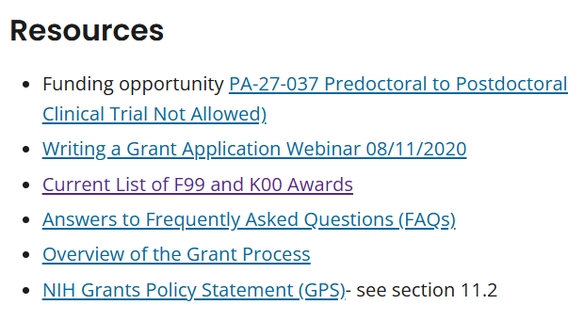
Use the NCI F99 Website and carefully read PA-27-037
NCI Predoc to Postdoc Transition Award (F99/K00)
Notes:
This slide shows a screenshot of the left navigation list on the NCI Center for Cancer Training webpage
It has a highlighted box over the NCI F99/K00 Award page link

Slide 31
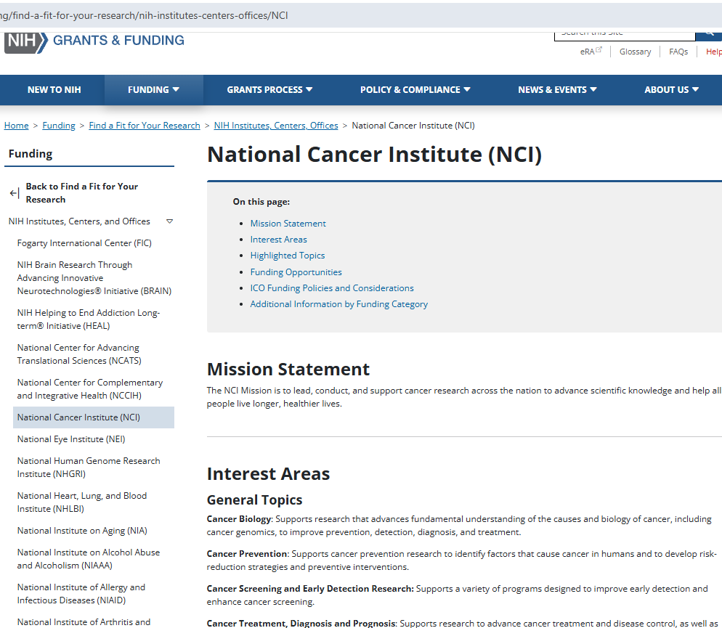
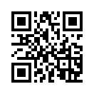
New NIH ICO Specific Pages
Visit this page for information about the NCI mission, interest areas, highlighted topics, funding opportunities, ICO funding policies and considerations, and additional information by funding category.
https://grants.nih.gov/funding/find-a-fit-for-your-research/nih-institutes-centers-offices/NCI

Slide 32
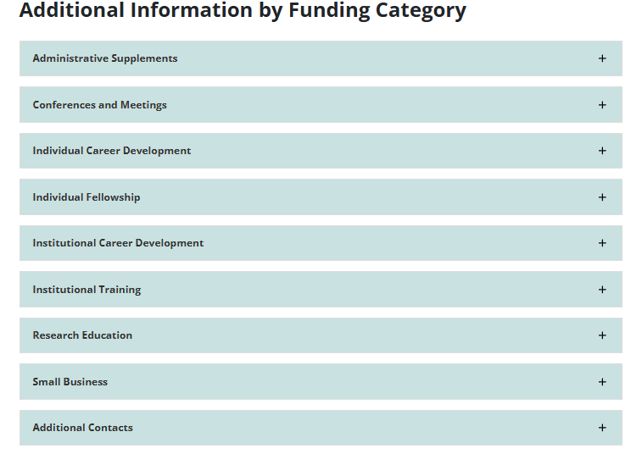
New NIH ICO Specific Pages
https://grants.nih.gov/funding/find-a-fit-for-your-research/nih-institutes-centers-offices/NCI

Slide 33
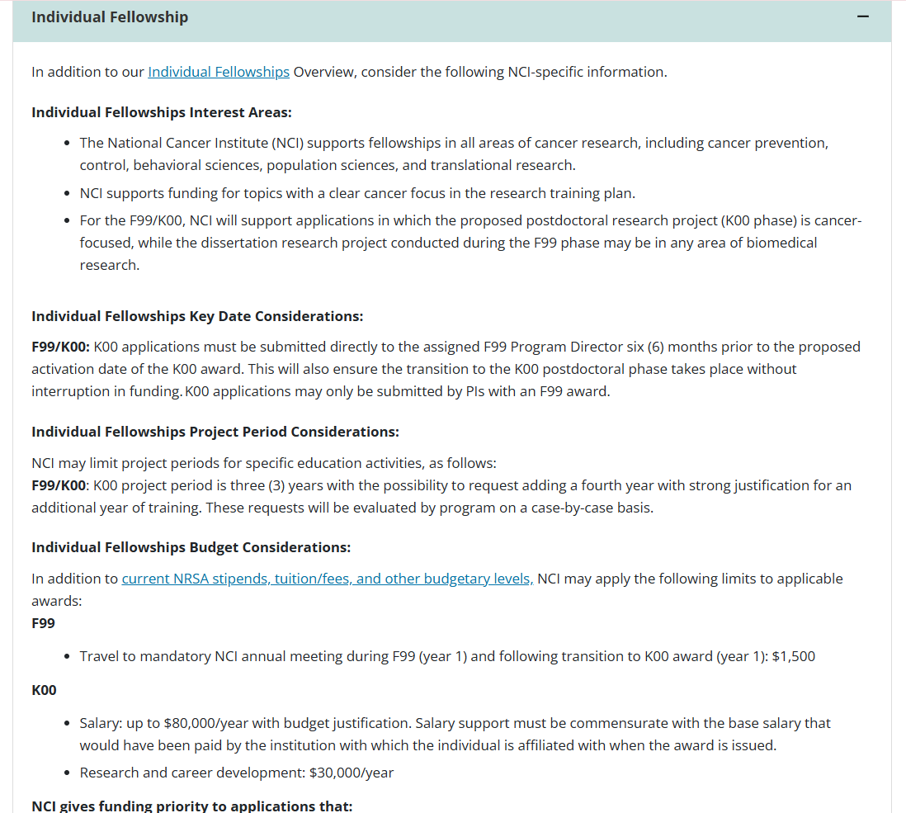

Slide 34
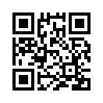
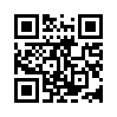
Thank you for your attention
Email: NCIF99-K00@mail.nih.gov
LinkedIn CCT Page: Train at NCI
Visit our website for more information,
and contact us
cancer.gov/CCT/Funding
Access our flyer for Cancer Training Funding Opportunities!

