Slide 1
Notice of Special Interest: Administrative Supplements to Participate in the NCI Early-Stage Surgeon Scientist Program (ESSP) Pre-Application Webinar
NOT-CA-21-100
Nas Zahir, PhD
Branch Director, Cancer Training Branch
Center for Cancer Training
NCI, NIH
September 11, 2023

Slide 2
AGENDA
1:30 pm: Welcome & Introductions (Dr. Zahir)
1:35 pm: ESSP Presentations (Drs. Zeiger & Bogler)
2:10 pm: Q&A Session (NCI Panel, moderated by Dr. Bogler)
2:30 pm: Adjourn

Slide 3

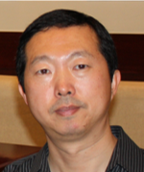
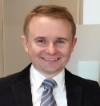
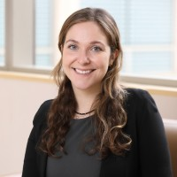

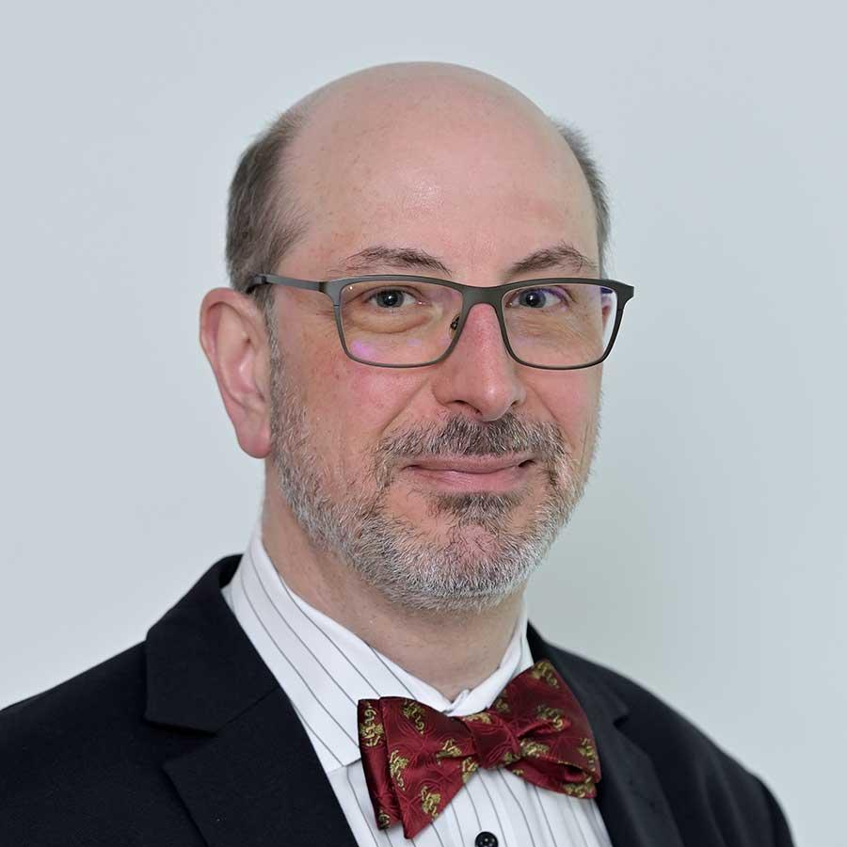
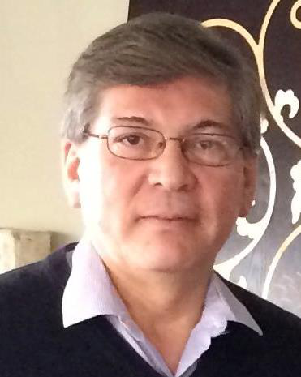

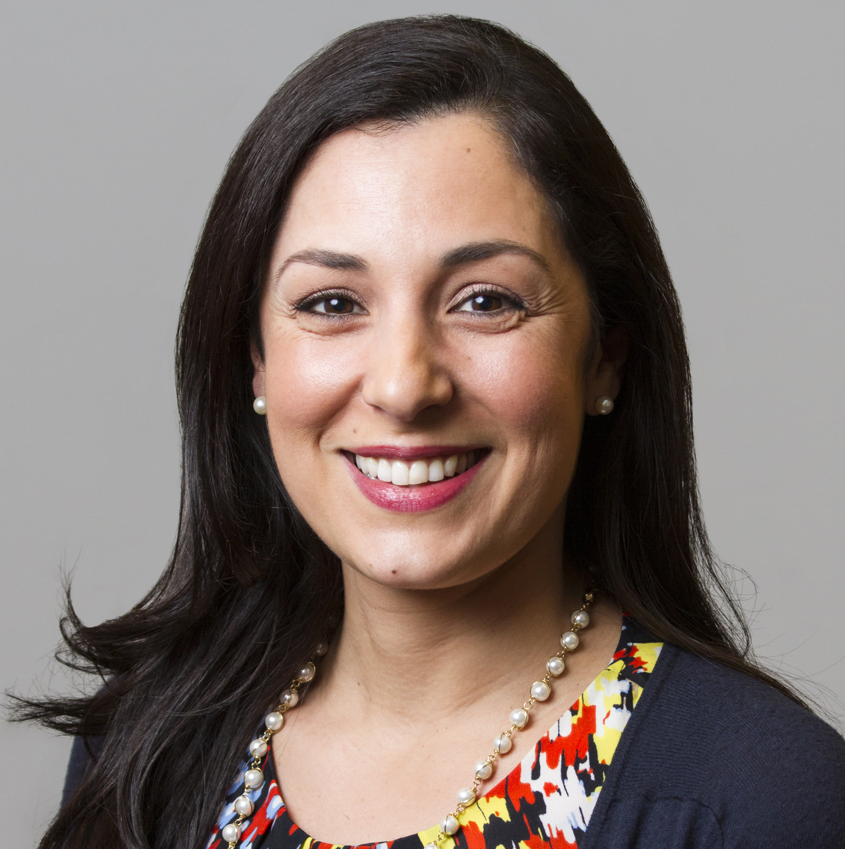
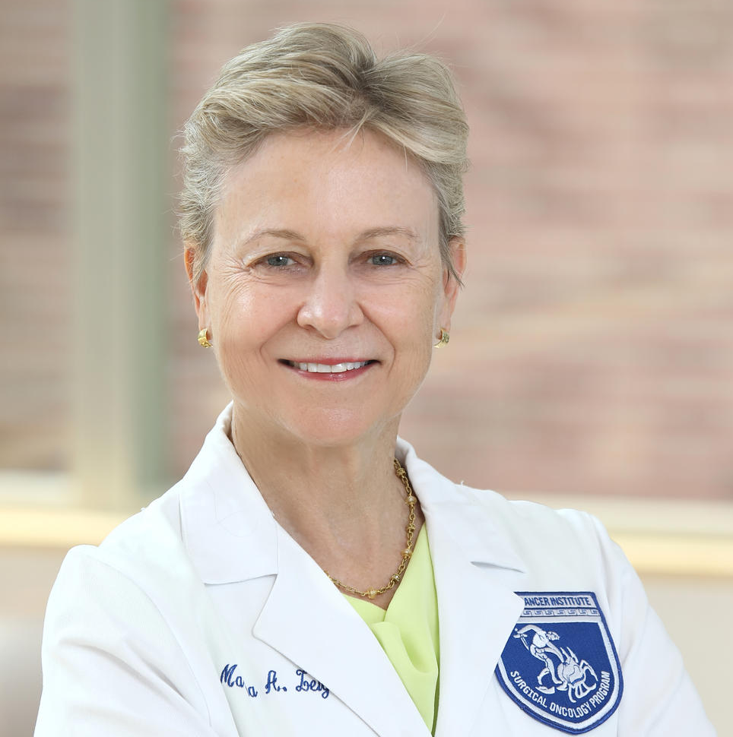
NCI Panel
Oliver Bogler, PhD
Director,
Center for Cancer Training
Yansong Bian, MD, PhD
Program Director,
Cancer Training Branch, Center for Cancer Training
Krzysztof Ptak, PhD
Associate Director,
Office of Cancer Centers
Lindsay Demblowski, BS
Scientific Educator,
Office of Surgeon-Scientist Career Development
Erika Ginsburg, MA
Branch Director, Office of Training and Education
Nelson Aguila, DVM
Deputy Director,
Center to Reduce Cancer Health Disparities
Crystal Wolfrey, BS
Director, Office of Grants Administration, Chief Grants Management Officer
Nas Zahir, PhD
Branch Director, Cancer Training Branch, Center for Cancer Training
Martha Zeiger, MD, FACS
Director, Office of Surgeon-Scientist Career Development
Notes:
Erika Ginsberg

Slide 4

Resting Slide with image of pipette

Slide 5
Notice of Special Interest: Administrative Supplements to Participate in the NCI Early-Stage Surgeon Scientist Program (ESSP) Pre-Application Webinar
NOT-CA-21-100
Martha A. Zeiger MD, FACS
Director of Surgeon Scientist Programs
Center for Cancer Research
NCI, NIH

Slide 6
Application Due Dates: December 8, 2023
Earliest Start Dates: March 1, 2024
Expiration Date: December 9, 2023

Slide 7
Purpose
Administrative supplement funding to support and train early-stage surgeon scientists (ESSP) conducting cancer-related basic or translational research
Goal to accelerate them into an independent surgeon scientist career
Background
Physician scientists decreased from 4.7% of the workforce to 1.5% since the 1980s

Slide 8
Challenges surgeon-scientists face
Administrative responsibilities
Difficulty obtaining grant funding
Clinical productivity pressures
NIH salary caps
Hospitals & procedure-based revenue
Surgical training paradigm
Keswani, S et al; Ann Surg. 2017
Jain, MK et al; NEJM. 2019

Slide 9
Training Paradigms
Year 5
Submit K
award
Medical Oncology
3 years
2 years
Medical oncology fellowship
Internal medicine residency
Year 11 Submit K award
2 years
General surgery residency
2 years
Research fellowship
3 years
2 years
General surgery residency
2 years
Surgical oncology fellowship
Attending
Surgical Oncology

Slide 10
Training Paradigm
Surgical Oncology
Year 11 Submit K award
2 years
General surgery residency
2 years
Research fellowship
3 years
2 years
General surgery residency
2 years
Surgical oncology fellowship
Attending
NCI Early Surgeon Scientist Program (ESSP)

Slide 11
Overall ESSP
Participants from across the United States trained in cohorts in cancer-related research
Participants chosen through administrative supplement to grantee’s NCI-designated Cancer Center Core Grant (P30) or Comprehensive Partnerships to Advance Cancer Health Equity (CPACHE; U54)
Intramural surgeon scientists [physician early investigator (PEI)] may also apply to participate in the program; administrative supplement of intramural PEI base budget
Exposure to content experts from academic medical centers, the NCI and NIH
Timelines and milestones proposed by participants: 1) manuscript submissions, 2) grant proposal submissions and obtaining additional funding, 3) national presentations, and 4) progress reports
Annual surveys from participants and mentors conducted to improve program organization, educational sessions, and outcome metrics

Slide 12
NCI ESSP Structure
5-year pilot program will support a total of 36 early-career surgeon scientists total 12/yr. Intramural surgeon scientists also eligible
Each in a 3-year program of three cohorts of 12 investigators/cohort, staggered a year apart
Semi-annual symposia: grant writing seminars, content area mentoring, scientific methods, professional development curricula and, more
Funding per ESSP Participant
up to $125,000 in direct costs annually to cover 6 calendar months (50%) effort and other allowable costs including $2000 travel and support for research training activities
total cost approximately $195K (estimating F&A rate at 55%)

Slide 13
Diversity, Equity and Inclusion
American College of Surgeons
Association of Women Surgeons
Indian American Surgical Association
Society of Black Academic Surgeons
Society of Asian Academic Surgeons
Others
Diversity, equity and inclusion will be a factor in recruiting mentors for the ESSP participants to ensure that the ESSP community reflects these values.

Slide 14
ESSP Participant Milestones
Second and third years of funding dependent on achieving sufficient progress towards milestones: eg. 1) acceptance of abstract at a society meeting or, manuscript submission; 2) submission of an NIH grant application; 3) submission of a non-NIH grant application; 4) participation in all professional development sessions offered by the ESSP
Intramural Physician-Scientist Early Investigators expected to submit an internal NIH proposal and a non-NIH grant.

Slide 15
Evaluation Metrics
Program evaluated annually for outcomes, through participant surveys, exit interviews of participants graduating from the program, academic activity of participants and alumni

Slide 16
Eligibility and Eligible Institutions
Active NCI P30 Cancer Center or CPACHE U54 Center ISUPS awardees are eligible (ISUPS: Institutions Serving Underserved health disparity Populations and underrepresented Students)
Not Eligible
Centers which will enter an extension year during the fiscal year in which award would be made

Slide 17
ESSP Participant Candidate Requirements
U.S.-licensed surgeon scientist with active surgical duties at an NCI-designated Cancer Center (P30), an ISUPS funded by a CPACHE U54 or, Physician Early Investigator at NIH
Within the first 3 years of academic or PEI appointment and must conduct research on cancer-related science
Must commit a minimum of 6 person-months (50% full-time professional effort) to the ESSP award
Current and/or former PDs/PIs on any NIH awards are not eligible ESSP Participant candidates, with the following exceptions: PD/PIs of NIH Fellowships, PD/PIs of Loan Repayment Program (LRP) awards, and individuals appointed to institutional T programs (eg.T32 or F32)

Slide 18
Nomination
The ESSP Participant candidate must be nominated by the Center Director [Principal Investigator (PI) of the P30 CCSG or PI of the U54 CPACHE] based on the candidate’s qualifications, interests, accomplishments, and plans to pursue a career as a surgeon scientist with a focus on cancer-related basic or translational research.

Slide 19
Number of Applications
Only one submission per year per NCI-designated Cancer Center made through the PI of the P30 is permitted (consortium centers may submit only one application) and one submission per year per CPACHE program made through the PI of the U54 is permitted.
The NCI-designated Cancer Center must apply for a P30 administrative supplement; the CPACHE ISUPS must apply for a U54 administrative supplement.
Only one submission per intramural NIH Branch each year

Slide 20
Allowable costs
Salary of the ESSP Participant candidate must commit a minimum of 6 person months (50%) effort
Support for research personnel
Research consumables and career development for the ESSP Participant
Travel budget for ESSP Participant candidate only, up to $2,000 per year

Slide 21
Body of the Application
NIH Biosketches of ESSP Participant candidate and mentors
Candidate Section
Career Goals and Objectives
Coursework and Professional Development Plan
Mentor Section
Plans and Statements of Mentor and Co-mentor(s)
Specific Aims page
Research Plan
Budget

Slide 22
Letters of Support
  Letter from the Chair of Surgery or Branch Chief outlining the details of financial support and mechanisms to assure at least 50% protected time for research training and career development, candidate-specific goals, and curriculum for the ESSP Participant
  Letter from the P30 or U54 Center Director
  Letter from mentor(s)

Slide 23
Reporting Requirements
A progress report for the ESSP supplement must be included as a separately labeled section in the annual progress report for the P30 or U54 Center for any reporting period for which ESSP supplemental funds are received.

Slide 24
Review and Selection Process
NCI will conduct administrative reviews of applications and support the most meritorious applications submitted for consideration.
ESSP Participants will be chosen based on candidate and mentor qualifications, Research Plan, and institutional research environment.

Slide 25





Resting Slide with images

Slide 26
ESSP Grant Application
Oliver Bogler, PhD
Director, Center for Cancer Training
NCI, NIH

Slide 27
Structure of ESSP - Grant Application
Specific Aims
Candidate Section
Research Strategy
Significance
Innovation
Approach
Goals for Career Development
Mentor Section
1 page
5 pages
2-5 pages
5 pages
https://grants.nih.gov/grants/how-to-apply-application-guide/format-and-write/page-limits.htm#car

Slide 28
Structure of ESSP - Grant Application
Specific Aims
Candidate Section
Research Strategy
Significance
Innovation
Approach
Goals for Career Development
Mentor Section
The most important page in the grant – the only page that non-assigned reviewers may read
Written for a scientist
Uses short declarative sentences
Does not include jargon
Clearly states the hypothesis
Ensures that the aims test the hypothesis
Is not be technology driven
Elements are interdependent, not dependent

Slide 29
Structure of ESSP - Grant Application
Specific Aims
Candidate Section
Research Strategy
Significance
Innovation
Approach
Goals for Career Development
Mentor Section
Has one to two paragraphs of introduction
Funnels concept to the hypothesis
“Sprinkles in” a little preliminary data
Clearly states the hypothesis and aims
Includes rationale and/or research design
Ask yourself:
  Is the hypothesis functional (mechanistic) or descriptive?
  Do the aims test the hypothesis?
  Is the project doable within the funding timeframe (overly ambitious)?

Slide 30
Structure of ESSP - Grant Application
Tell the story of your training path, and goals
Focus on the “why” not the “what” you did
Include information not in biosketch
Put your best self forward
Prepare a “Training Program”
  Select mentors and/or an advisory committee
  Self identify deficiencies in your training & address with workshops and courses
  Use the grant to augment your training
  Indicate how the grant will maximize your chances of becoming an independent investigator
Specific Aims
Candidate Section
Research Strategy
Significance
Innovation
Approach
Goals for Career Development
Mentor Section

Slide 31
Structure of ESSP - Grant Application
Mentor and all co-mentors
Demonstrate sufficient independent research support
State that there is support for candidate to commit 6 person-months effort to ESSP
Describe experience conducting research program and supervising research
Include plans for mentoring and supervision
Include plan for monitoring candidate’s progress towards independence
Specific Aims
Candidate Section
Research Strategy
Significance
Innovation
Approach
Goals for Career Development
Mentor Section

Slide 32
Structure of ESSP - Grant Application
Specific Aims
Candidate Section
Research Strategy
Significance
Innovation
Approach
Goals for Career Development
Mentor Section
Is not a literature review
Leads the reader to the hypothesis
Demonstrates the “conversation” in the field
Demonstrates a critical question is being asked and (hopefully) answered
Focuses everything on the hypothesis

Slide 33
Structure of ESSP - Grant Application
Demonstrates ability to perform work
Shows PI’s contribution to work
Shows feasibility of experiments
Can be structured relative to each aim
Must be “doable” in requested period of funding
If studies are an extension of current project, can you take the work with you?
Is hypothesis-based, not tech driven
Is innovative and feasible - if very innovative, MUST have preliminary data to show it is feasible
Is NOT descriptive or a “fishing expedition”
Is FOCUSED and not a multi-aim proposal to conquer the world
Includes controls
Includes a section on statistics
Discusses potential pitfalls and proposes alternatives
Specific Aims
Candidate Section
Research Strategy
Significance
Innovation
Approach
Goals for Career Development
Mentor Section

Slide 34
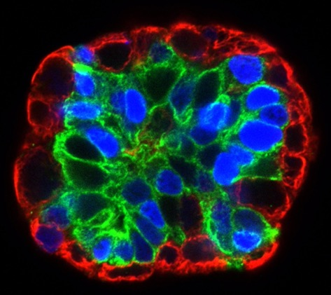
Flaws that are often Fatal
Big Picture
Lacks relevant significance
Not innovative
Not hypothesis-driven
Poorly written
Experimental Approach
Overly ambitious …
… Too narrow
Dependence of one aim on another
Lacks preliminary data & demonstrated reagents
Lacks sufficient detail and statistical analyses
Lacks anticipated results and alternative strategies

Slide 35
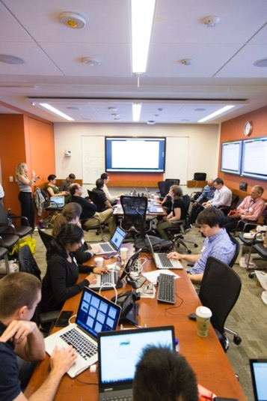
Other Factors to Consider
Are the research facilities, resources (e.g. equipment, laboratory space, reagents), and training opportunities adequate and appropriate?
Is the institutional environment for the scientific development of the fellow high quality?
Is there appropriate institutional commitment to fostering the fellow’s training as an independent and productive researcher?
Are the mentor(s) research qualifications (including successful competition for research support) and mentoring track record appropriate for the proposed fellowship?
Is there
  evidence of a match between the research interests of the applicant fellow and the mentor (including an understanding of the applicant’s research training needs) and
  a demonstrated ability and commitment of the mentor to assist in meeting these needs

Slide 36
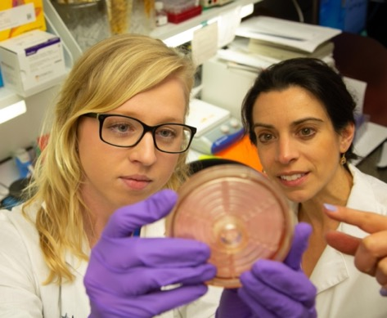
Common Issues that Limit Enthusiasm from Reviewers
Training plan is too generic:
If you can put someone else’s name in the training plan then it is not specific to the applicant
The more detail the better (who, what, where, when)
Reference letters not glowing:
Hint: All letters need to be "outstanding”
Strategize with your sponsor concerning letters
Ask people who know you, know your work and who are positive people and good writers

Slide 37
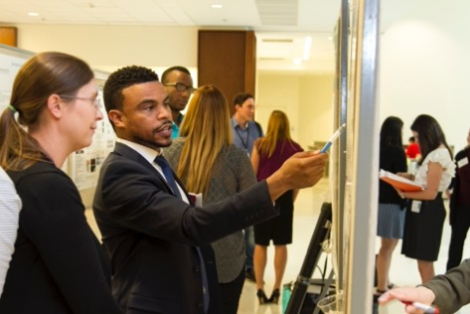
Thoughts on Review
Reviewers will be internal NCI & NIH surgeon scientists and program directors
Appreciate that they are busy people with full time jobs
Be considerate of their time
Make their job as easy as possible with clarity, clear language, good structure e.g. sub-headings, etc
Provide them the information they need for writing their review

Slide 38
Scientific/Research Contacts
For Cancer Centers:
The Program Director for the P30 CCSG Award, NCI
Telephone: 240-276-5000
For CPACHE Centers:
The Program Director for the U54 CPACHE Award, NCI
Telephone: 240-276-6170
For General Inquiries:
ESSP Program Officer, NCI
Email: ncicct@nih.gov

Slide 39
Financial/Grants Management Contact
Crystal Wolfrey
Office of Grants Administration (OGA), NCI
Telephone: 240-276-6277; email: crystal.wolfrey@nih.gov

Slide 40
Questions?

