Slide 1
TRAnslational research in Clinical Oncology (TRACO)

Slide 2
Program Director
Terry W. Moody, Ph.D.
(240)276-7785
9609 Medical Ctr. Dr., Rm. 2W134
moodyt@mail.nih.gov

Slide 3
Organizing Committee
    Irwin Arias
    Oliver Bogler
    Terry Moody
    Lyuba Vartikovski
    Farah Zia

Slide 4
SYLLABUS
DATE TOPIC
SPEAKERS
Sept. 3 Introduction, Immune checkpoints Moody, Goff
Sept. 9 HIV, Cervical Cancer Maldarelli, Schiller
Sept. 16 Epigenetics, Cancer global health
Verma, Gopal
Sept. 23 Clinical Trials, Cancer microbiota
Smith, Greten
Sept. 30 Small Molecules, Health disparities
Simeonov, Ambs

Slide 5
SYLLABUS, continued
DATE TOPIC
SPEAKERS
Oct. 7 Ovarian cancer, Prostate cancer Lee, Karzai
Oct. 15 Radiation oncology, Imaging
Nichols, Choyke
Oct. 21 Breast cancer, NSCLC
Zia, Szabo
Oct. 28 Genomics, Cannabinoids
Wei, Freedman
Nov. 4 Precision medicine, K-RAS Harris, Luo,

Slide 6
SYLLABUS, continued
DATE TOPIC
SPEAKERS
Nov. 12 Case reports, CAR T-cells
Olaku, Silbert
Nov. 18 Liquid biopsy, Pancreatic cancer
Ossandun, Alewine
Nov. 25 Topoisomerase, Nanotechnology
Pommier, Dobrovolskaia

Slide 7
REGISTRATION
The course is open to all interested personnel without charge. Registration is available at the NCI Web site (http://www.cancer.gov/grants-training/training/resources-trainees/courses-fellowships/translational-research-clinical-oncology). The lecture PDFs will be posted on the website after they are made 508 compliant. WEBEX chats will be taken at the end of each lecture.

Slide 8
Lecture recordings
The archived lectures will be on available on WEBEX. The 2 hour lecture for Sept. 3 will be TRACO1. The number will increase each week and the Nov. 25 lecture will be TRACO13.

Slide 9
COURSE CERTIFICATION
Registrants can obtain a course certificate upon passing a computer graded final examination.

Slide 10
Lung, colon, breast and prostate cancer account for half of the U.S. cancer mortalities.
TYPE INCIDENCE (MORTALITY)
Lung 171,900 (157,200)
Colon/Rectum 147,500 (57,100)
Breast 211,300 (39,800)
Prostate 220,900 (28,900)
Others 582,500 (273,500)
Total 1,334,100 (556,500)
Thun, Jamal and Ward, “Cancer: Principles & Practice of Oncology.” Edited by DeVita, Lawrence and Rosenberg. (2011), pp. 241-260

Slide 11
Cancers which kill 10,000-30,000 U.S. patients annually include:
Pancreatic cancer
Non-Hodgkin’s Lymphoma
Leukemia
Stomach cancer
Ovarian cancer
Brain cancer
Liver cancer
Bladder cancer
Esophageal cancer
Kidney cancer

Slide 12
Cancer risks include:
Alcohol
Asbestos
Diet
Familial
Hormones

Slide 13
Cancer risks (continued)
Obesity
Ion Radiation
Tobacco
U.V. Radiation
Viral

Slide 14
Lung Cancer kills over 150,000 patients in the U.S. annually.
There are 45 Million current smokers and 45 Million ex-smokers in the U.S.
It is difficult to quit smoking due to nicotine addiction.

Slide 15
Carcinogens which have been identified in cigarette smoke include:
Polyaeromatic hydrocarbons (PAH),
aza-arenes,
4(methylnitrosamino)-1-(3-pyridyl)-1-butanone (NNK),
1,3 butadiene,
ethyl carbamate,
ethylene oxide,
nickel, chromium, cadmium,
polonium, arsenic
hydrazine

Slide 16
The process by which unreactive carcinogen converts to a form which binds DNA is known as metabolic activation.
Bay region diol epoxides are the principal PAH metabolites involved in DNA adduct formation. For Benz[a]pyrene (BaP), BaP-7,8-diol-9,10-epoxide (BPDE) forms adducts with DNA leading to G:C>T:A mutations in pulmonary DNA. The genes for p53 and k-ras are frequently mutated.

Slide 17
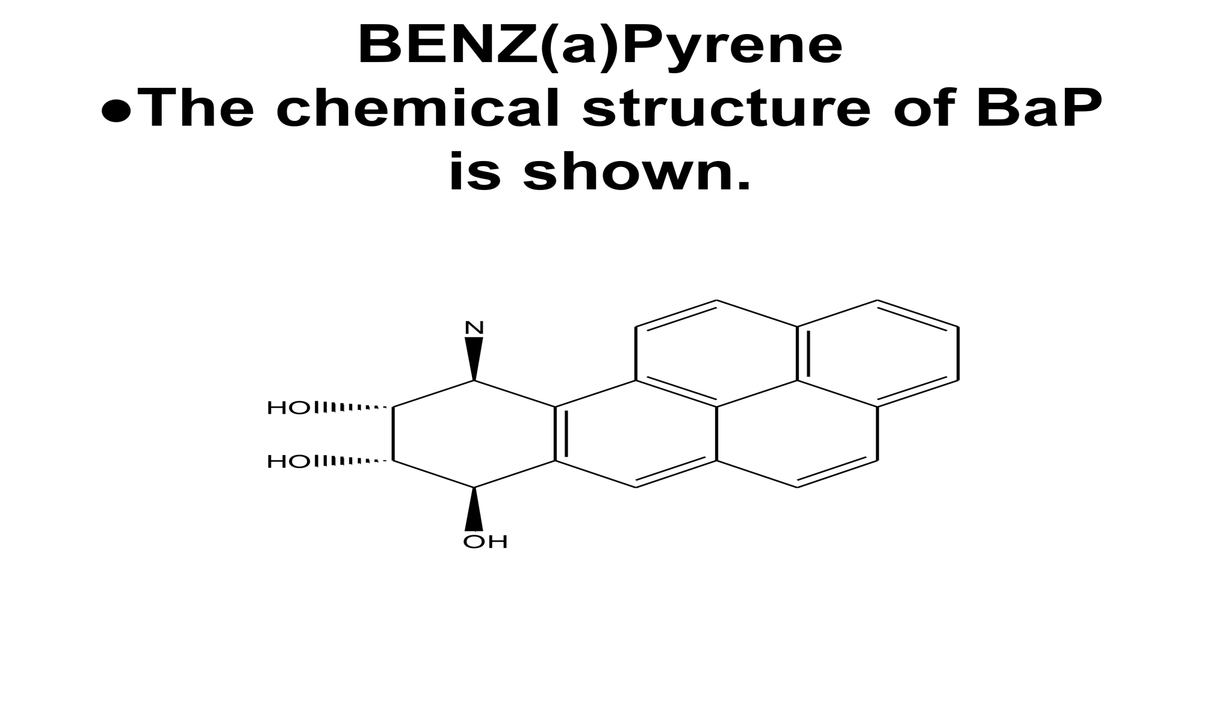
BENZ(a)Pyrene

Slide 18
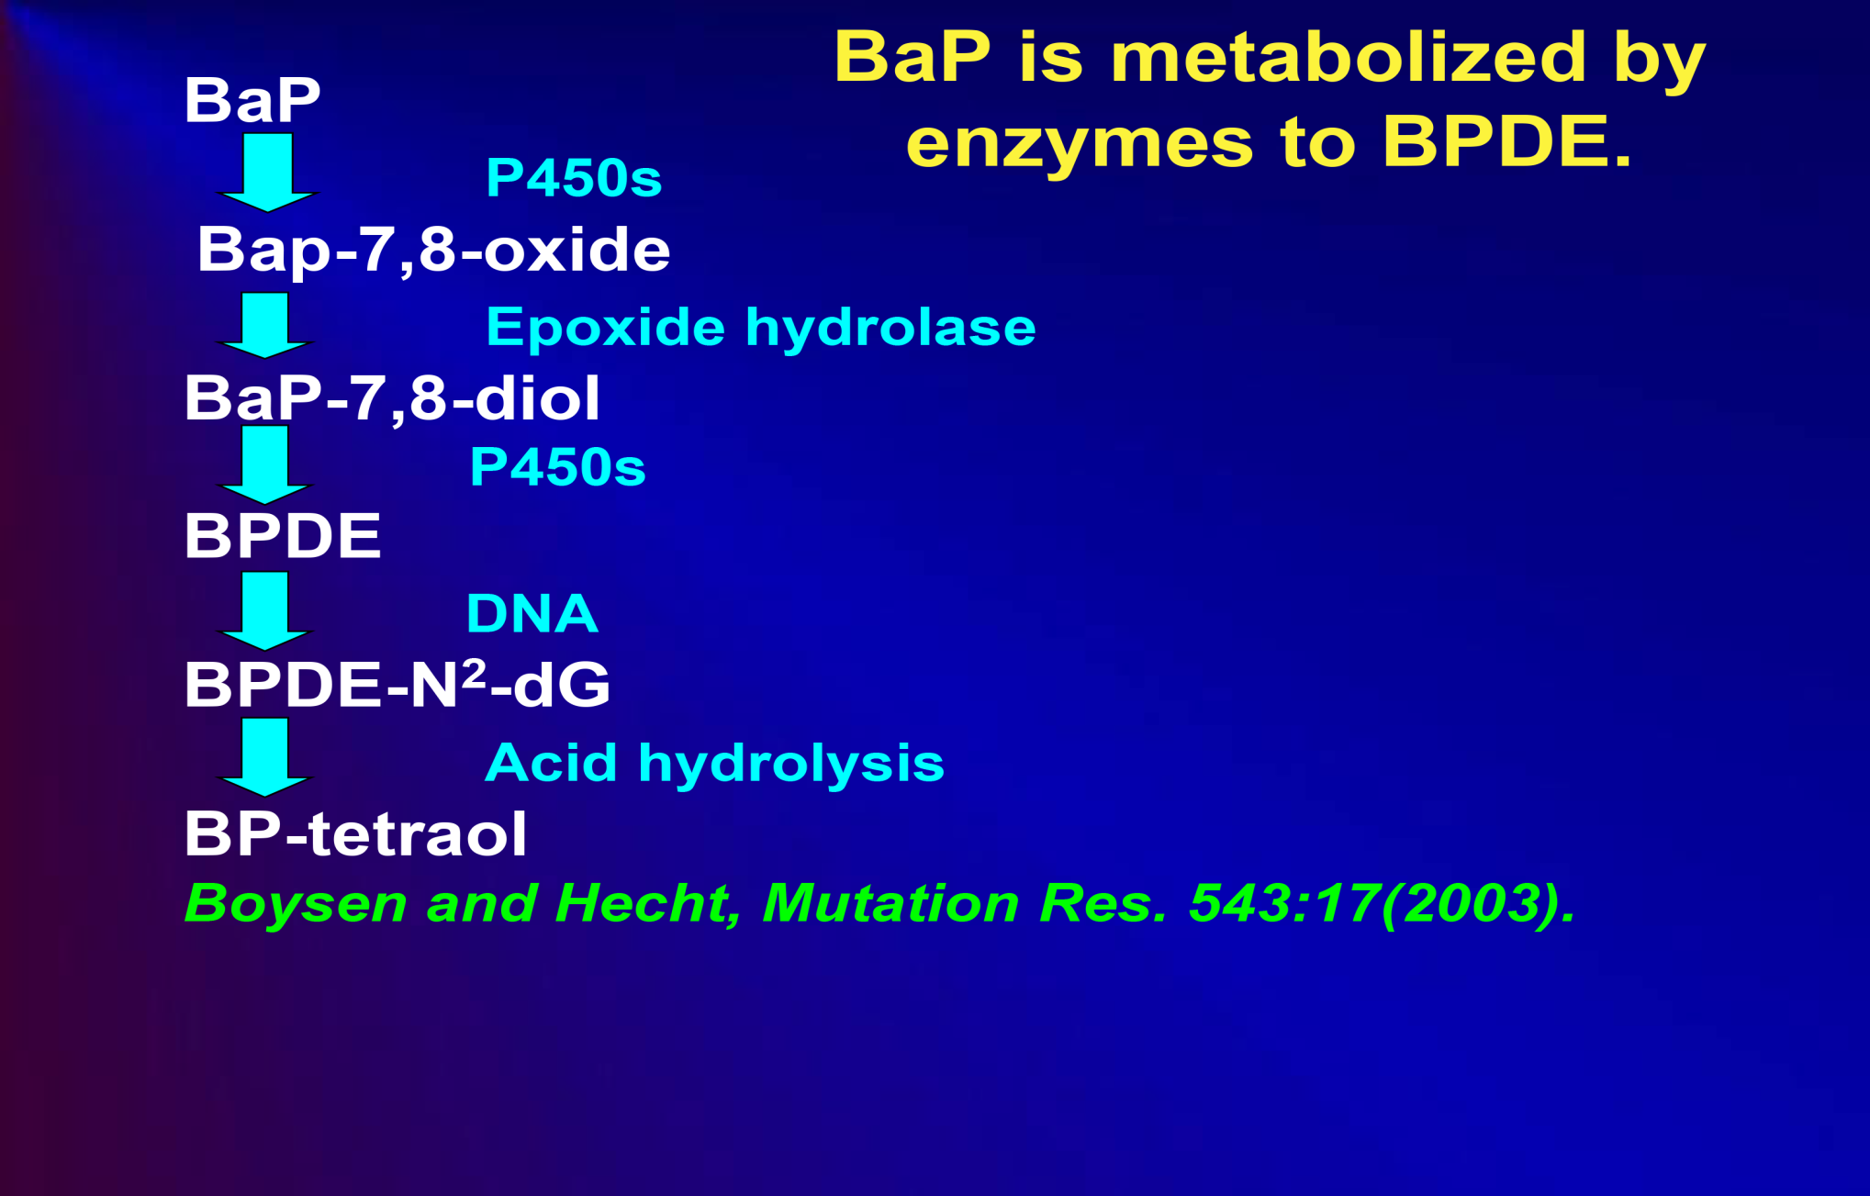
BaP is metabolized to BPDE

Slide 19
DNA is mutated if the rate of carcinogen activation exceeds the rate of carcinogen detoxification and/or DNA repair.
DNA adducts as well as intra- and
inter-strand DNA crosslinks are removed by nucleotide excision repair.

Slide 20
Carcinogens can be detoxified and excreted prior to DNA damage.
Cytochrome p450 enzymes catalyze addition
of an oxygen to the carcinogen, increasing
its water solubility.
● Phase 2 enzymes convert the oxygenated
carcinogen to a form that is highly soluble in
water, converting it to a form that can be
excreted.

Slide 21
P53, a tumor suppressor gene:
●mediates the G1 to S-phase checkpoint of the cell cycle,
●drives programmed cell death or apoptosis after DNA damage,
●is increased along with p21 (cell cycle checkpoint) after DNA damage.
● Phosphorylated p53 induces expression of BAX (apoptosis), GADD45 (DNA repair) and thrombospondin (angiogenesis)

Slide 22
P53 mutations are detected in most of the lung cancer patients.
G to T transversions occur at the CpG rich codons including 153-158 (exon 5), 248 and 249 (exon7) and 273 (exon 8) of the p53 gene. There is an excess of G to T transversions in smokers relative to non-smokers.

Slide 23
P53 mutations.
●P53 is mutated at codons 157, 158, 245, 248, 249 and 273 in lung cancer.

Slide 24
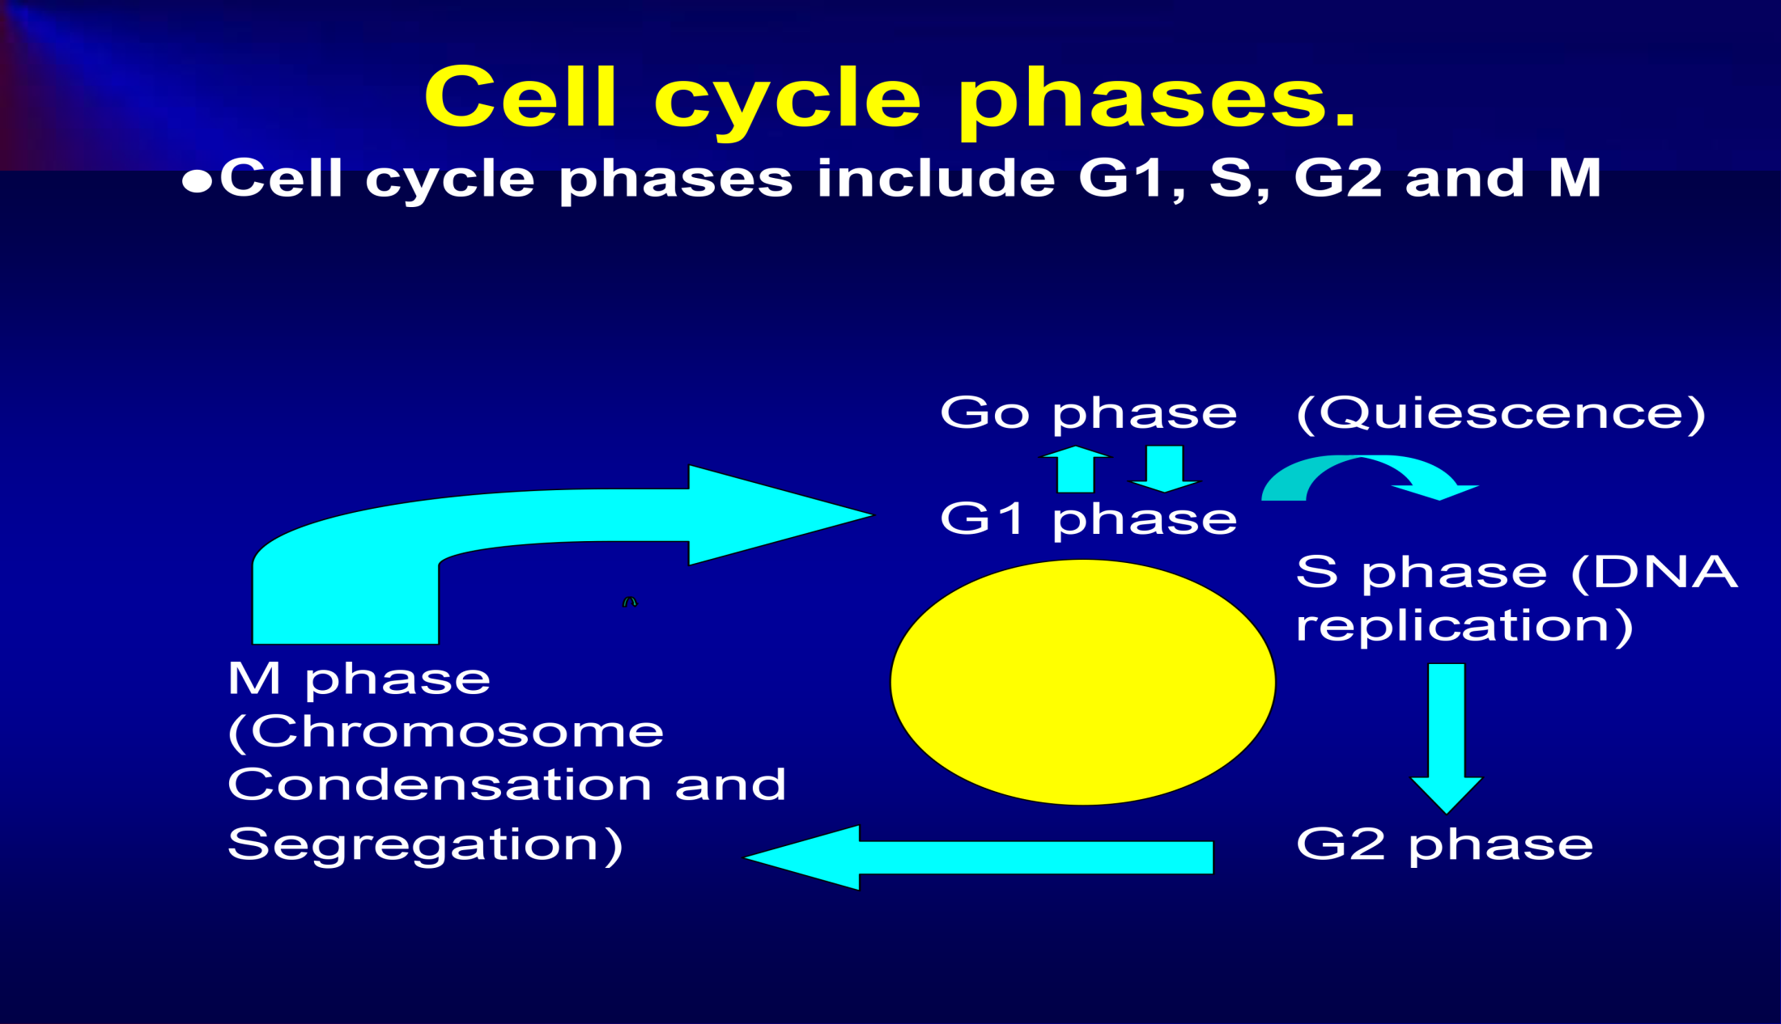
Cell cycle phases

Slide 25
p53 mediates the G₁ to S-phase checkpoint of the cell cycle
●DNA damage increases p21 and p53.
●P53 drives programmed cell death or apoptosis after DNA damage

Slide 26
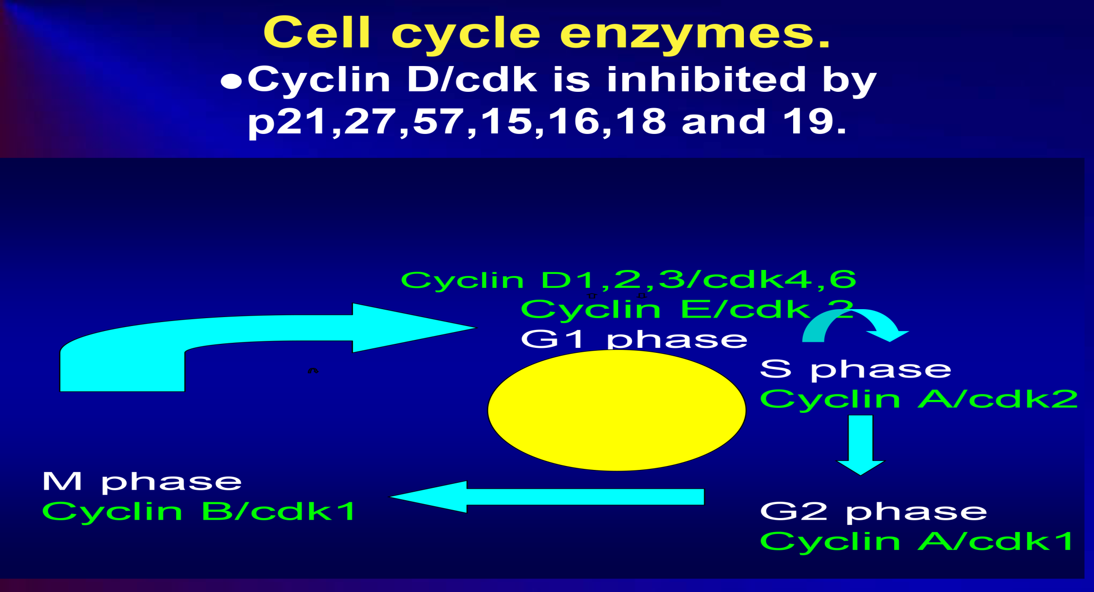
Cell cycle enzymes

Slide 27
Genotoxicity of tobacco smoke.
●After 10 years of chronic cigarette smoking, normal lung tissue can undergo hyperplasia and metaplasia.
●After 15 years, dysplasia can result.
●After 20 years, a carcinoma in situ can form.
●After 25 years, a malignant cancer can form.

Slide 28
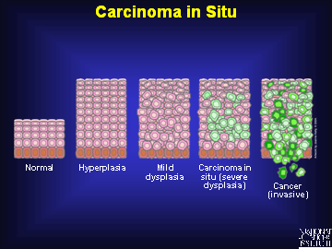
Carcinogenesis
●Cancer progression occurs over a period of decades.

Slide 29
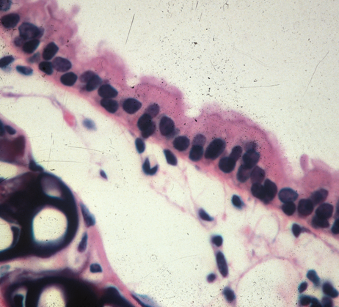
Normal lung
●Carbon dioxide is exhaled from the lung whereas oxygen is inhaled.

Slide 30
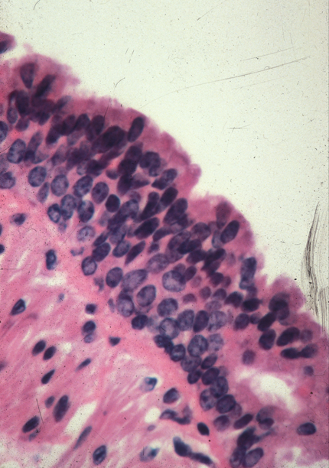
Hyperplasia
●After exposure to tobacco smoke, hyperplasia can result.

Slide 31
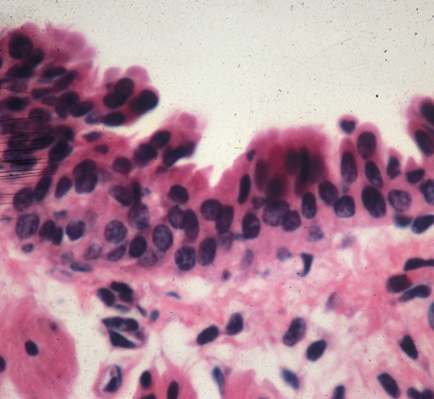
Dysplasia
Continued exposure to tobacco smoke leads to dysplasia.

Slide 32
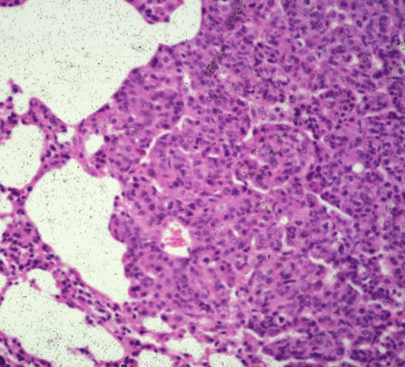
Adenoma
●Continued exposure to carcinogens leads to benign tumors such as adenomas.

Slide 33
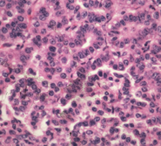
Adenocarcinoma
●Chronic exposure to tobacco leads to malignant tumors such as adenocarcinoma.

Slide 34
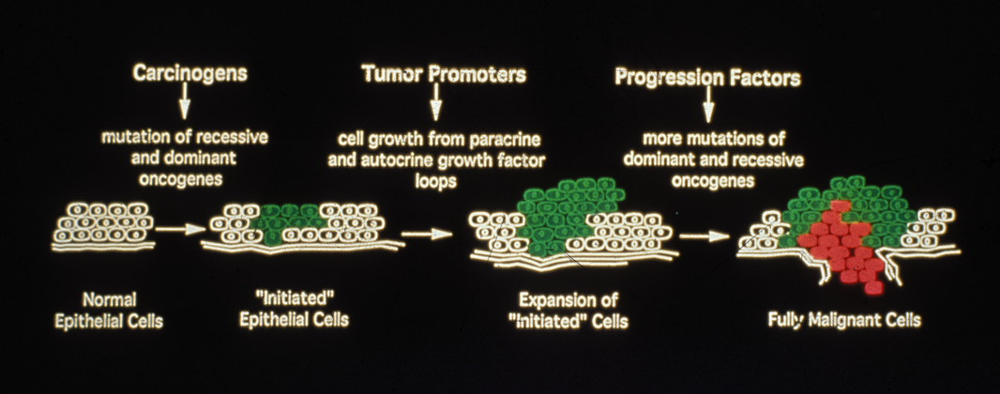
Tumor formation
●Growth factors promote carcinogenesis. Progression factors lead to malignant tumors.

Slide 35
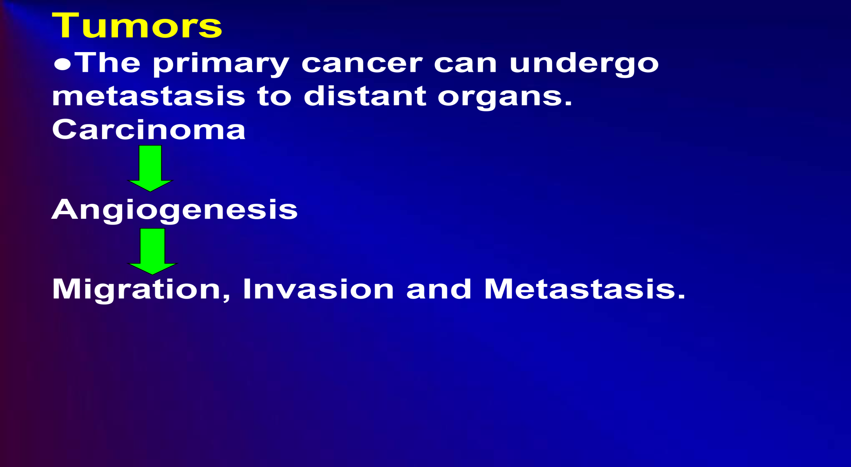
Tumor growth

Slide 36
Genetic abnormalities in lung cancer include:
Mutation of tumor suppressor genes such as p53
Silencing of tumor suppressor genes such as p16, Rb
Amplification of oncogenes such as
c-myc, cyclin D1, erbB-2
. Mutation of oncogenes such as K-ras, EGFR

Slide 37
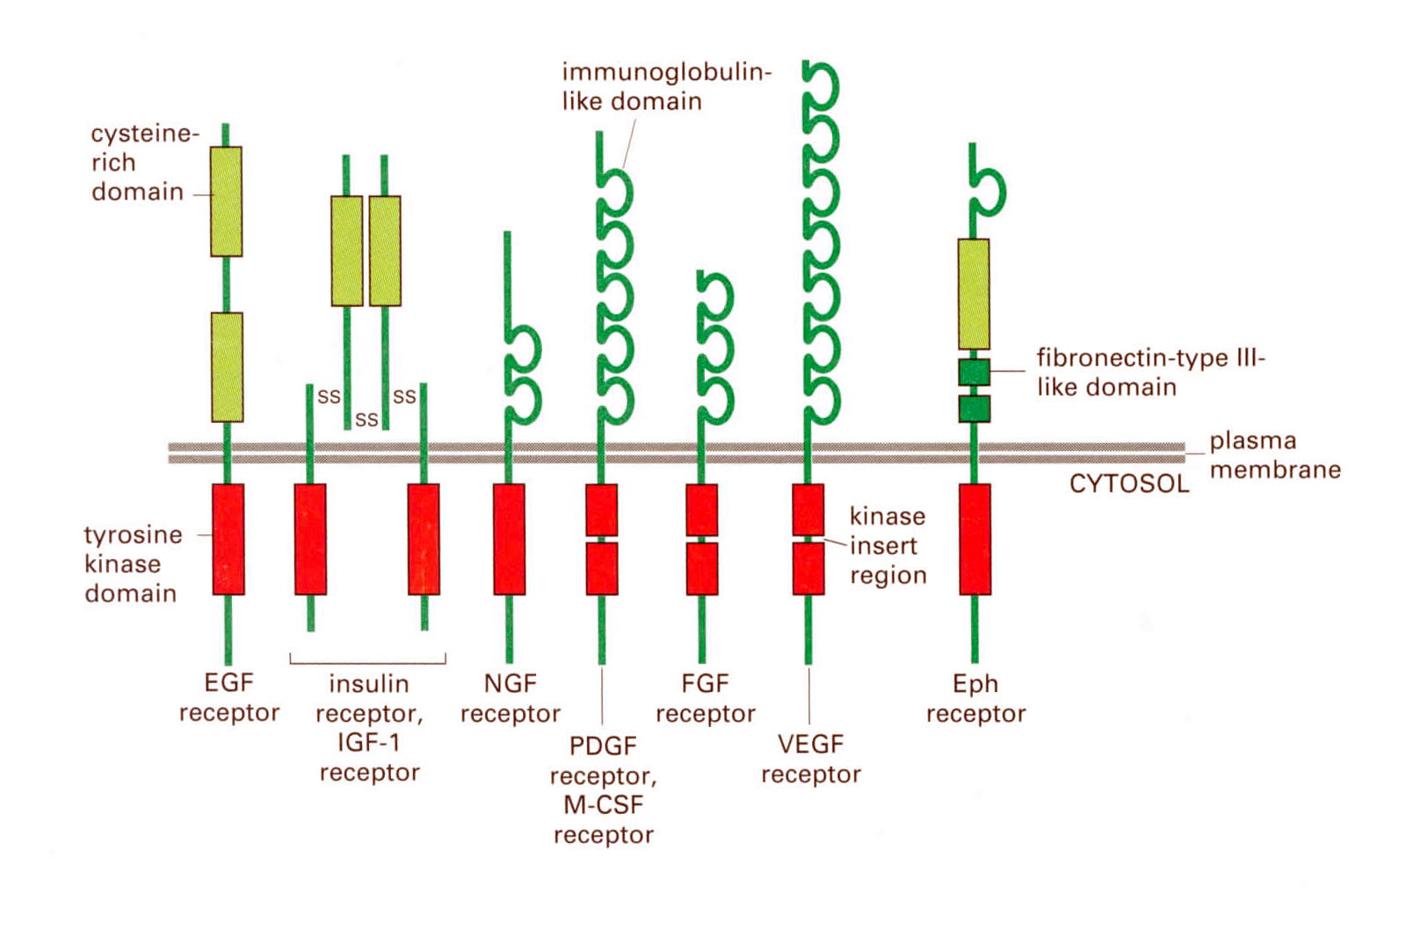
Tyrosine kinase receptors.
Molecular Biology of the Cell, Alberts et al., 2001.

Slide 38
Tyrosine kinase receptors and ligands
Notes:
38

Slide 39
The EGFR is an 1186 amino acid integral membrane protein.
●The 621 amino acid extracellular domain binds EGF with high affinity. Domains I and III form the EGF binding site whereas domains II and IV are enriched in cysteine amino acids.
●The 24 amino acid transmembrane domain anchors the receptor into the membrane and tranduces signaling.
●The 541 amino acid intracellular domain contains tyrosine kinase activity.
●Lys721 binds ATP and Tyr amino acids are subsequently phosphorylated.
●Tyr1068, 1086, 1148, 1174 are phosphorylated

Slide 40
EGF, TGFα and mAb 108 bind with high affinity to lung cancer cells.
Agent IC₅₀, ug/ml
EGF .03
TGFα .8
TGFα-PE38 .4
mAb 108 3
IgG >10
The IC₅₀ to inhibit ¹²⁵I-EGF specific binding to NCI-H157 cells was determined.
Draoui et al., Life Sci. 1994; 35:352.

Slide 41
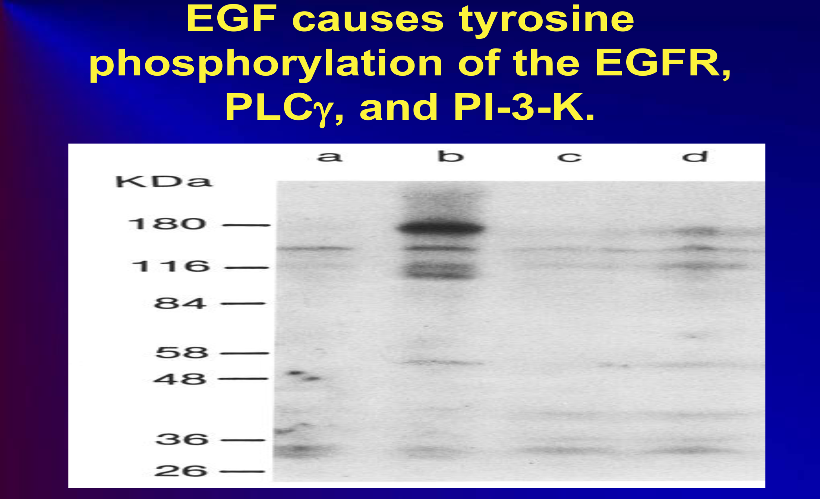
EGF tyrosine phosphorylation

Slide 42
Tyrosine kinase receptors are mutated in several diseases leading to increased cancer proliferation.
EGFR mutations occur in the activation loop, especially L858R.
Tyrosine kinase inhibitors (gefitinib and erlotinib) have been developed for the mutated EGFR.
Paez et al., Science 304:1497 (2004)
Notes:
42

Slide 43
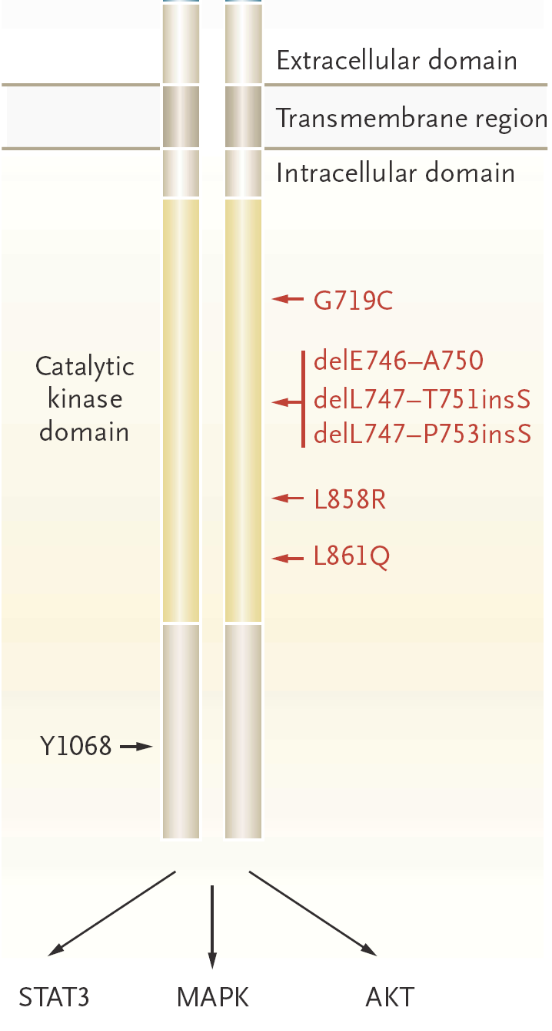
EGFR mutations
Notes:
43

Slide 44
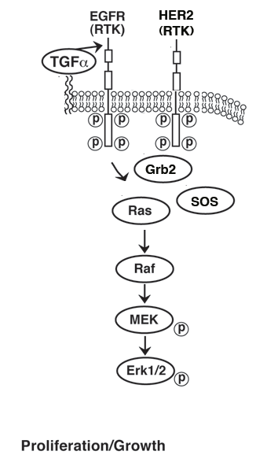
RAS, RAF, MEK and ERK
Receptor tyrosine kinases
(RTK) stimulate proliferation
Through the RAS, RAF,
MEK and ERK pathway
• In NSCLC, K-RAS is
Mutated in approximately 30%
of the patients.

Slide 45
RAS
Mutated RAS has reduced GTPase activity resulting in an abundance of biologically active RAS-GTP.
Most of the RAS mutations are G-to-T transversions in codon 12.
The FDA recently approved sotorasib (AMG510) for treatment of lung cancer patients with the KRAS G12C mutation.

Slide 46
RAF
RAF is a serine threonine kinase which activates MEK. B-RAF-V600E mutations occur in approximately 60% of melanoma patients leading to an active kinase.
PLX4032 is a kinase inhibitor which has an 81% response rate in patients with metastatic melanoma.
RAS and B-RAF are driver mutations in several types of cancer.

Slide 47
MEK
RAF phosphorylates mitogen activated protein kinase kinase (MEK) increasing its activity.
MEK1 and MEK2 are inhibited by trametinib
Dabrafenib and trametinib are used in B-RAF mutated patients.

Slide 48
ERK
•MEK1/MEK2 regulates the phosphorylation of extracellular signal-regulated kinases (ERK) 1 and 2.
•Phosphorylated ERK goes to the nucleus where it regulates expression of transcription factors such as fos, jun or myc.

Slide 49
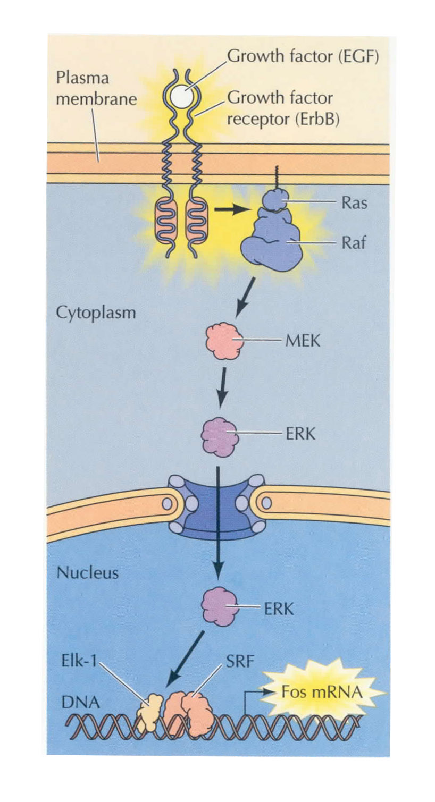
The EGFR stimulates cancer cell growth. Molecular Biology of the cell; Alberts et al., 2001.

Slide 50
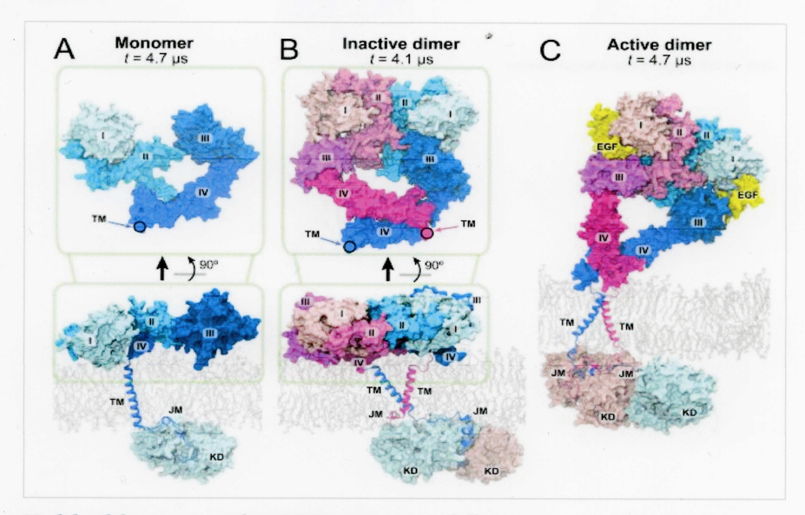
EGFR homodimerization

Slide 51
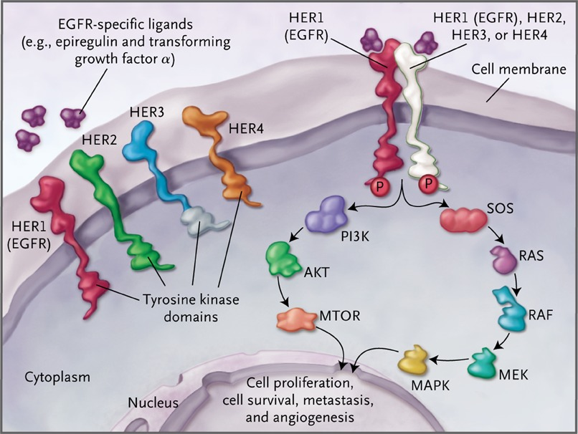
ErbB RTKs and signal transduction

Slide 52
The EGFR forms heterodimers with HER2
● HER2 lacks a ligand binding site but forms heterodimers with the EGFR, HER3 and/or HER4.
● Trastuzumab is a mAb that is used to treat breast cancer patients who overexpress HER2

Slide 53
The EGFR forms heterodimers with HER3
● HER3 binds Neuregulin-1 and -2 with high affinity.
● HER3 has weak tyrosine kinase activity and must form heterodimers with the EGFR, HER2 or HER4 to become biologically active.
● Increased expression of HER3 results in resistance to many therapeutic agents.

Slide 54
The EGFR forms heterodimers with HER4
● HER4 binds Neuregulins 1,2,3 and 4 with high affinity. It can form homodimers.
● HER4 undergoes alternative splicing and can stimulate or inhibit cancer growth.
● Neuregulin-1 HER4 interactions are altered in schizophrenia.

Slide 55
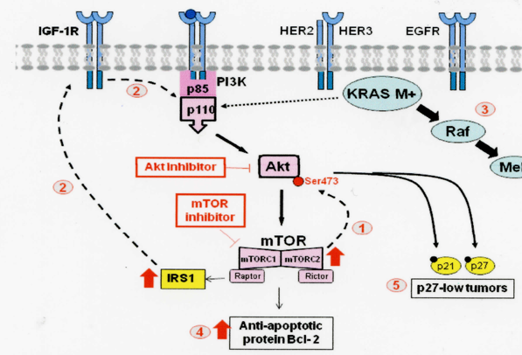
PI3K, Akt, mTOR pathways stimulate cellular survival.

Slide 56
PI3K
The phosphatidylinositol 3 kinase (PI3K) pathway promotes cancer cell survival.
The catalytic 100 kDa subunit metabolizes PIP₂ to PIP₃
PI3K is mutated in breast (25%), brain (27%), colon (30%) and stomach (25%) at E542, E545 or H1047 resulting in a gain of enzymatic activity.

Slide 57
PTEN
PI3K mutations involve chromosome 10q, which contains phosphatase and tensin homolog (PTEN).
PTEN metabolizes PIP₃ to PIP₂ leading to inhibition of AKT signaling.
PTEN is mutated in approximately 13% of breast cancer patients but loss of heterozygosity is more common.

Slide 58
Akt
AKT or protein kinase B prevents apoptosis of cells.
AKT is a serine/threonine kinase which is phosphorylated at Ser473 increasing phosphorylation of mTOR.
AKT promotes cellular survival by phosphorylating BAD and caspase-9 preventing apoptosis of cancer cells.
AKT is mutated in breast cancer (5%), colorectal cancer (6%) and ovarian cancer 2%.

Slide 59
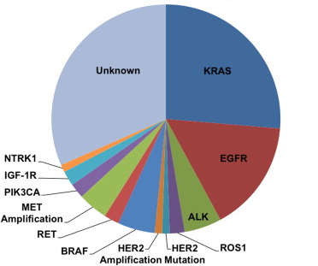
Personalizing Therapy for NSCLC Genetic Abnormalities in Lung Adenocarcinoma
-

Slide 60
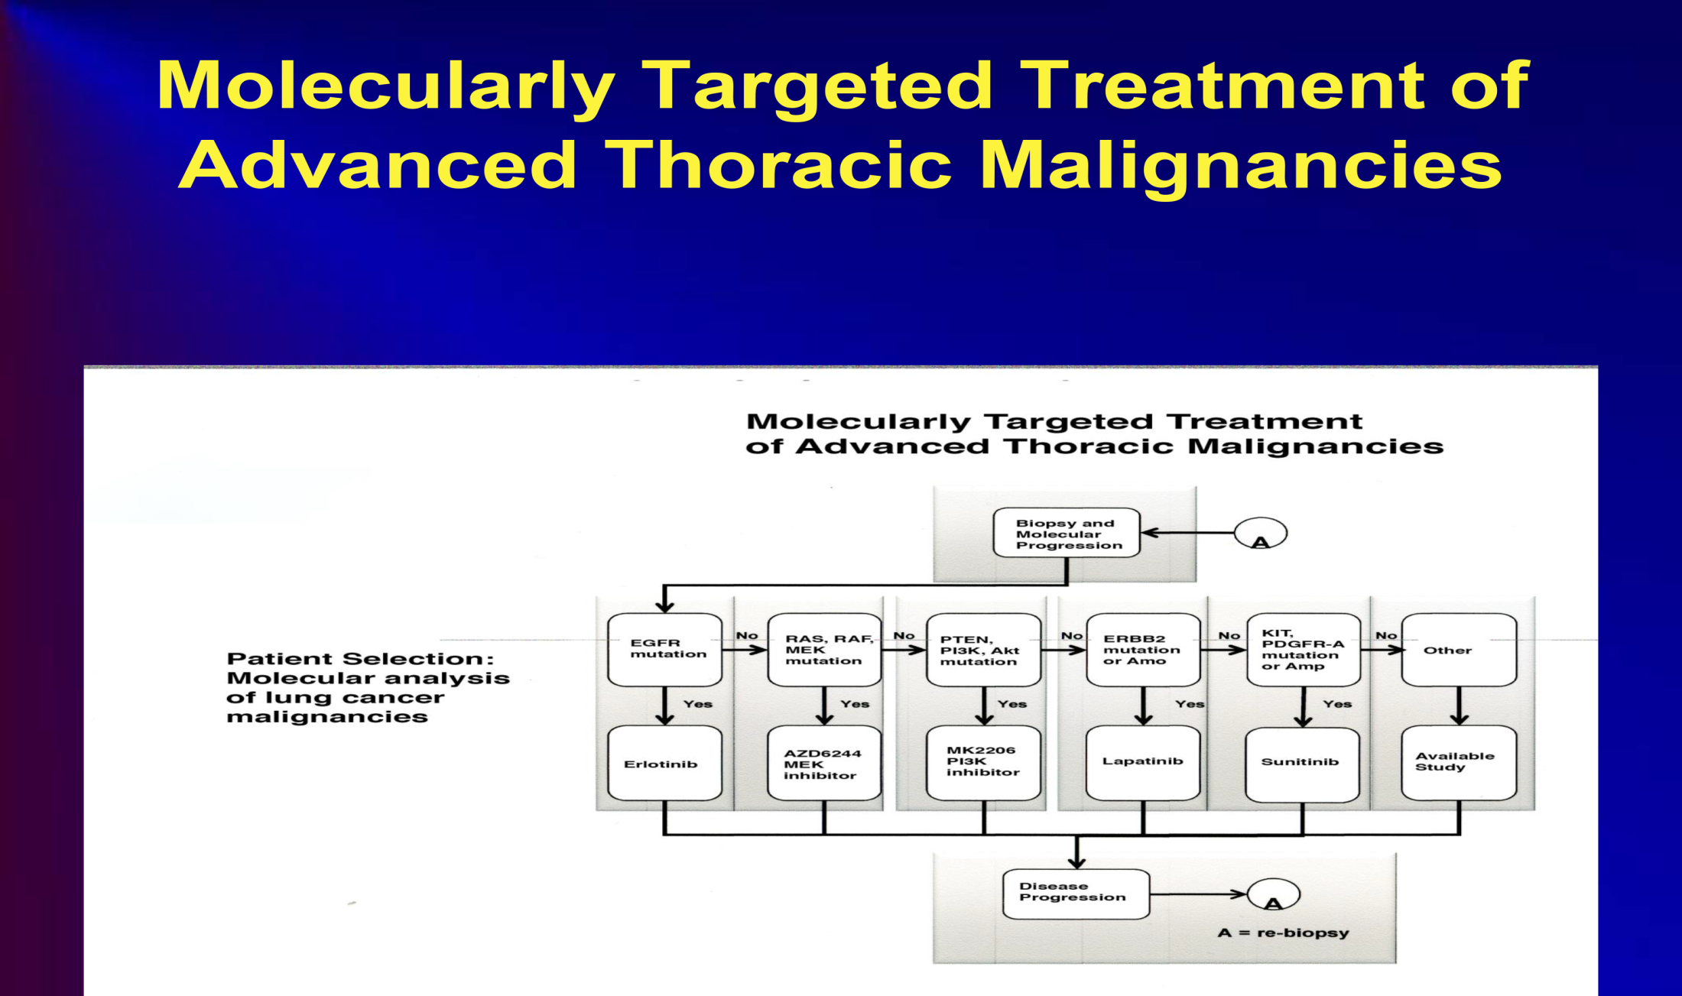
Molecular medicine

Slide 61
Erlotinib/gefitinib resistance
NSCLC patients with L858R EGFR mutations develop resistance to erlotinib/gefitinib after 1 year due to a secondary mutations.
Aproximately 50% of the patients develop T790M mutations which can be treated with Osimertinib.

Slide 62
Secondary mutations in NSCLC
Westover et al., Ann Oncol. 2018

Slide 63
RTK TKIs
1st generation TKI (reversible)
Gefitinib, Erlotinib
2nd generation TKI (irreversible)
Afatinib
3rd generation TKI (irreversible)
Osimertinib

Slide 64
Osimertinib improves overall survival in EGFR T790M patients
Mok et al., N Engl. J Med 2017

Slide 65
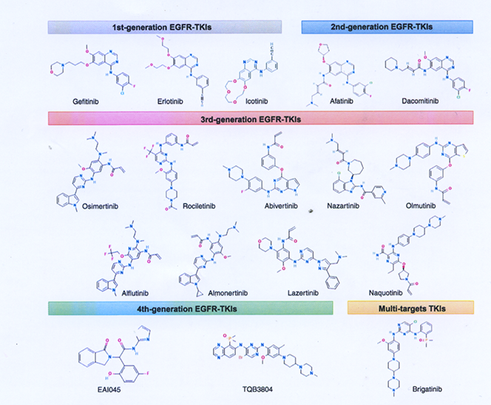
EGFR TKI structures

Slide 66
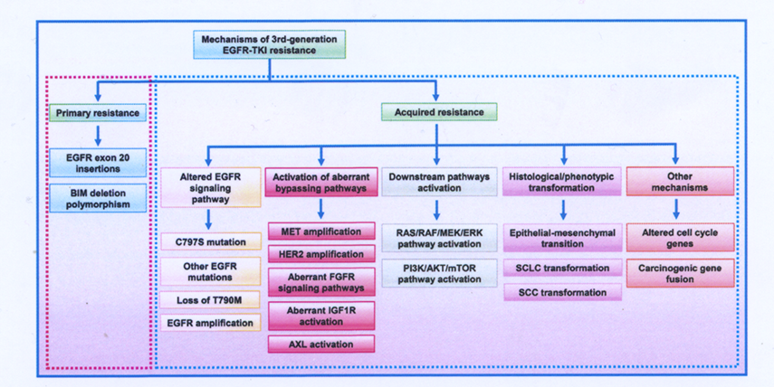
TKI resistance trial
He J. et al.,Int J Oncol 2021; 53:90

Slide 67
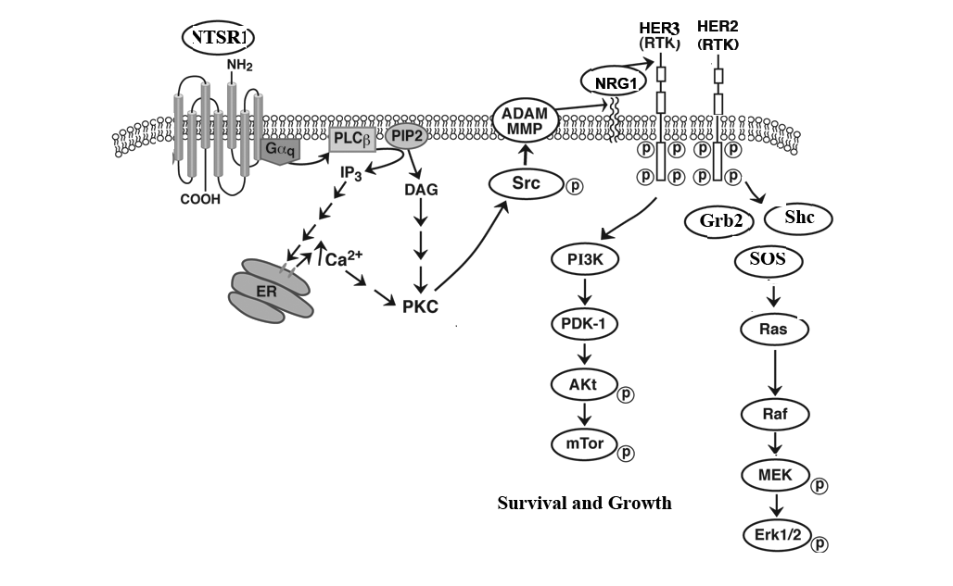
RTK transactivation.
Activation of GPCRs leads to tyrosine phosphorylation of RTK

Slide 68
Immune checkpoint inhibitors such as pembrolizumab increase overall survival in patients with PD-L1

Slide 69
PRACTICAL STEPS TO PREVENT CANCER
●Check your house for radon.
●Check your house for asbestos.
●Take precautions at your workplace.
●Check your community water system.
●Avoid breathing polluted air.
●Protect your skin.
●Don’t breathe smoke.
●Exercise daily.

Slide 70
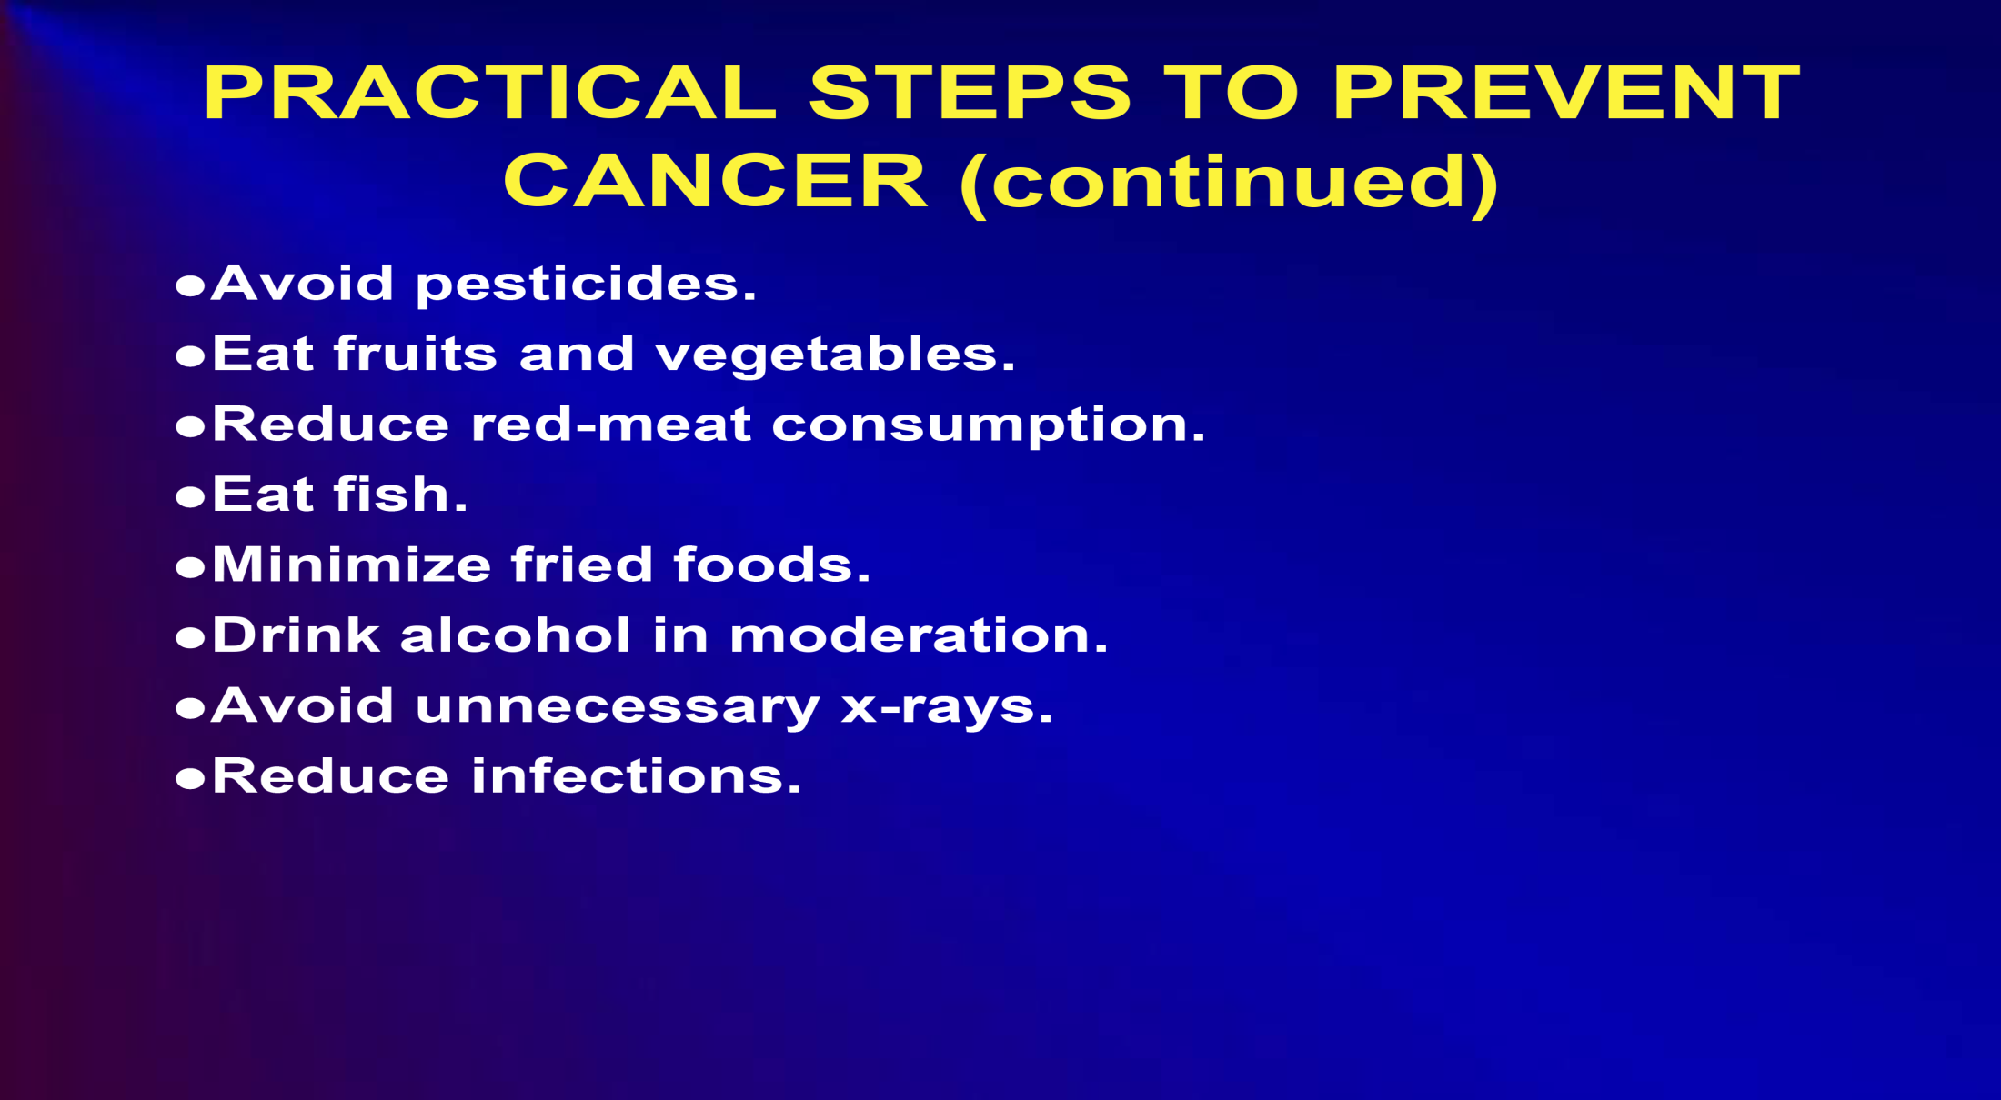
Cancer prevention

Slide 71
REFERENCES
●Thai AA, Solomon BJ, Sequist LV, Gainor JF, Heist, RS. Lung cancer. Lancet, 2021. PMID 34273294.
Westover D, Zugazagoitia, J, Cho BC, ●Lovely CM, Paz-Ares L. Mechanisms of acquired resistance to first-and second-generation EGFR tyrosine kinase inhibitors. Ann Oncology 2018; 29: 110-119.

